Slide 1
Findings from the 100% eCook study
Monday 19th June 2023

Slide 2
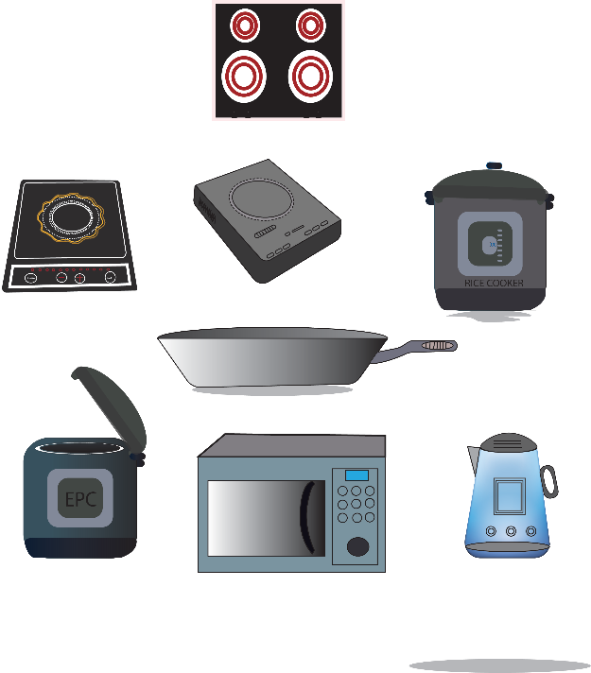
Aim and Objectives
Understand the energy implications of cooking entirely with electricity:
Energy requirements, energy savings, cost implications, dish compatibility, user experience, barriers, difficulties
Supporting policy making
Evidence of energy use for carbon credit market
Device supply chain: supporting manufacturers to understand the appliances consumers want
100%
transition
Application

Slide 3
Summary of key findings
Energy requirements varied – Nepal average 60 kWh, CREEC 40 kWh, but cost savings evident (50% for CREEC)
People want to cook concurrently, reluctance to cook consecutively in EPC
2+ electric cookers means you don’t have to stack, if electricity reliable…
Barriers: unstable electricity supply, EPCs too small for bigger families, upfront costs
Notes:
People used the electric cookers at the same time, to save time, as you’d imagine…
So if people only have one electric cooker, they will fuel stack with LPG or biomass
Reluctance expressed to cook consecutively in an EPC, which is important for our work… one dish per meal… double dish cooking?
…

Slide 4
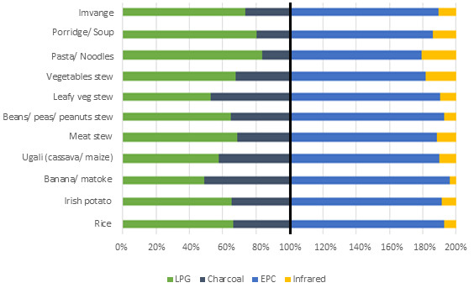
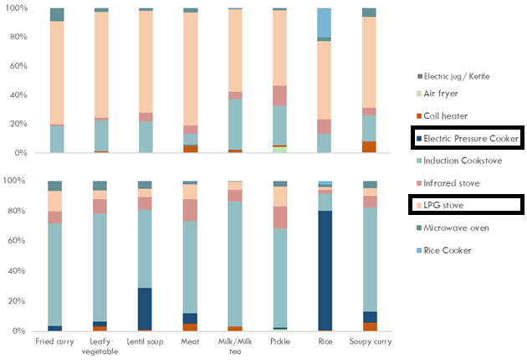
Key Findings
Transitioning to eCooking did not generally change existing cooking practices in all countries.
The cooking diaries showed acceptable power supply reliability to sustain eCooking in most countries. Also, electricity provides a clean stacking cooking solution.
There was widespread perception that electricity is too expensive for cooking.
Different eCooking appliances are better preferred for some cooking processes than others.
Electric cooking data aggregated across multiple households showed daily evening cooking peak coinciding with peak demand for power utilities (and minigrids).
Number of cooked dishes by cooking solution (%) in Rwanda (above) and Nepal (right)

Slide 5
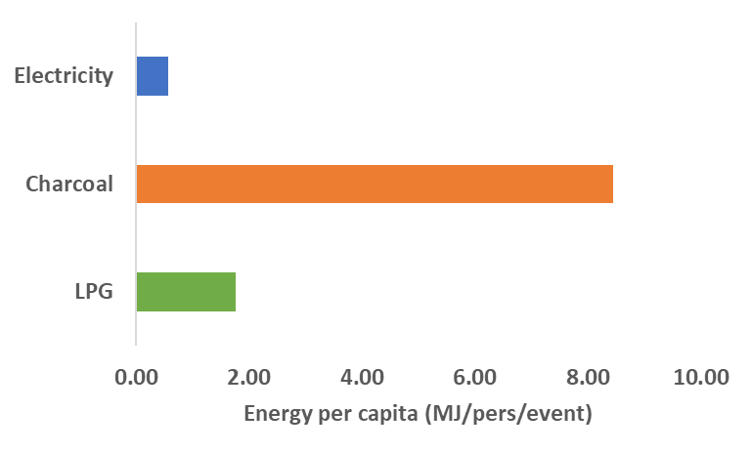
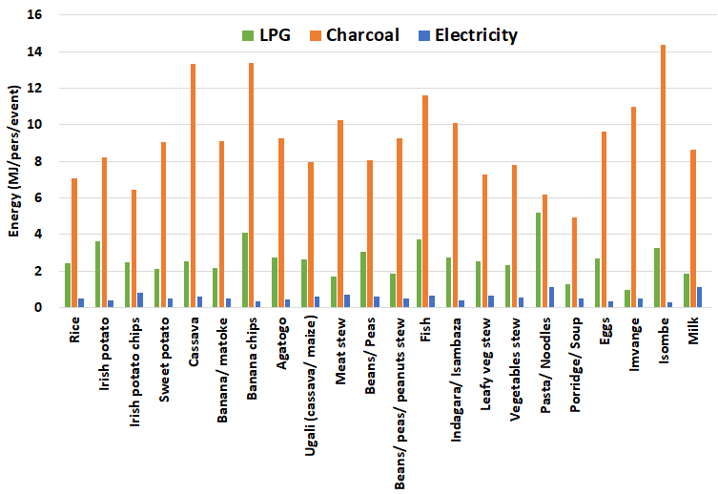
Key findings
Cooking with electricity generally required the least amount of energy. For example, in Rwanda on average cooking with electricity required a third and less than a tenth of the energy required to cook the same meal with LPG and Charcoal, respectively.
Energy consumption depends on the cooking process, the cooking time length and the cooking solution. For instance, in the case of Rwanda, while the average per capita energy consumption decreased by more than 10 times for boiled dishes, it is by around 5 times for fried ones when an energy-efficient eCooking appliance is used compared to baseline fuels.
Mean Energy Consumption per capita by cooking fuel
Per capita energy consumption of cooked dishes by cooking fuel

