Slide 1
‘Carbon Financing Presentation’
MECS Programme Workshop
21/06/2023
Malcolm Bricknell
Matthew Leach
Samir Thapa

Slide 2






Carbon Finance is important part of MECS Scale
up Finance Programme
Broad objective is to Catalyse Finance to support transition to MEC- other initiatives include;
Acumen Pilots and report to promote Patient Equity investment
Financing Clean Cooking Series of reports including a major Landscape Report
RBF work including Kenya EPC and support to Endev/Nefco/WB
Ecooking initiatives including both off grid and utility level work and OBF
Impact Finance including supporting the Clean Impact Bond
Collaborations with MDBs/DFIs to promote their involvement in MEC
Different research initiatives and related publications

Slide 3
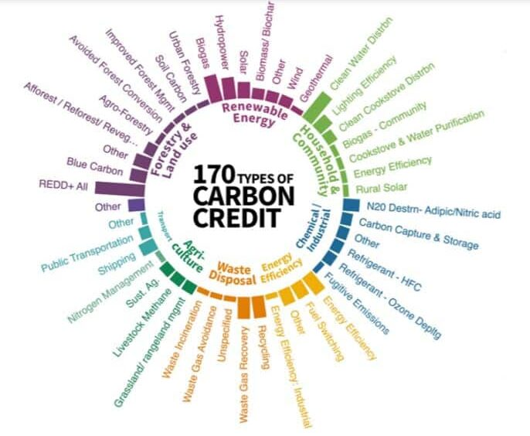
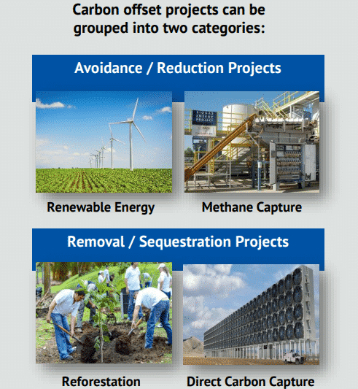
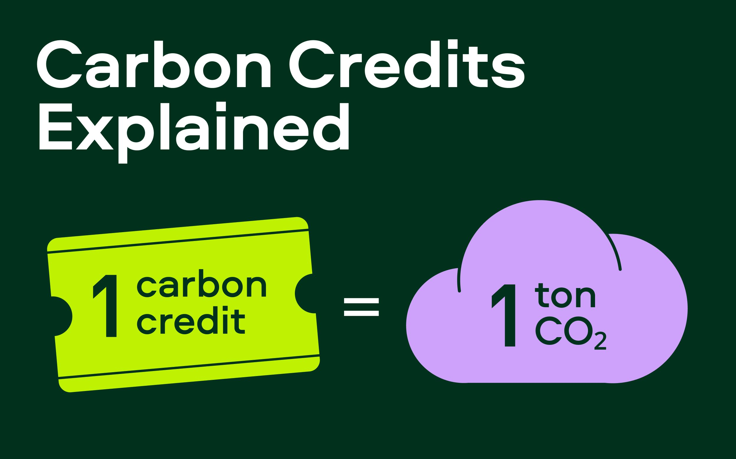
What are Carbon Credits ?

Slide 4
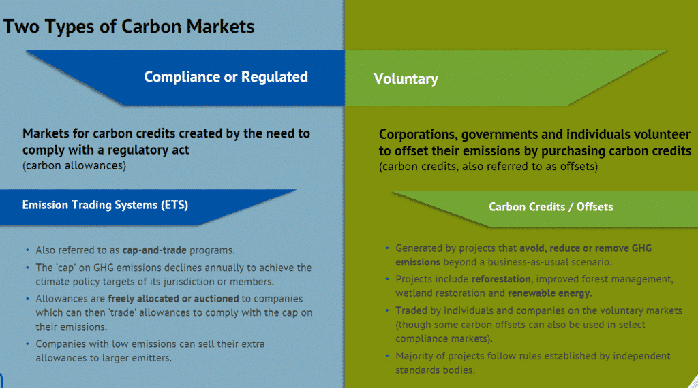
Compliance and voluntary markets

Slide 5
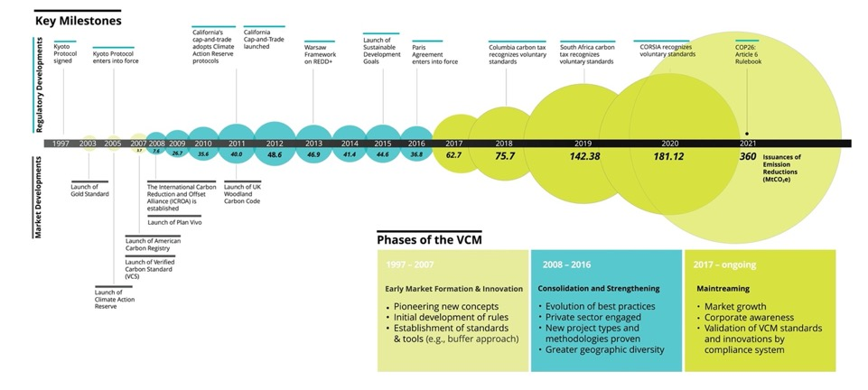
Evolution of the Voluntary Carbon Market

Slide 6
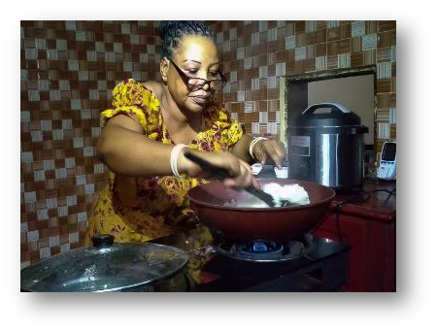
Carbon Credit Market Background
Difficult History
Controversial-were offsets the right way to reduce emissions ?
Risk of double counting / fraud, inaccuracies
Controversial projects eg Coal fired power
High certification costs and burdensome procedures
Collapse in market prices post 2012 caused much distress

Slide 7
Carbon Credit Market Background
Growing awareness of climate change suggested a trend to higher prices
High emission savings from MECS devices compared to lighting/SHS e.g., around 2-5 tonnes CO2e per annum
Higher prices available for MEC appliance projects due to high SDG co-benefits: Health, Gender, Livelihood and Environmental
New opportunities arising from smart data features of MEC devices
Potential "game changer" for reducing appliance costs and improving company/project profitability and viability
Just transitions narrative
Where should MECS play a role ??

Slide 8

Background to the Methodology work
Discussions with Gold Standard and others identified the opportunity to introduce a revised methodology for metered clean cooking appliances
Two main elements to the new approach;
To use actual metered energy use as the basis on which to calculate emission reductions so improving accuracy and reducing costs
To potentially use high-quality third-party data ( e.g., World Bank MTF analysis) for Baseline fuel usage calculations
Significant consultations with some leading NGOs, Companies, CCA and ESMAP/Ci-Dev showed a strong interest in MECS promoting this opportunity. Some reservations around effects on carbon credit calculations from some developers.
Considered better to produce a whole new procedure than ad hoc changes

Slide 9
Start of the Methodology work
After a RFP ( conducted in mid 2020) , Climate Care (now Climate Impact Partners) won the tender to act as advisor to MECS
Climate Care then developed a new streamlined approach for calculating emission reductions for Electric Cooking and other Metered Cooking Devices as an amendment to the Gold Standard Technologies and Practices to Displace Decentralized Thermal Energy Consumption (TPDDTEC).
The project had 2 phases:
  Phase 1: Climate Care was to adapt the existing Gold Standard methodology for certification of GHG emission reductions from modern cooking appliances.
  Phase 2: Once the new methodology was approved by Gold Standard, Climate Care to take a project through the new methodology and lead the project to registration.

Slide 10



METHODOLOGY FOR METERED & MEASURED ENERGY COOKING DEVICES (MMECD)
New approach to quantify GHG impact from cooking devices through direct measurement of energy or fuel. Covers Electric, LPG, Biogas, and Bio-ethanol cookstoves.
  Many MEC cookstove developers have monitoring and data processing technologies, eg to support PayGo needs
Reduced survey and monitoring transaction costs for project developers, whilst at the same time increasing reporting accuracy.
University of California (Berkeley) paper identified 6x over-crediting of most clean cooking carbon methodologies; recommended use of the MMECD
Climate Focus: “A key advantage of clean over improved cookstoves in this respect is the ability to derive much more accurate estimates of project stove use through directly monitoring use …..Risk averse credit buyers would do well to seek out such projects"

Slide 11
Developing the MMECD
The first version of the methodology used ratio of the efficiencies of the project device and the traditional stove replaced to work out how much of the baseline fuel use is avoided (and hence emissions offset)
  Efficiencies estimated using Water Boiling Test
But efficiency in a WBT doesn’t do justice to the energy performance of the most efficient cookstoves (eg Electric Pressure Cookers): faster cooking = different energy service.
The second version of the methodology also allows use of the ratio of specific energy consumption to cook a stated dish or meal.
  From Controlled Cooking Test;
  GS quote MECS analysis of cooking data as suggested default values for SEC

Slide 12
Lessons learned – MMECD new project developer
  The actual timeline of the pilot design certification/validation of 13 months so far
    Longer than the usual max. 12 months for carbon credits
    Future estimated timeline certified within five to six months.
Steep Learning Curve
Establishing default values, Fraction of Non-Renewable Biomass (fNRB) due to different default values UNFCCC proposed and academic values.
  Comprehensive stakeholder consultations – extended certification process requires extended documentation and clarity for all stakeholders involved.
  DMRV application - integration of appliance usage-dashboard with live-usage data into the certification and credit issuance process is a stepping stone

Slide 13
Lessons learned – MMECD overall
Electric cooking: diverse portfolio of technologies and cooking types, far beyond simple hotplates
  The energy performance of appliances similarly varied: hence needed case 2 calculation route
  Air fryers, effectively small/efficient convection ovens, became significnt in cost-of-living crisis in Europe; may come to LMICs.
Similarly, innovation in usage data monitoring, plus data transmission and then impact platforms, and in business models
  Lots of well-established and new players getting involved with the MMECD
Test methods and standards, and impact methodologies, will need to keep up with innovation

Slide 14

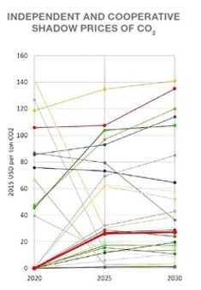
Article 6 and clean cooking projects implementation
Over-crediting – Non-renewable biomass fraction, fuel consumption, adoption, usage, stacking.
Permanence and leakage - How to establish!
Additionality – Higher tier cleaner solutions, life-cycle analysis, national policies.
Third party validation and verification - limited capacity spread across standards.
Notes:
Article 6 is different compared to Kyoto in that everybody is expected to contribute towards meeting the net-zero and beyond ambitions, building upon the structures that were set up during the Kyoto Period.
Before going into Article 6 details, I would like to talk a bit on the issues which would be important going forward with carbon financing to scale clean cooking.
These issues are particularly related to the establishment of related parameters such as non-renewable biomass fraction, where the discussion is whether we should support establishing these parameters or help the sector to establish these values through development of methdologies and capacity devleopment required for that.
Next important isseus is with respect to additionality, besides financial additionality, are there other avenues which can be used to prove the additonality such as mecs being higher tier solutions, and their life cycle analysis vis a vis lpg and their mention in the NDCS.
Most importantly, how to scale up when we have such limited number of third parties involved – standards, validators and verifiers. Should we try to work with standards and mechanisms beyond GS and Verra – focus on others such as ACR, Plan Vivo including Article 6.2 and Article 6.4
Further, the graph on the right shows the shadow prices which shows that the prices above US $35 is ideal for carbon financing, however the prices are less than that which shows that financial structuring beyond carbon revenues are requried to meet the costs for some of the higher tier solutions.

Slide 15
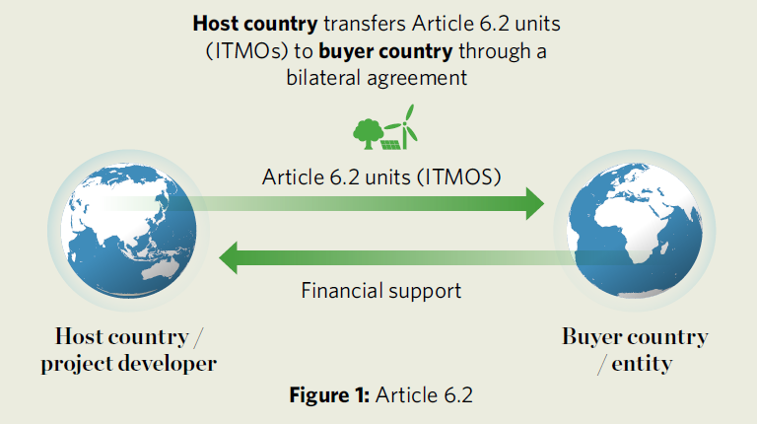
Paris Agreement - Article 6.2
Cooperative Agreement to achieve Parties’ NDCs
Several Article 6.2 pilots signed, but no bilateral trades so far.
Flexibility to set rules and standards within the Article 6.2 guidance.
Move quickly with clean cooking especially for small countries e.g., Laos, Nepal, Kenya.
More guidance on reporting and tracking expected at COP.
Source: Ecosystem Market Place
Notes:
Paris Article 6.2 is related to primarily bilateral agreements between countries. The implementation requires corresponding adjustments to their respective NDCs, meaning no double counting or double usage of the carbon credits.
Several article 6.2 pilot projects are underway, but none so far on modern cooking, and no bilateral trading has been completed.
It is expected that Article 6.2 projects and transactions can happen quickly since there is flexibility to set standards and rules with the Article 6.2 guidelines.
This then could be implemented for electric cooking projects based upon previous clean cooking carbon project experiences, especially for small countries such as Laos, Bhutan, and Nepal – which have good electricity access and in some cases experiences of doing carbon projects.
However, more guidance on reporting and tracking is expected from ongoing negotiations especially at the upcoming COP.

Slide 16

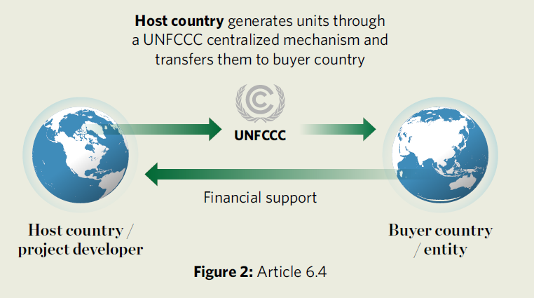
Paris Agreement - Article 6.4
Achieveing Mitigation and Sustainable Development Outcomes
Centralized mechanism for public and private entities
Most likely CDM and its methodologies will be adapted.
Share of proceeds and overall mitigation contribution finalised.
Source: Ecosystem Market Place
Notes:
Paris Agreement Article 6.4 will be an adapted version of the earlier Clean Development Mechanism, which is a central repository for private and public entities to register and trade the credits for their projects, similar to GS and VCS in the voluntary market.
It is expected that the CDM methodologies will be adapted to suit the Article 6.4 requirements – where probably the corresponding adjustment is going to feature prominently.
However, share of proceeds and contribution to overall mitigation from the projects that use Article 6.4 is finalised. Share of proceeds is based both on volume of issuance and a fixed fee while the overall mitigation contribution is 5% of the overall project issuances.
Article 6.4 is expected to be easier to implement in countries which already has experience of going through CDM procedures for clean cooking projects such as Nepal.

Slide 17
Article 6 and Voluntary Carbon Market
Host country requirements – new legislation shows increasing ownership.
  Kenya CCA 2016 Amendment Bill with Corresponding Adjustment (CA).
Market requirements - Buyers conditions, CORSIA requires CA.
Article 6.4 Mitigation Contribution units -
  which do not require CA, which VCM participants can consider.
  “Units used inter alia,…..., for the purpose of contributing to the reduction of emission levels in the host party”
Notes:
With regards to how Article 6 will impact the voluntary carbon market, it is expected that host country will mandate corresponding adjustments for all projects irrespective of where the projects end-up, given the need to fulfill their NDCs.
Besides, buyers in the market is expected to also require corresponding adjustments, such as CORSIA where parties can use verra and GS credits but with CA.
Recently in 2022, another set of credits within Article 6.4 were defined as mitigation contribution units, which would not need corresponding adjustment because of being used to fulfill the domestic targets, and which the VCM participants can consider to develop, like the ones being developed for GS.

Slide 18
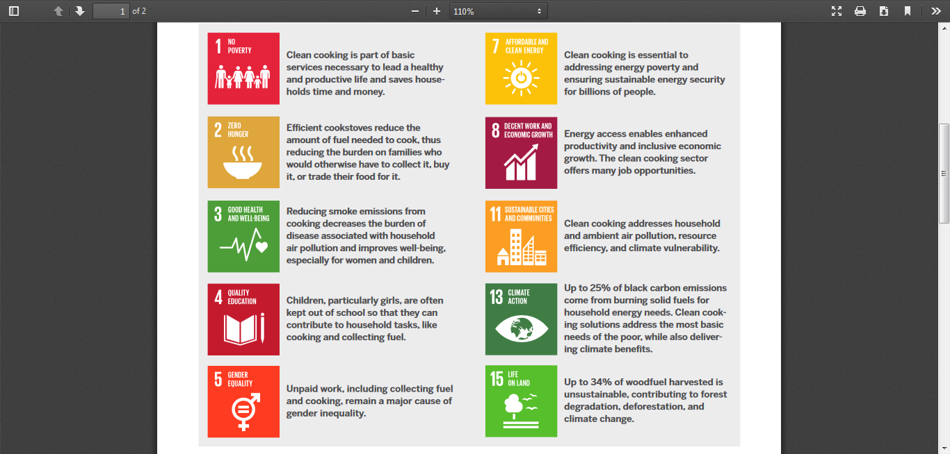
Major SDG impacts achievable from the transition to MEC - especially for Health, Climate, Gender, Livelihood, and Environmental.
Carbon Credit buyers in the VCM will pay premium prices due to other SDG impacts in addition to Climate.
Opportunities to use smart data to lower costs and improve reporting accuracy.
Importance of Impact Funding

Slide 19
Gold Standard approaches to certify and monetise SDG outcomes
“Certified SDG contributions” are self-proposed indicators. These are referred to as ‘co-benefits’ and are part of the project narrative.
“Certified SDG impacts” require certification under separate Gold Standard-approved methodologies.
GS is moving over to the compulsory use of a SDG Impact Tool that will define metrics that are acceptable.
MECS research around SDG impacts commissioned from Climate Focus has been informative.

Slide 20
Typical historic metrics for co-benefit claims

Slide 21
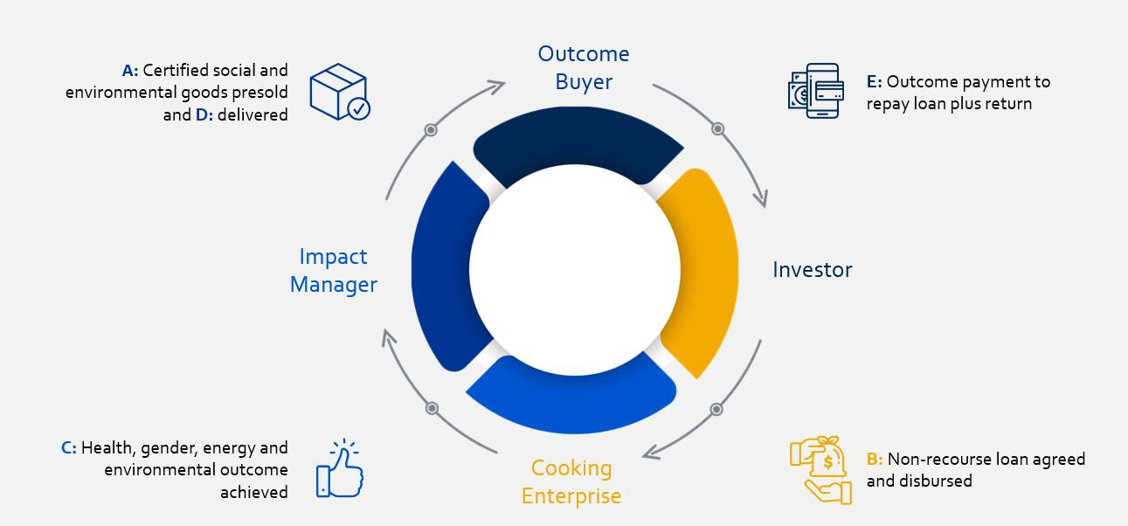
Cardano Clean Impact Bond
CIB Structure

Slide 22
Potential Opportunities for MECS - Emission Reductions
Liaising with Gold Standard to ensure that the new metered methodology is rigorous and reliable. Helping GS develop new procedures and revisions to the methodology as may be required. Coordinating responses around the methodology.
Evaluating different technical approaches for project developers to utilize smart data for certification purposes.
Providing practical information to potential project developers on carbon credits and in particular on the new metered methodology.
Helping to develop new lower cost digital approaches
Exploring opportunities to leverage the new technology to create new funding opportunities

Slide 23
Potential Opportunities for MECS –SDG Impacts
“projects generally use simple indicators that rely on one single datapoint (e.g.number of users). While such indicators are easier to measure and monitor, they are difficult to contextualize........ "
Deepening the understanding of how particular SDG impacts can be effectively promoted in MEC projects ( including new ones e.g., Biodiversity).
with higher reporting standards expected around SDG co-benefits there is a need to improve the quality of analysis and reporting.
co-benefit MRV can be integrated into digital systems required for the MMECD and into the new GS digital framework and similar.
The Clean Impact Bond mechanism offers a pathway to develop alternative approaches to monetize other SDG impacts.

Slide 24
Potential Opportunities for MECS –Article 6 and other
Responding to requests from Project developers
General Knowledge dissemination around MEC and Carbon Credits
Integrating Carbon Credits into Country Clean Cooking Strategies
Cooperation with third party initiatives
Ad Hoc research around issues of interest eg revenue sharing, market access, integrity and standards

Slide 25

Thank you for listening!

