Slide 1
MECS CHALLENGE FUND
Jane Spencer

Slide 2
Overview of Challenge Funds
£7.2 million over 5 years
Early-stage research to stimulate technology and innovations (focus on cooking but energy efficiency/storage and business models too)
Innovators and entrepreneurs – ServedOnSalt; Calpoly; Kachione
Run as a series of competitions, each with their own focus and objectives. Start small
Open to all companies/organizations, any size, based anywhere in the World;
Challenge and solutions must apply to a country supported by FCDO;
Accessed via one of the open competitions

Slide 3
Funded CF Partners
2019
2019/20
2020/21
2022/23
TRIID and LEIA I launched
Global LEAP Awards
ECO Challenge Fund/TRIID Extension/LEIA 2
Sustainable Supply Chain and eCooking on MiniGrids

Slide 4
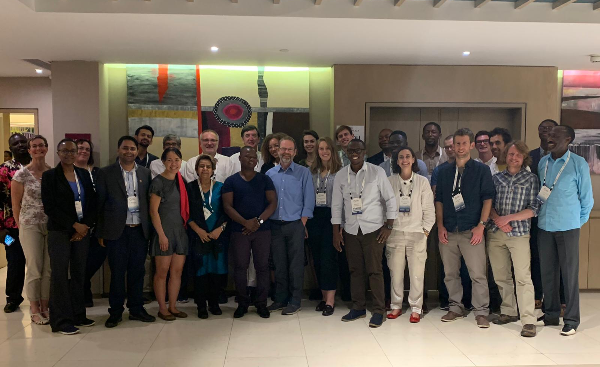
TRIID CF Winners – Clean Cooking Week Nairobi, 2019

Slide 5
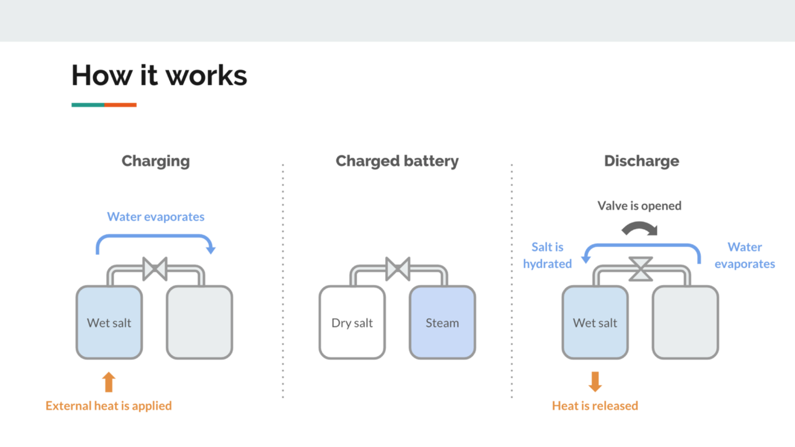
Highlights – ServedOnSalt, Kenya
Start up company
Cooker with integrated thermochemical energy storage
Low tech, low cost option
Theory suggested it could work
Follow on funding with firm parameters:
Reduce salt hydration time
Dehydrate 400 grams of salt by 90% in 30 minutes for 15 cycles
Showed an 88% dehydration in 30 minutes but other parameters not met. Work was discontinued.
Notes:
Technical University of Denmark where salts had been nano-coated to enable cycling of hydration/dehydration to run a 10 MWh pilot project in Berlin. Exploring alterative uses for the tech. Portal cook stove with TC battery which would be charged at charging station where switching occurs.
Discharge of energy too slow
Low efficiency of heat transfer
Cyclability of salt an issue

Slide 6
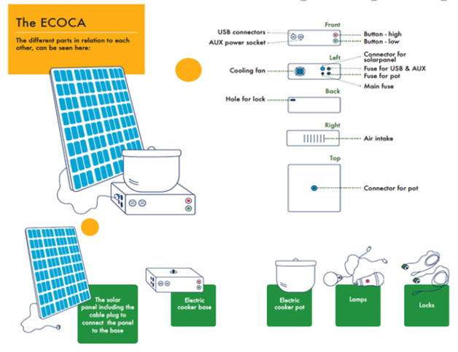
Highlights – Pesitho & EcoBora, Uganda & Kenya
Last Mile Distribution: Ecoca Stove
Compact, self-contained stove with battery pack and solar panel trialed in Bidibidi refugee camp, Uganda
Proved concept but needed some refining and more data
LEIA 2 funding to sell 1000 Ecoca’s
Small Supply Chain (SC2) award to EcoBora to test acceptance of the appliance in rural Kenya using solar kiosks
Notes:
LEIA 2 – Carbon Credits
Unit value is high $500 for solar panel, cooker and two pots, a lamp and torch. PayGo technology

Slide 7
Highlights – Burn, Kenya
2019 developing a new EPC for the Kenyan market
ECO project in Uganda and Kenya
LEIA 2 award – piloting EPC in Tanzania
2023 – new manufacturing facility
Innovate funded project
Notes:
ICS manufacturer in Nairobi since 2013 (sold over half a million)
2019 – LEIA 1 funded
Three rounds of prototyping, proved willingness to buy and use
2021 LEIA 2 award

Slide 8
Highlights – Kachione, Malawi
2019 PayGrow for ISEC (insulated solar electric cooker)
150w ISEC developed with 1/3 of users keen to utilize
2021 LEIA 2 – Efficient Empowerment ‘Earn & Grow’
Solar electric kitchens
Community-based women’s empowerment was the key (income generation, solar pumps generate income, solar-run shops enable access & commission-based income)
2022 – Extended project to explore lithium titanate batteries & solar shops
2023 – Supply chain funding
Notes:
Very low income villagers, offering modular systems for Malawi-made solar electric cooking
SC2 - $200 system for OGSEC (solar pumping same price for 5 HHs to generate income to enable incremental system growth and utilization of cooking.

Slide 9
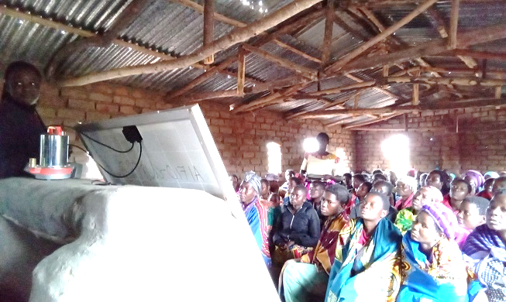
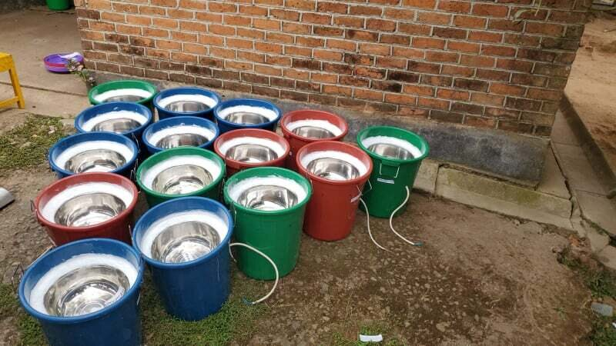
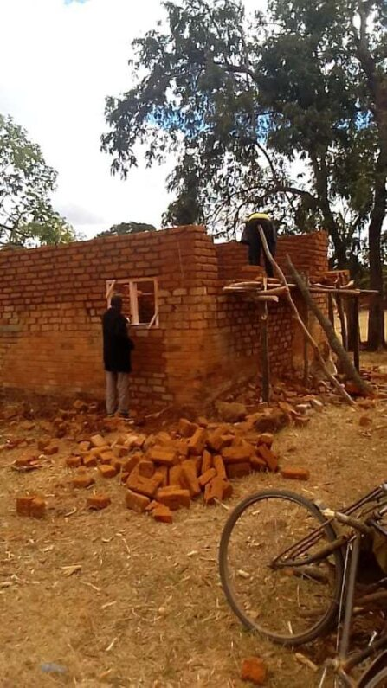
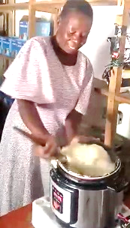
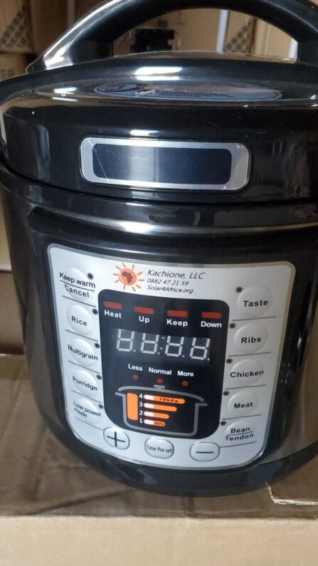
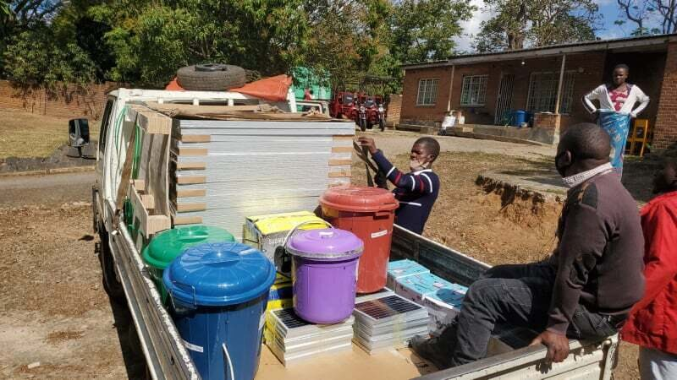
Highlights - Kachione
2022
2019
2023
2020
Notes:
Malawian-made does not offer reliability hence imports
Lundu village shop and training – 200 womens groups signed up

Slide 10
Kachione Cooking Demonstration

