Slide 1
Cooking with different fuels – energy and costs
MECS Workshop (19 – 21 June 2023)

Slide 2
Energy consumption data
Gathered data from MECS:
Cooking diaries (adding 100% eCook studies)
Electric Cooking Outreach (ECO)
Kitchen laboratory tests and Cookbooks
From 4 African countries (KE, TZ, UG, ZM) and 5 SE Asian countries (BD, KH, IN, MM, NE)
Dataset contains:
300 data points electric cooking
130 data points traditional fuels
Analysis based on:
Per capita energy consumption (MJ/person/event)
Cooking a single dish only

Slide 3
Cooking with different fuels
Charcoal uses approximately:
15 times as much energy as an EPC;
7 times the energy of a modern hob (Asia);
6 six times the energy used by a hotplate
Median energy consumption figures

Slide 4
Different electric cooking technologies
Rule of thumb conclusions; compared with hotplates:
Modern hobs save approximately 10%
Automated devices save approximately 25%
EPCs save approximately 50%
Median energy consumption figures

Slide 5
Some physics….heat losses and energy services Source: adapted from Batchelor (2023), https://mecs.org.uk/blog/energy-transfer-in-kitchen-appliances/
Basic electric cooking
Pressurise
EPC
Raised pressure=>
higher boiling point=>
faster cooking
Resistive heating element
Add insulation
Rice cooker
Modern controls; smarter technology
Different “energy service” delivered
Induction coil

Slide 6
Why this is important: eg carbon credit calculations
$ received α CO2e emissions avoided
CO2e emissions avoided α (baseline vs project eCook performance)
Most carbon credit methods use Cooking efficiency (baseline)
Cooking efficiency (eCook)
With the cooking efficiency measured by Water Boiling Test
WBT ignores pot moving about/stirring; doesn't need much stove control; and requires >30mins ‘boiling’
Doesn’t fully capture modern controls, induction technology, insulation and pressurisation
For the new MMECD, we proposed the Energy ratio
Can double the $ received

Slide 7
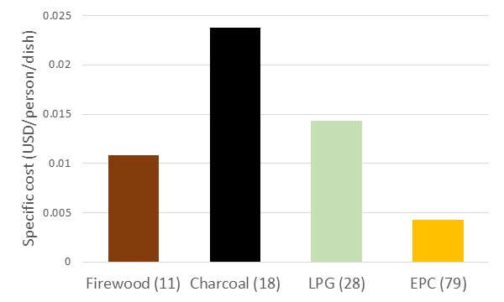
Comparing the cost of cooking
The cost the cost of cooking with an EPC is approximately:
33% of the cost of using LPG;
20% of the cost of using charcoal
Caveats:
everybody pays a different price - location, season, quantities;
Kitchen lab tests used fuel prices prevailing in the study country at the time of the study.

