Slide 1
E-Cook: the system perspective
A focus on End of Life implications

Slide 2
Session Outline
Introduction to Life Cycle Thinking and Burden Transfer
Summary of initial findings from End-of-Life country reports
Activity: Maximising value retention for e-cook

Slide 3
Life Cycle Thinking
Raw materials extraction
Supply chain manufacture
Desired product
By-products
Emissions to land, sea and air
Jobs
Well-being
Energy and material resources
Labour
Infrastructure
In house manufacture and assembly
Use and maintenance
Refurbishment and reuse
EoL (recovery, recycling, final disposal)

Slide 4
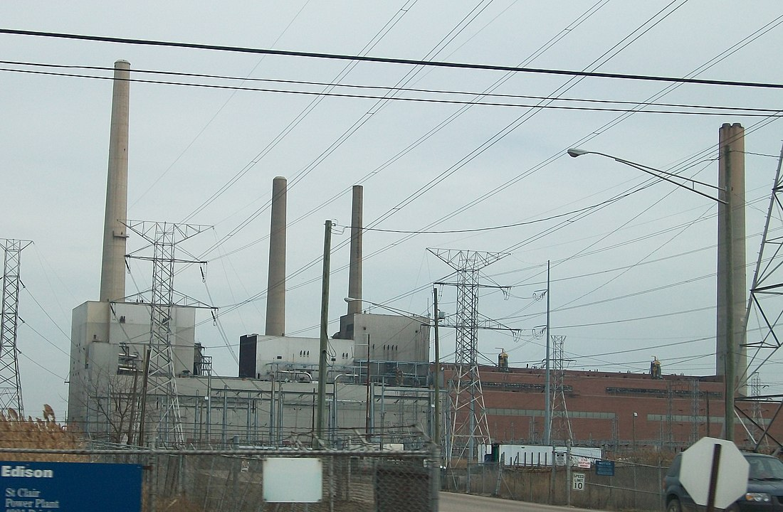
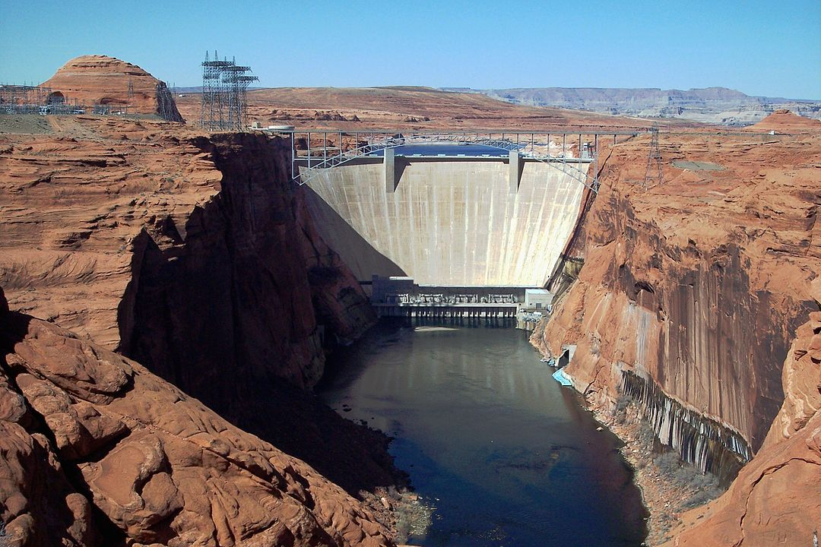
Transfer of burdens - form
By Cgord (talk) - (Cgord (talk)) created this work entirely by himself. Transferred from Wikipedia., GFDL, https://commons.wikimedia.org/w/index.php?curid=19912142
By Adbar - Own work, CC BY-SA 3.0, https://commons.wikimedia.org/w/index.php?curid=31639595
© S²A Associates Ltd

Slide 5
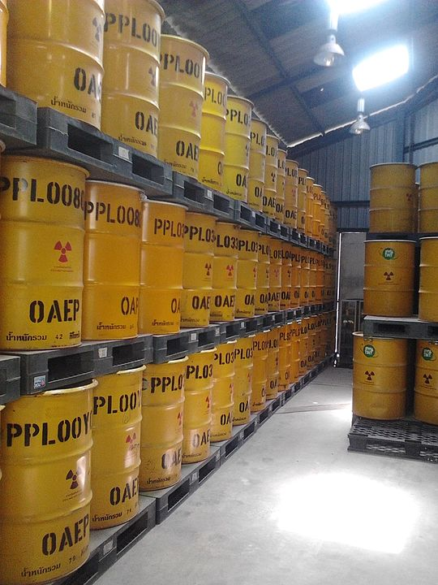
Transfer of burdens - Time
This Photo by Unknown Author is licensed under CC BY-SA-NC
By ShinRyu Forgers - Own work, CC BY-SA 4.0, https://commons.wikimedia.org/w/index.php?curid=36803706
© S²A Associates Ltd
Notes:
Nuclear fuel, issue simply deferred

Slide 6
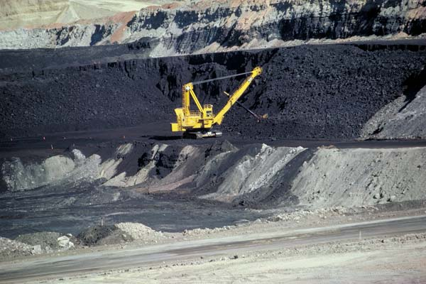
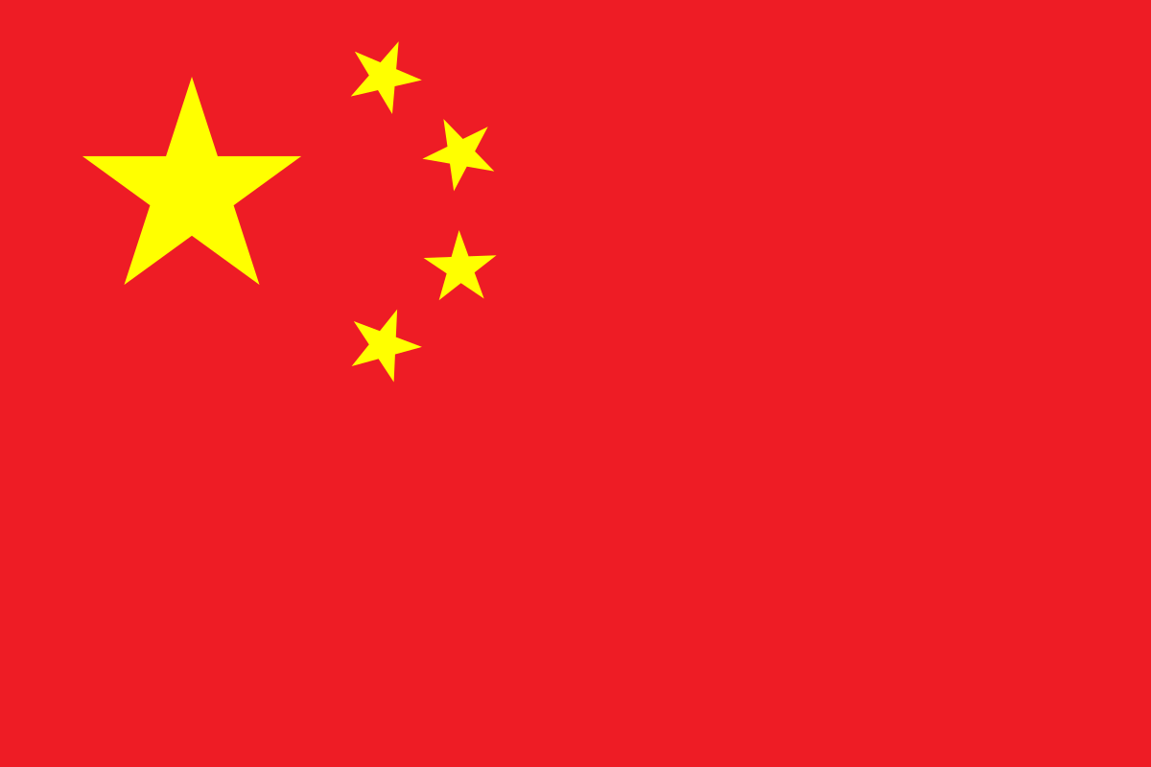
Transfer of burdens - Place
This Photo by Unknown Author is licensed under CC BY-NC
This Photo by Unknown Author is licensed under CC BY-SA
This Photo by Unknown Author is licensed under CC BY-SA
© S²A Associates Ltd
Notes:
Mining in US to mining in China

Slide 7
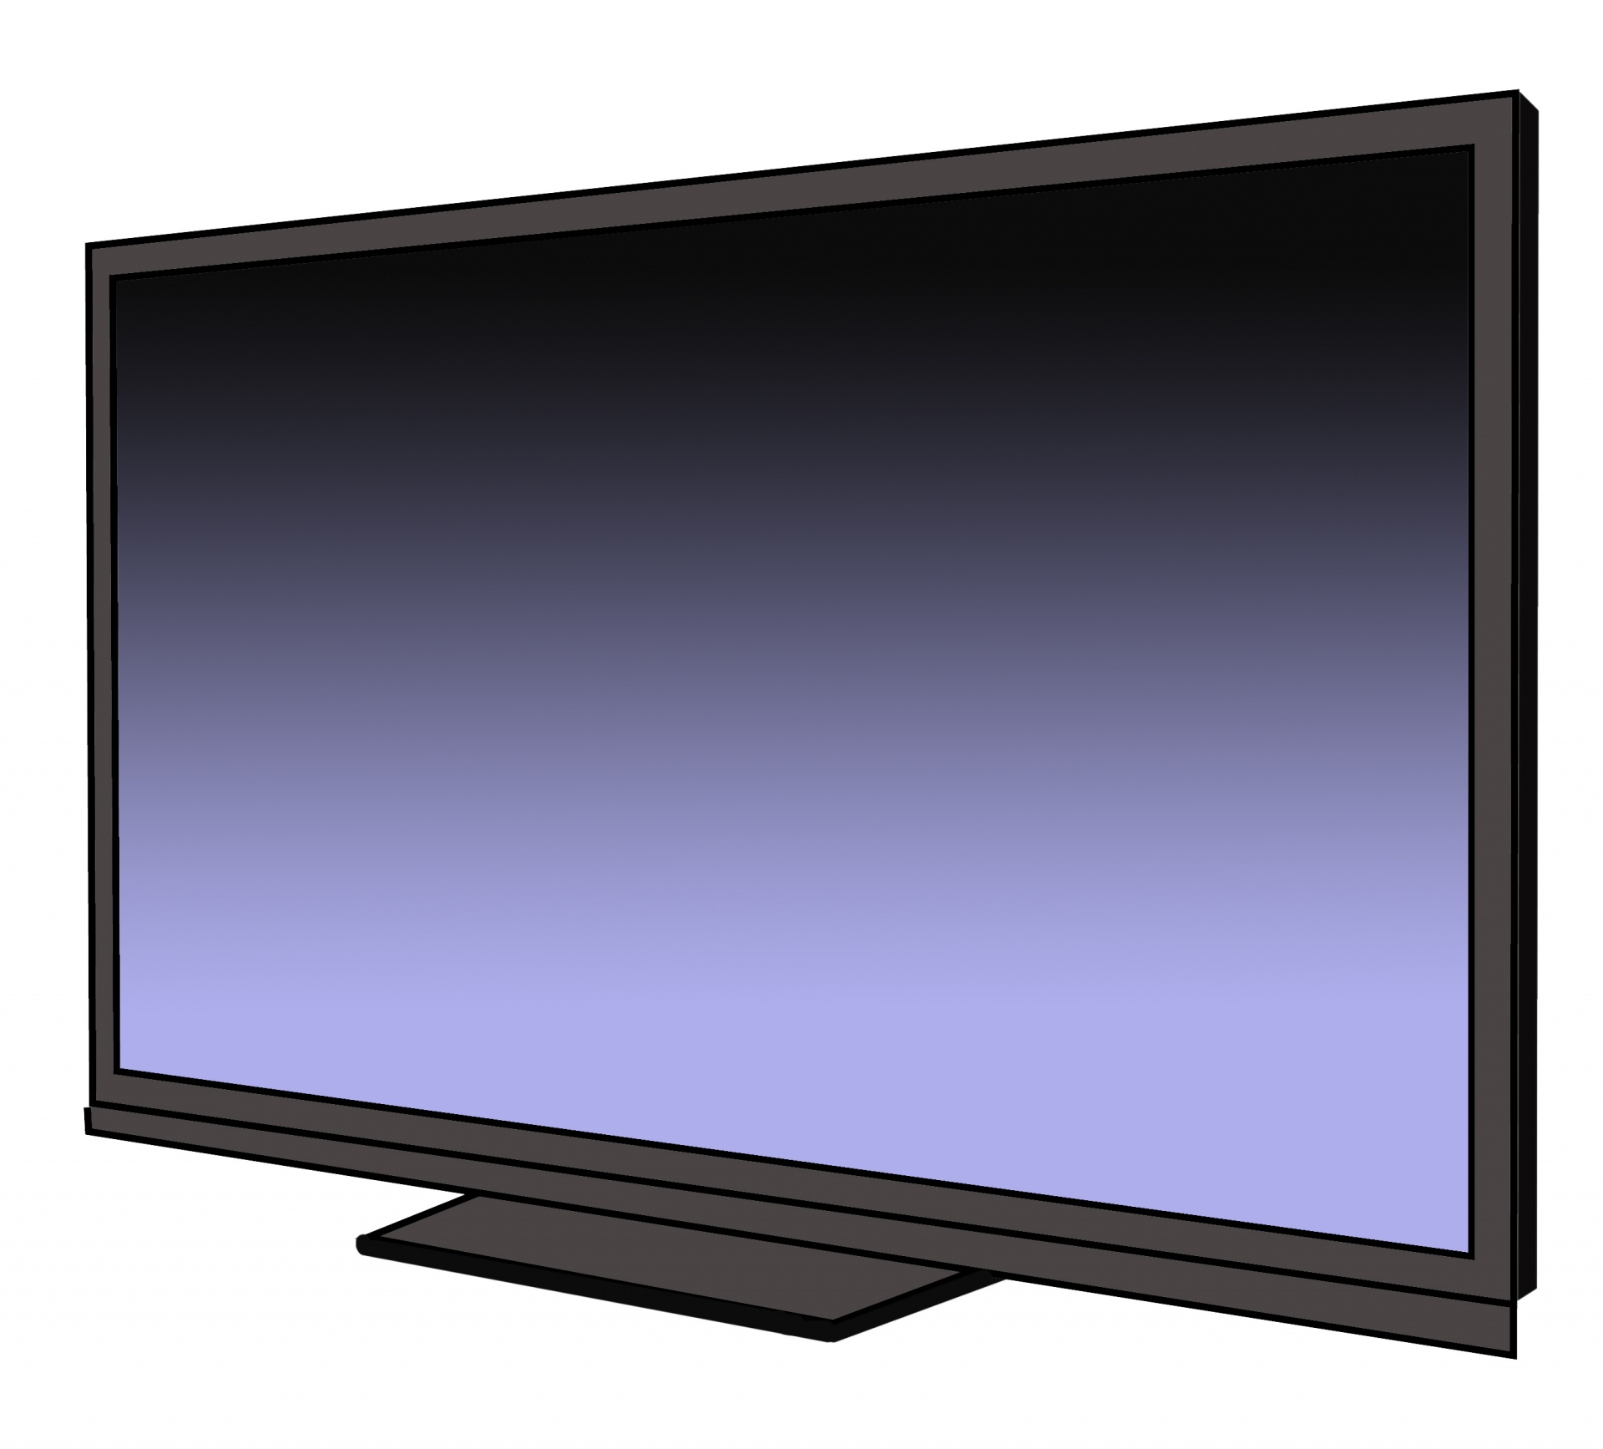
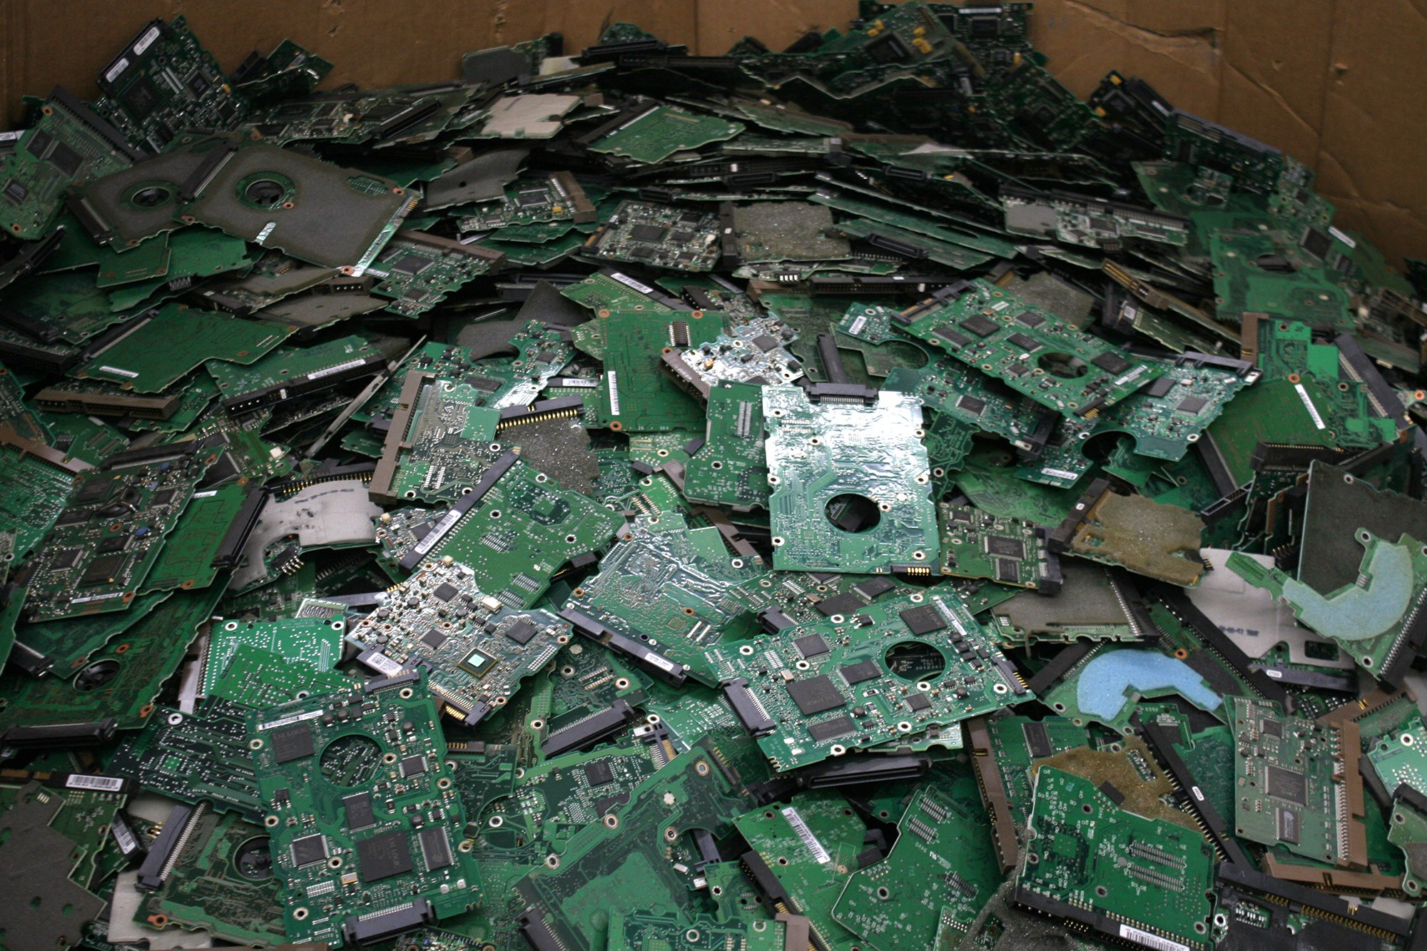
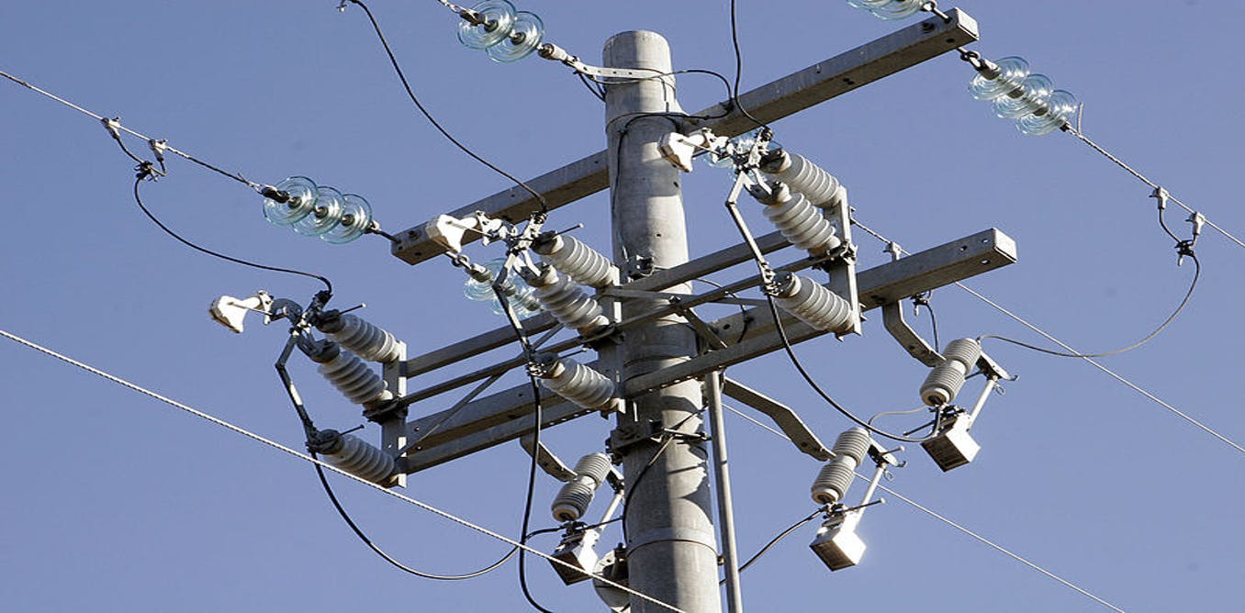
Transfer of Burdens - Stage
This Photo by Unknown Author is licensed under CC BY-SA
This Photo by Unknown Author is licensed under CC BY-ND
© S²A Associates Ltd
Notes:
More efficient but complex leading to more waste – shift from use stage (efficiency) to EoL materials

Slide 8
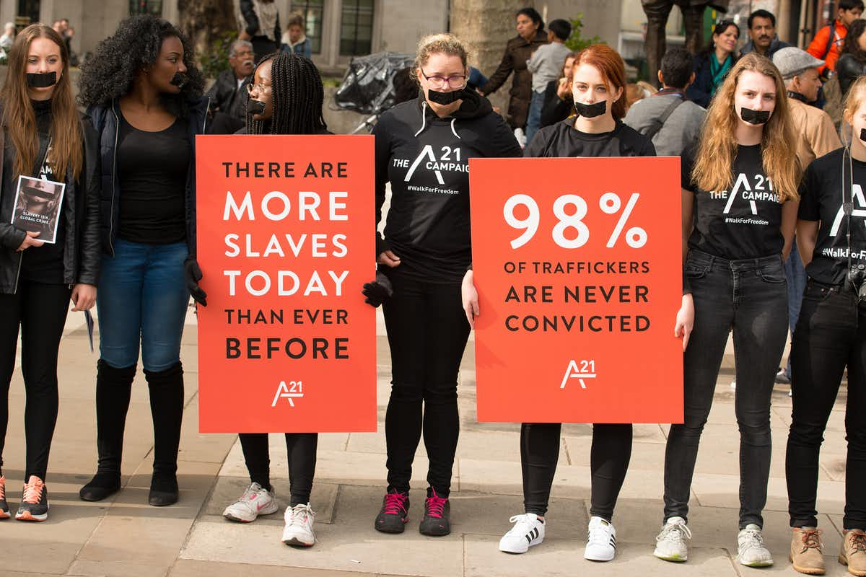
Transfer of Burdens - Pillar
This Photo by Unknown Author is licensed under CC BY
This Photo by Unknown Author is licensed under CC BY-NC
© S²A Associates Ltd
Notes:
More difficult to capture within eLCA study, but shift between the three pillars of sustainability, highlighted here, a reduction in costs to an increase in social costs (modern slavery).
Other examples include: an increase in pollution from an industrial process (river pollution) yielding a reduction in cost (no or reduced water treatment for example)

Slide 9
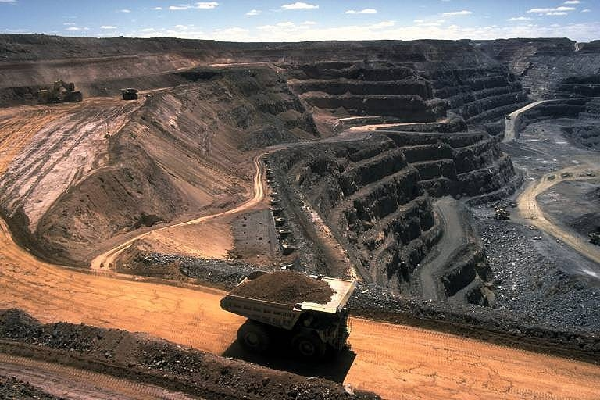
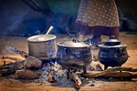
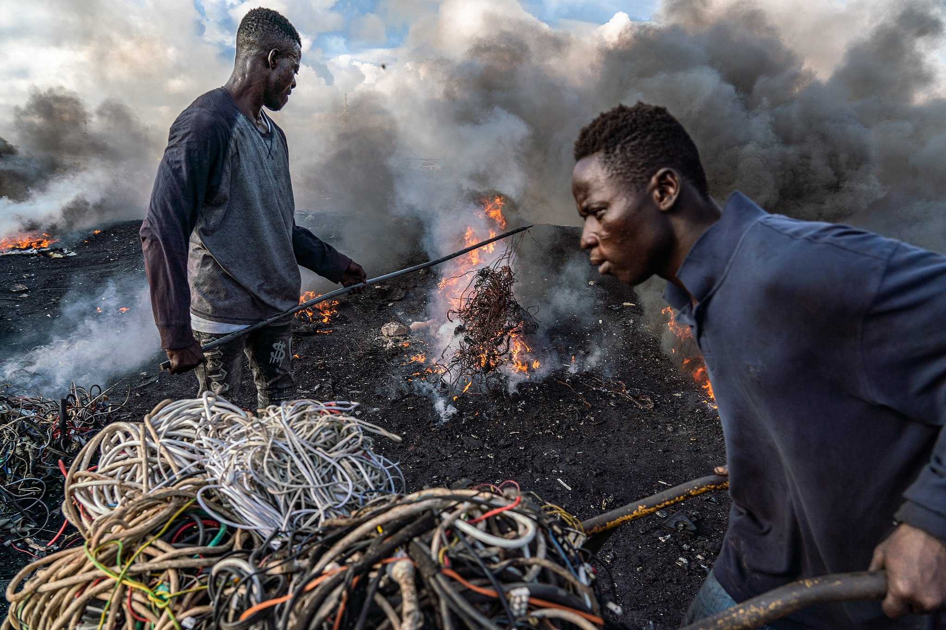
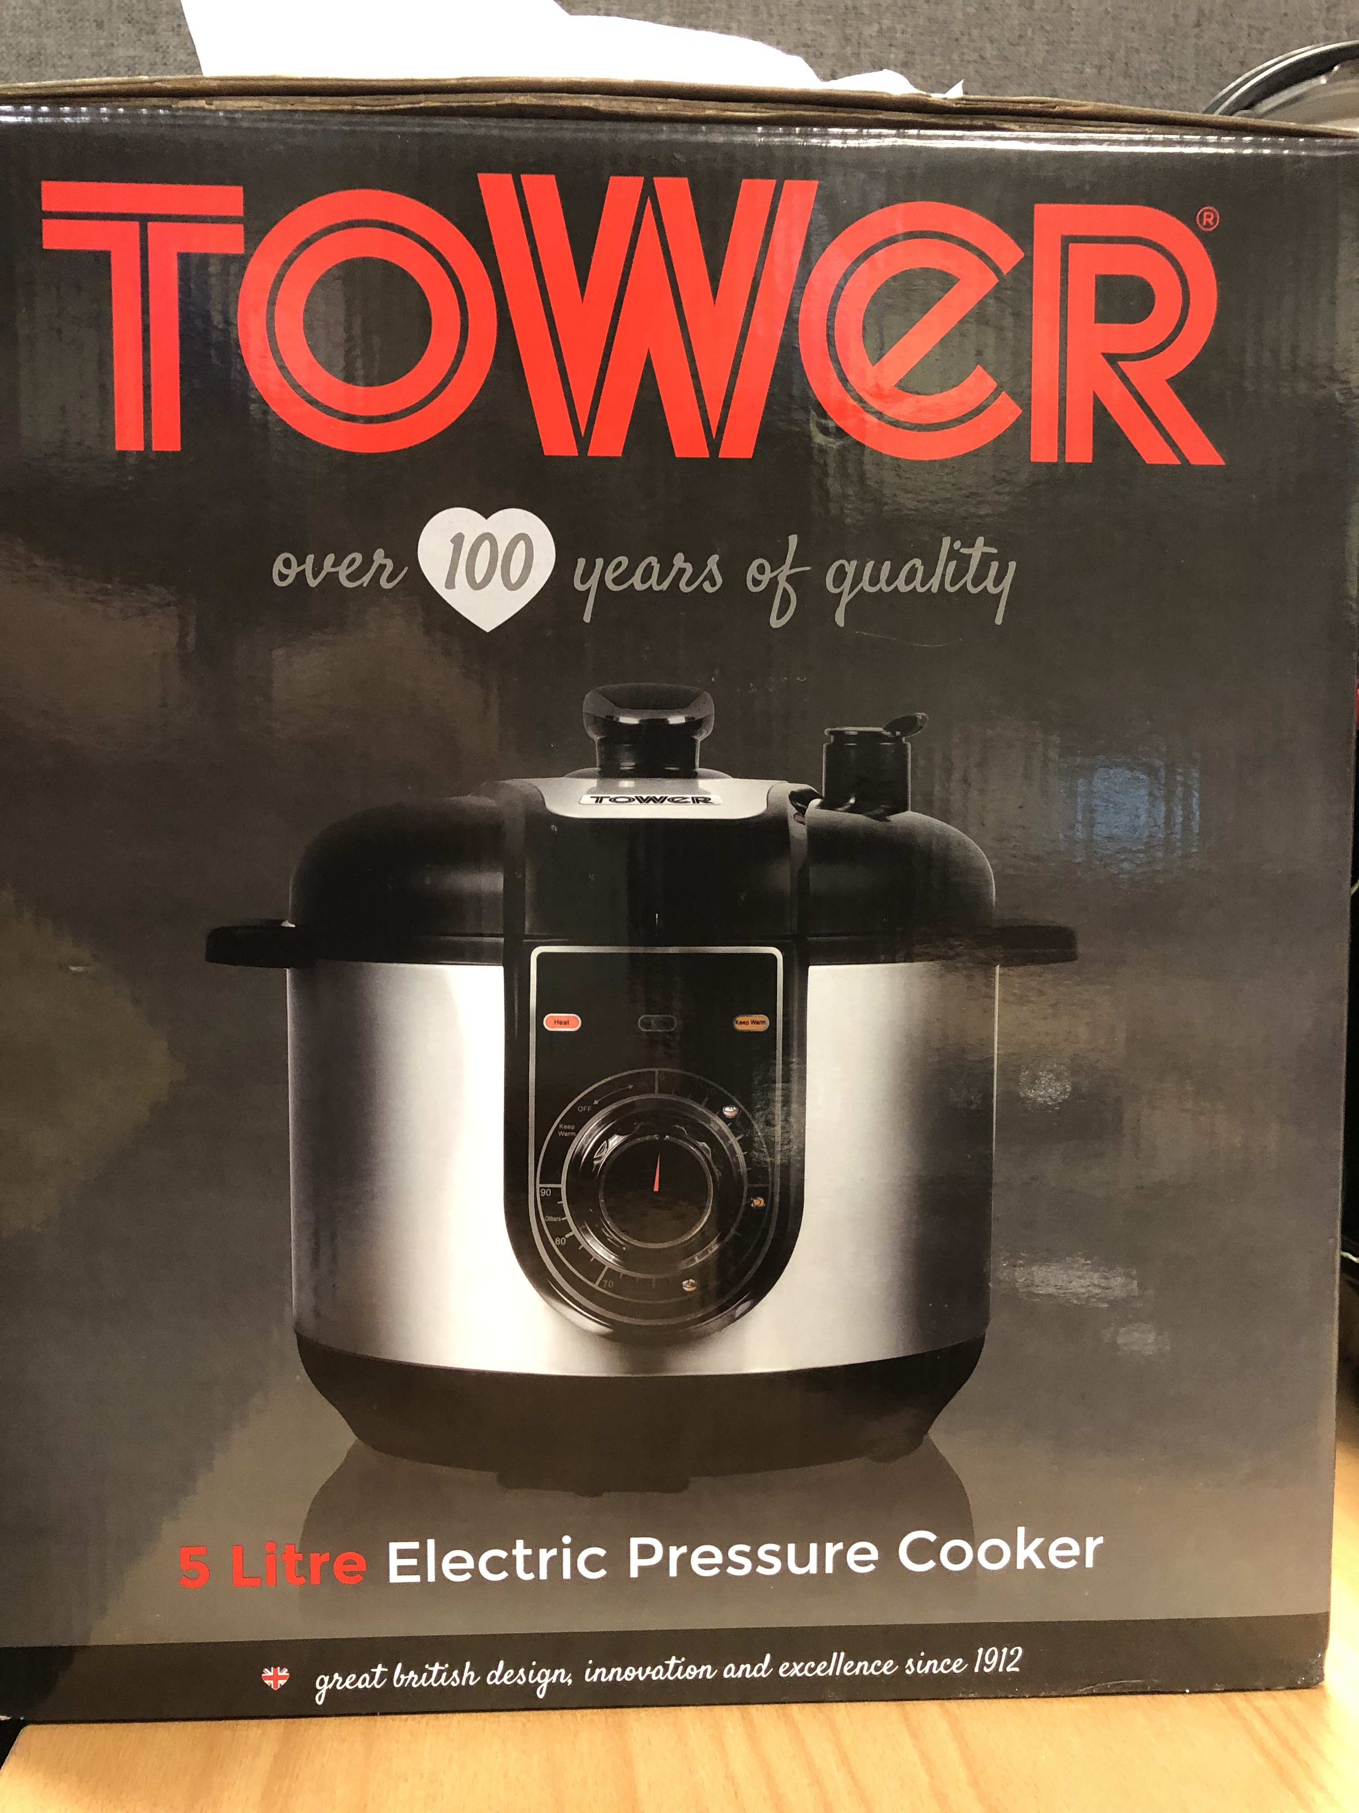
What’s happening in e-cook
Critical materials
Increased e-waste

Slide 10
Countries Investigated
Kenya
Rwanda
Ghana
Nepal
Bangladesh

Slide 11
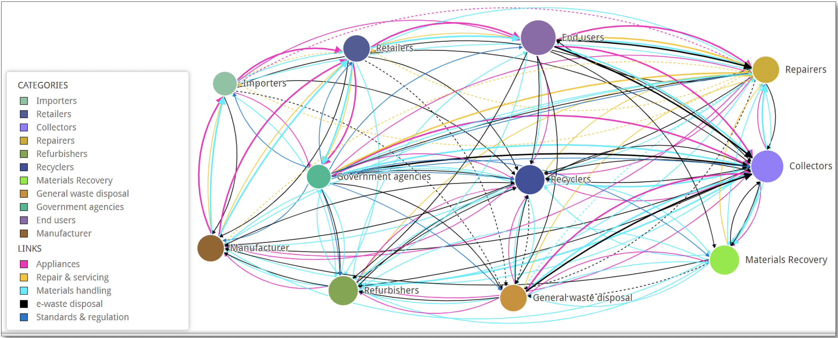
Net-Map Illustrating Stakeholders Supporting Proper Appliance EoL & e-waste Disposal Practices in Kenya

Slide 12
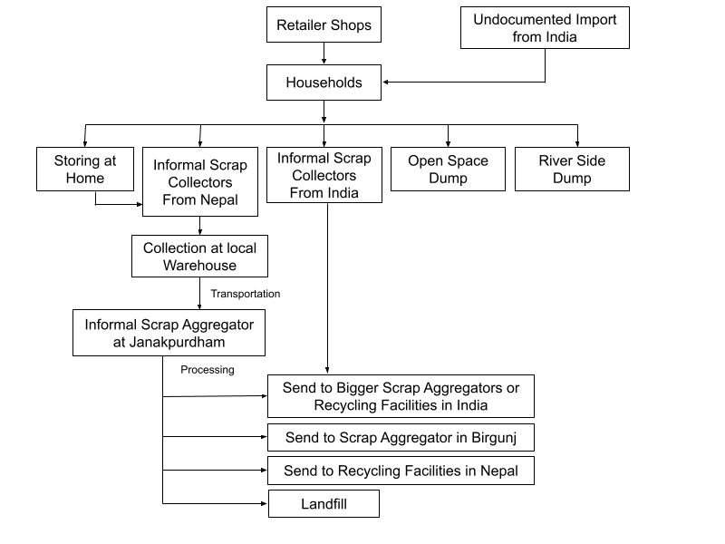
End of life system in Aaurahi Rural Municipality
CHINA
Tibet
Katmandu Metropolitan city
INDIA
Aaurahi rural municipality
Notes:
The people of Aurahi Rural Municipality have a distinct way of life, influenced by their geographic location. Many villagers rely on dry materials such as leaves, sugarcane remains, and wood for cooking. Although some wealthier families use liquefied petroleum gas (LPG) for cooking, burning dry materials that can ignite remains a common practice in the region. The majority of the population continues to rely on traditional cooking methods using firewood, cow dung cakes, and mud stoves. LPG is used primarily for quick snacks and tea, but not for cooking full meals. Due to economic constraints, many are unable to shift to modern electric cooking methods, and the local government has not established any policies or grants to promote the transition to electricity. Additionally, there is a lack of awareness and education on the use and benefits of e-cooking devices in the area.
Most households in this area prefer to repair their electronic devices by themselves, but if it's beyond their capacity and cannot fix it, they take it to the local repair shop. It is worth noting that most of the repair works for electronic devices are done at repair shops which are usually located in India. It is because the end consumer thinks it is cheaper to repair in India and is not far and easily accessible.
If the device is unrepairable, households tend to keep it at home until there is enough space to store unwanted items or get good scrap value from informal scrap collectors that come to purchase it.
Small e-waste items are sometimes burned nearby or openly dumped into nearby rivers by the end consumers.
There was one interesting discovery in Mahankal for EoL disposal., another rural area: They collect the e-waste items which were not taken by scrap collectors and wait for the monsoon season. Once the water flow in the nearby river increases and is sufficient to wash out heavy items, they throw un collected e-waste (CRT TV, lamps etc) into the river. This leads to conclusion about strong need for awareness among residents about hazards of e-waste dumping in river.

Slide 13
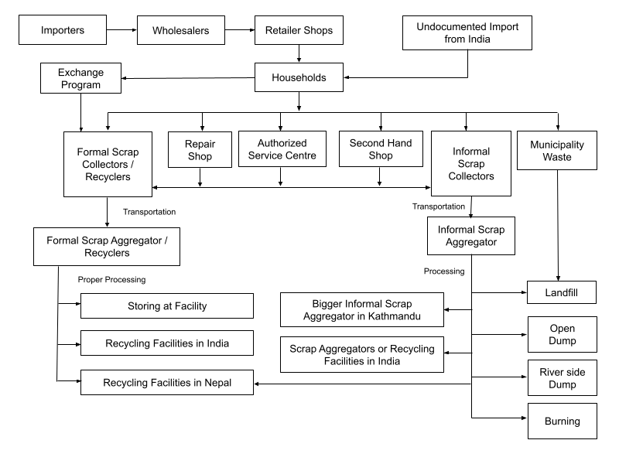
End of life system in Katmandu Metropolitan City
CHINA
Tibet
Katmandu Metropolitan city
INDIA
Aaurahi rural municipality
Notes:
boasts a population of more than 845,000 people, residing in an area of 50.67 square kilometers,
While the use of e-cooking devices has gained popularity in urban areas due to the availability of electricity, LPG gas is still prevalent in rural areas where access to electricity is limited.

Slide 14
Initial Findings
Consumers prefer to buy new appliances
Evidence that some consumers prefer single payment systems
Retail markets dominated by cheap Chinese imports that are quick to break and hard to repair
Local repair is primary choice for faulty devices (ease of access, cost)
Informal sector is very efficient at recovering base metals (Al, Steel, Copper). Not so good at collecting rarer materials
Warranties are viewed differently by different stakeholders
Notes:
Some things we knew but were confirmed:
E-Waste dominated by informal sector
Limited regulation in place and generally not enforced
Lack of infrastructure and skills necessary
Lack of awareness of issues at EoL in all actors (consumers through to waste operators)
Little to no measurement of EoL waste flows

Slide 15
Activity: Maximising value retention from e-cook - opportunities for integrating into ongoing MECS policy initiatives?
What activities/contacts/ideas do we have within the e-cook community to help shift from unsafe informal practice to safe EoL practice?
Include business model options, device design initiatives etc to facilitate value retention.
Small registered businesses
Regulated industry
FORMAL
1-2 man businesses, opportunistic
Foreign aid programmes
INFORMAL
BOTTOM UP
TOP DOWN

