Slide 1
Kenya’s story of change
Beryl Onjala, Jon Leary
Gamos East Africa

Slide 2

Outline
Baseline – Kenya’s trajectory before MECS’ interventions
MECS interventions
Future outlook
Photo credit: KPLC

Slide 3


Baseline
Kenya’s pathway before MECS’ interventions:
  ICS & LPG main focus for CC sector
  LMCP rapidly expanding grid, but with limited impact for customers & minimal additional revenue generation for KPLC
  No connection between the challenges of the CC sector and the opportunities presented by recent electrification
  Limited supply chain for eCooking appliances
Photo credit: KPLC
Photo credit: Mercy Corps Ethiopia

Slide 4




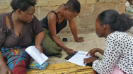





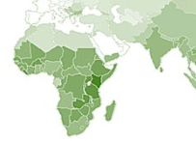













MECS activities in Kenya
New evidence highlights cost-effectiveness of modern EE appliances
Strategy development & eCAP begin
RRF request
1st challenge fund projects begin
Techno-policy analysis pinpoint opps. for integrated energy planning
GMA highlights high potential in Kenya
County eCooking Hubs & CoP launched
Cooking diaries show viability of eCooking
1st RBF programme for EPCs
2016
2017
2018
2019
2020
2021
2022
2023

Slide 5
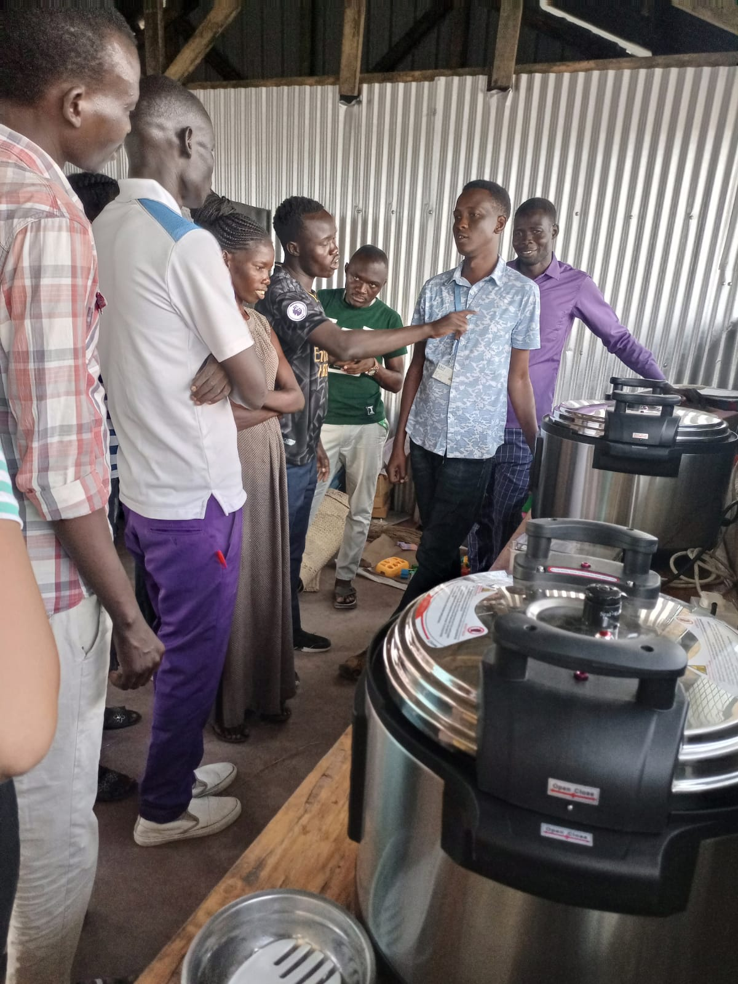
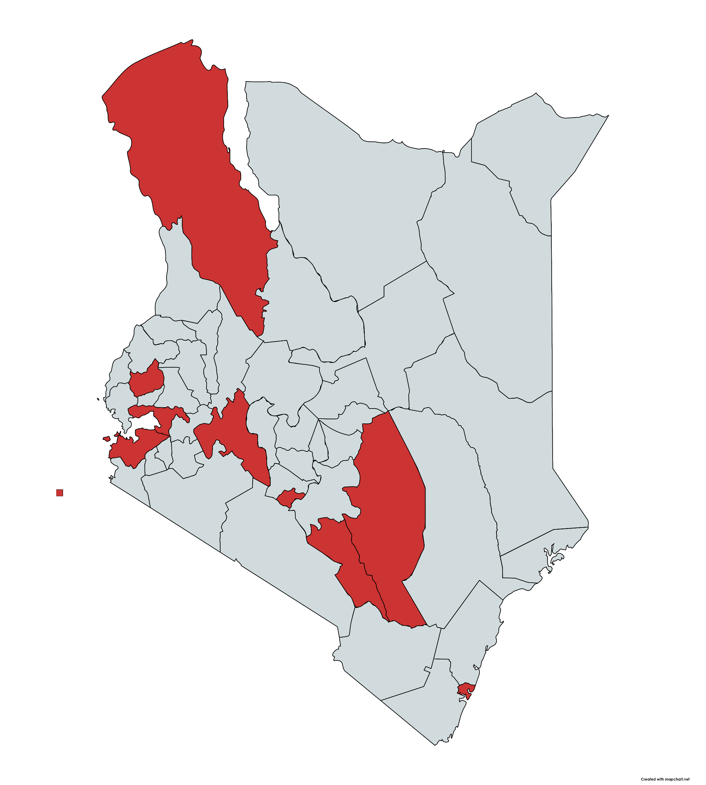
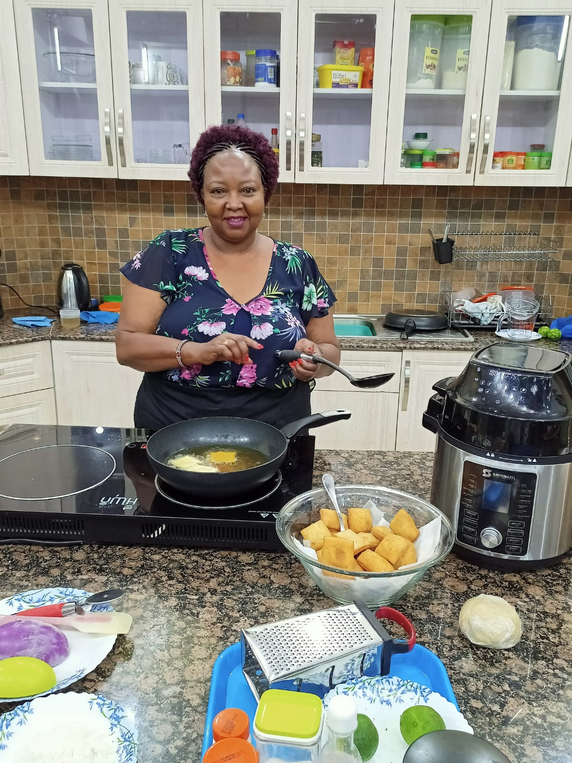

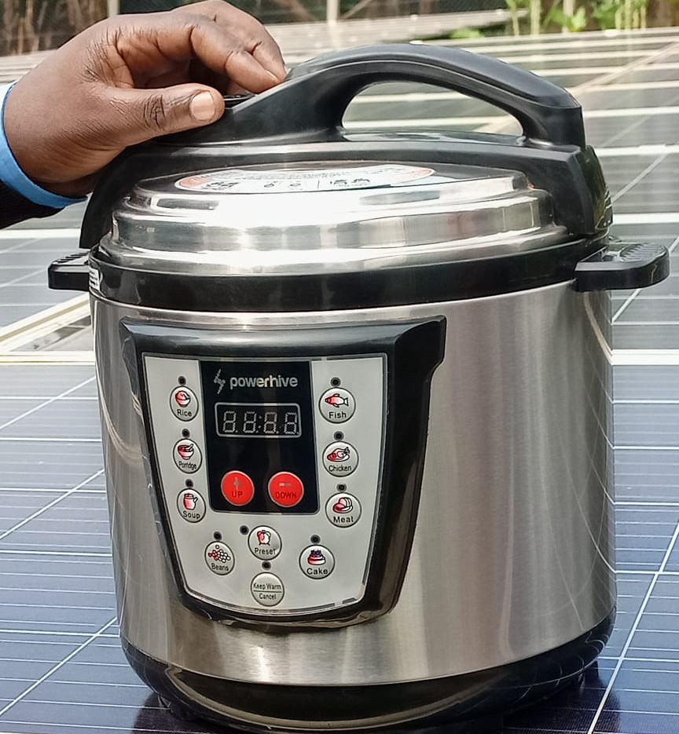
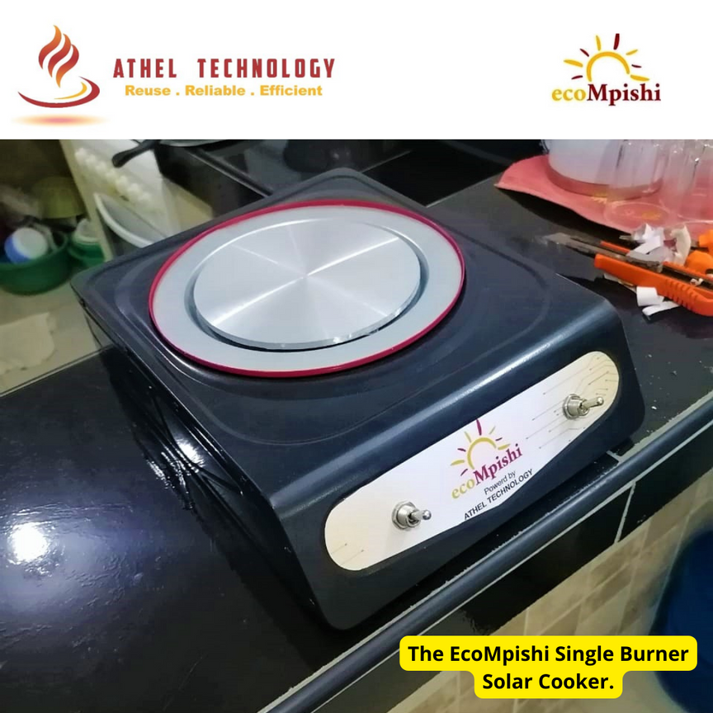
eCooking projects in Kenya
Selected Cooking projects in Kenya
SNV Institutional eCooking Pilot
Turkana County
Pika na Power, eCooking Demo Center
Nairobi County
County eCooking Hub Launches
Kakamega, Nakuru, Kisumu, Makueni, Kitui Counties
PowerHive pilot EPCs on solar hybrid MGs
Kisii County
Athel Tech. Solar eCooking
Mombasa County

Slide 6












































Building momentum in Kenya’s emerging eCooking sector
2016
2017
2018
2019
2020
2021
2022
2023

Slide 7



Examples of how the narrative has changed
ICS -> multi-fuel strategy
eCooking CoP
ICS -> higher tier
eCooking taskforce (CC+EA)
eCooking & eMobility key drivers of demand growth

Slide 8

Converting existing expenditures on charcoal into electricity unit sales offers a lucrative additional revenue stream for KPLC
*
Residential charcoal market
KSh 68 billion/yr
KPLC domestic customer revenue
KSh 46 billion/yr
“Data on weekly charcoal expenditure collected from responding households indicates that the annual market value of charcoal consumed by the residential sector alone is KES 68 billion* almost 40% more than what all domestic customers paid to Kenya Power in 2018 (according to Kenya Power’s annual report)” (MoE, 2019)
*38 billion KSh/yr in 2018 rising to 46 billion KSh/yr in 2022 (Kenya Power, 2022)

Slide 9

eCooking key area of demand growth for KPLC, but cost of power critical for uptake
“The business case for clean cooking using electricity is stronger considering the cost of fossil fuels has risen and efficiency for electrical appliances has increased.”
“It is expected that use of charcoal and kerosene for cooking will decrease while adoption of electricity for cooking will rise as electricity access increases and cost of power becomes more competitive.”
“Cognisant of this, we are working with various partners to drive the uptake of energy efficient cooking appliances such as induction and Electric Pressure Cookers (EPCs).”
(Kenya Power, 2022)

Slide 10
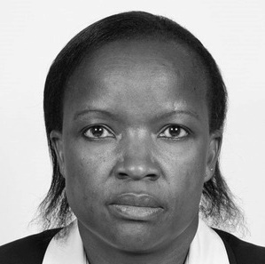

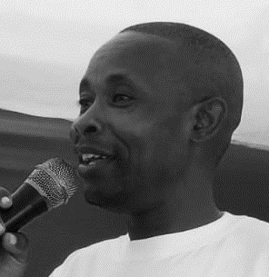
Key changemakers
Dr. Faith Wandera
Deputy Director of Renewable Energy, Ministry of Energy
Irene Wanjohi
Principal Customer Relations Officer, Kenya Power
Danson Ligare
Chair, KCREN & CEO, EPBP Ltd.

Slide 11
Spotlight on key activities
Clean Cooking Strategy
eCooking Strategy
eCAP
eCooking CoP
Electricity tariff review
AfDB

Slide 12















Kenya National Clean Cooking Strategy (KNCCS)
MoE target of Universal Access to Clean Cooking by 2028
Clean Cooking Strategy
Financing for implementation of strategies
Other studies (ICS, LPG, biogas, alt. fuels, cooking in institutions/businesses, consumer/enterprise financing)
eCooking Strategy
eCooking Study
eCAP

Slide 13




eCooking Study & Strategy
eCooking Study
eCooking Strategy
Status quo & future potential of eCooking in Kenya
Stakeholder workshops
Household survey
Key informant interviews
Sets out contribution of eCooking towards 2028 target of universal access
Integrated energy planning
Scenario modelling
Roadmap of activities
Mainstreams GESI
Investment prospectus
75% of kenyans now have access to electricity
3% own an ecooking appliance, <1% cook primarily with electricity

Slide 14
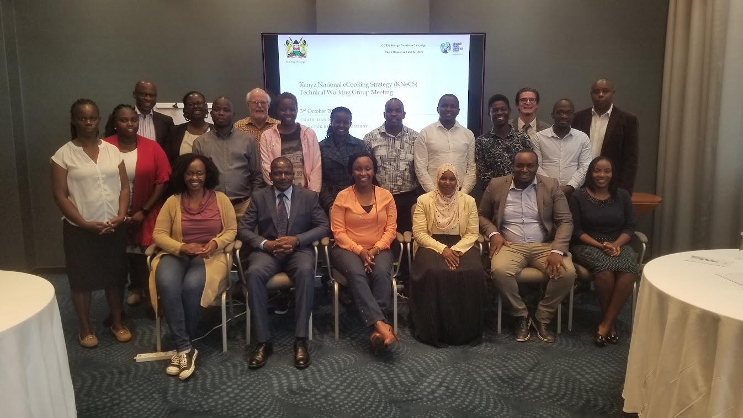

Slide 15



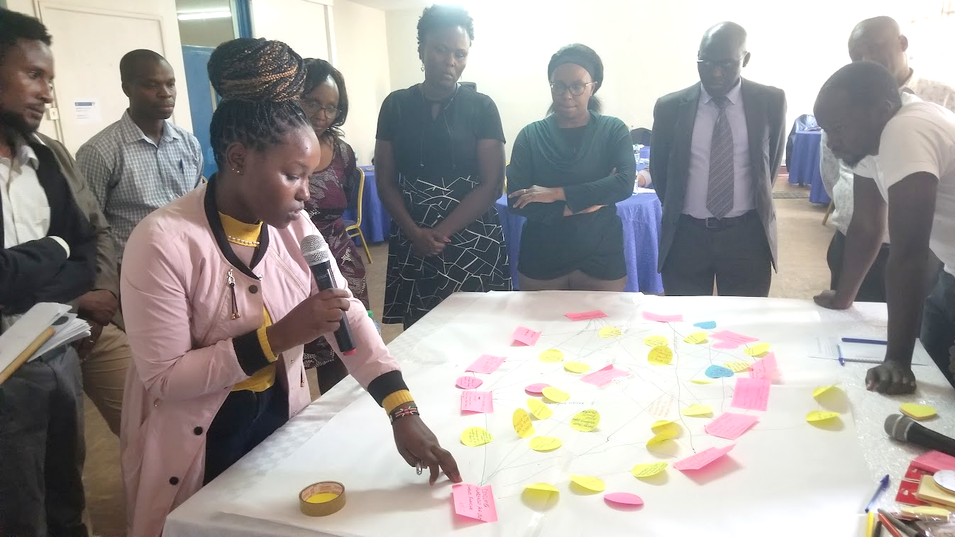
eCAP – eCooking Capacity Building & Market Development Programme
Objective: to build capacity of key market actors & drive forward the development of a sustainable eCooking sector in Kenya by:
  Developing institutional capacity within Kenya Power
  Designing & implementing a pipeline of scalable activities aligned with the Pika na Power campaign & eCooking Strategy
  Empowering a network of eCooking Champions by bringing together Kenya’s clean cooking & electricity access sectors
  Generating evidence to inform Kenya Power’s Board of Directors on the role of eCooking in demand stimulation & increasing the social impact of electricity access

Slide 16
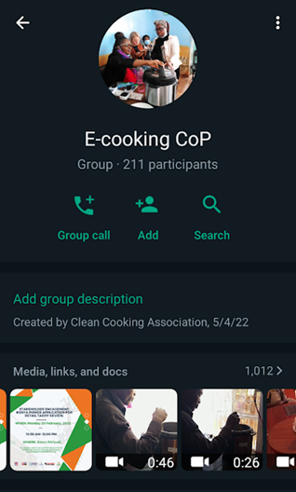
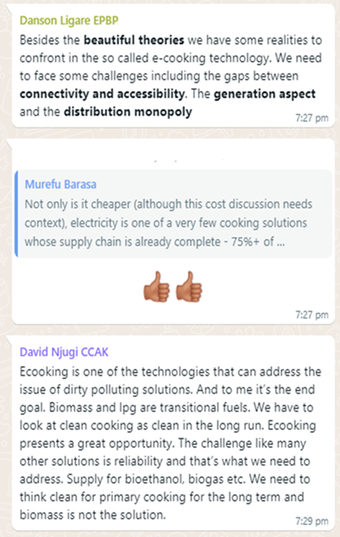
eCooking Community of Practice (CoP)

Slide 17
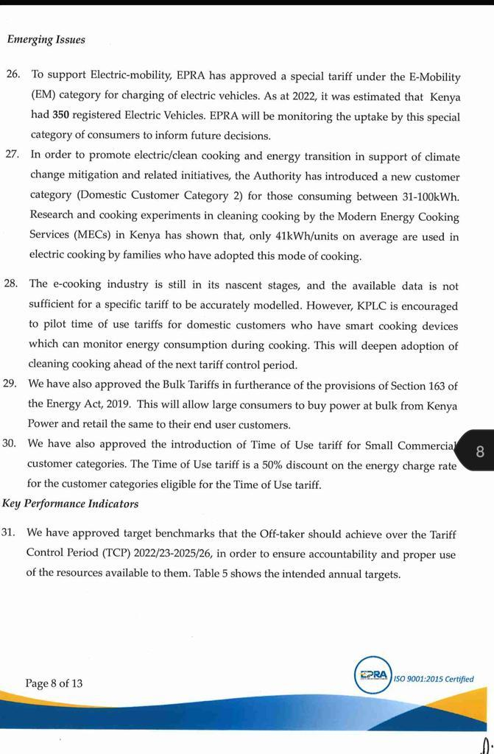
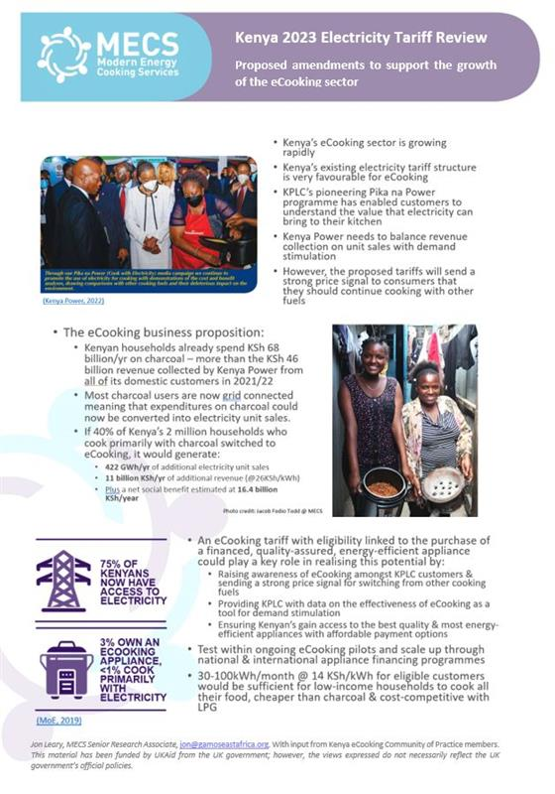
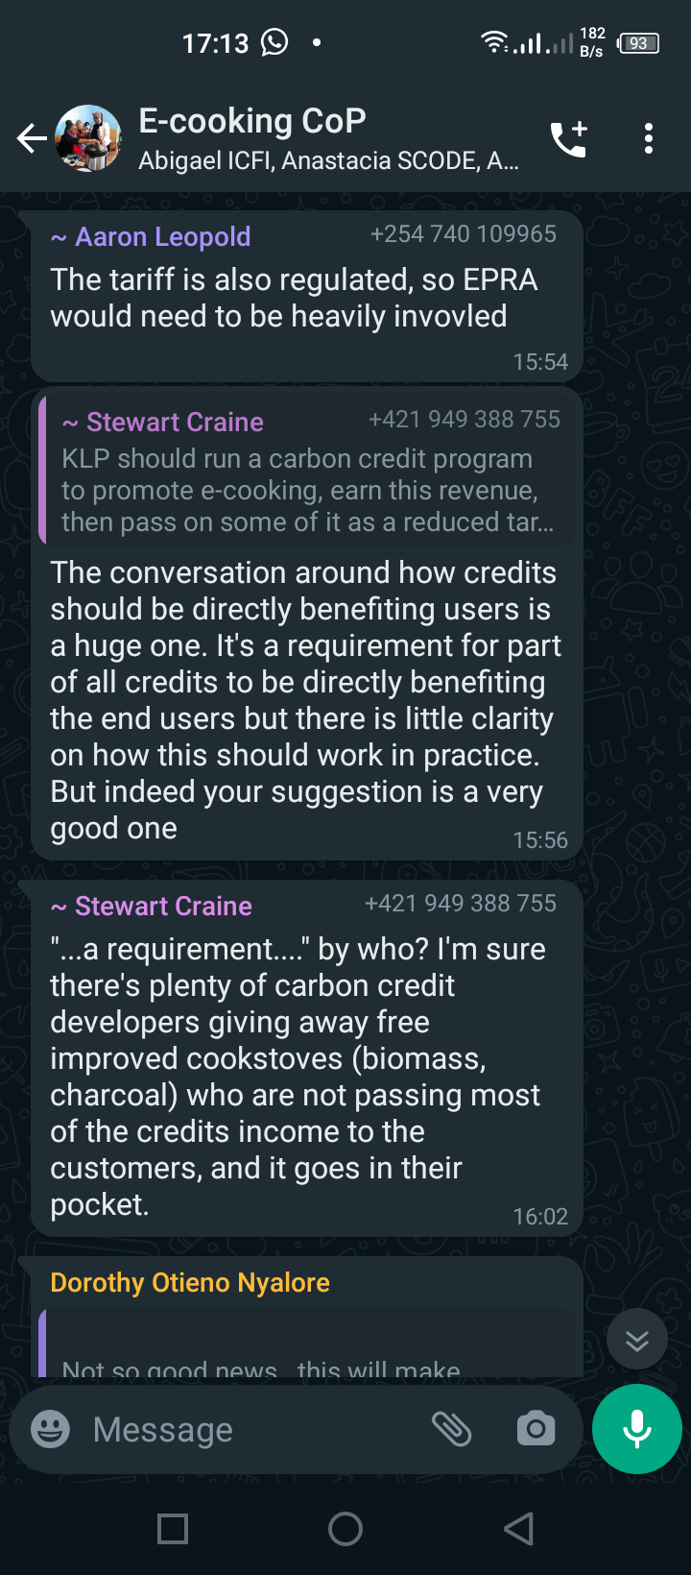
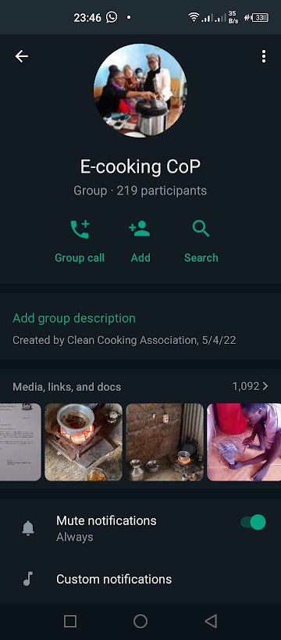

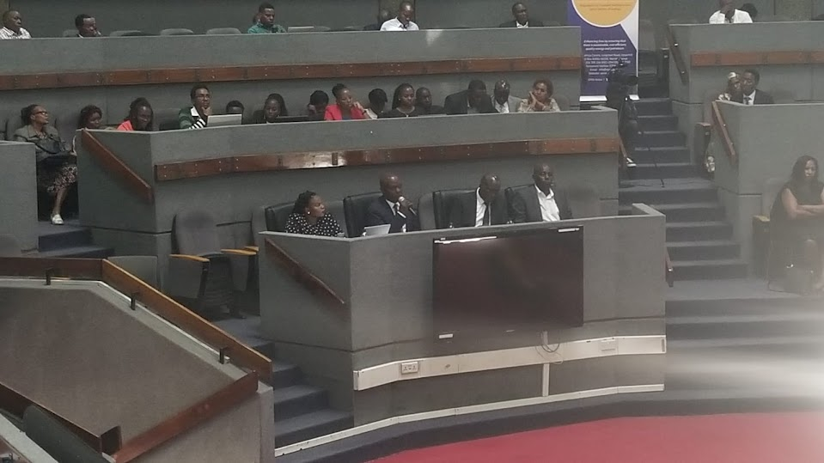

2023 electricity tariff review
+
=
+

Slide 18
AfDB
IDEV’s (2022:9,30) independent impact evaluation of the first phase of the AfDB-supported LMCP highlighted the limited impact on women and girls and the risks of supporting further grid extension without integrating demand stimulation.
  The evaluation concluded that “the project had a positive impact on the time women spent on leisure activities but no impact on women’s empowerment.”
  Moreover, “the LMCP was not found to improve the respiratory health or the subjective well-being of beneficiaries…This finding suggests that access to grid electricity may not have changed the cooking technology choice of LMCP households given the high cost of buying and using electrical appliances for cooking.”
  What is more, “…the sustainability of the development outcomes of the project was found to be highly unlikely in the near term…” due to a variety of factors including “low electricity consumption resulting in low revenues for the utility which is attributed to low income of the beneficiaries.”.
It is clear from these findings that the opportunity to generate more revenue for KPLC whilst simultaneously improving quality of life for women and girls by breaking down the upfront cost barrier for energy-efficient eCooking appliances holds the potential to significantly increase the breadth and sustainability of the development outcomes of the next phase of LMCP.

Slide 19
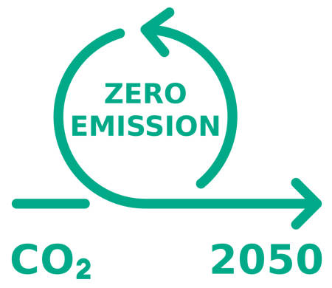






What does the future look like?
eCooking enables Kenya to meet its net-zero target ahead of 2050?
EPRA launch new energy-efficiency labelling for eCooking appliances?
eCooking & eMobility become KPLCs largest revenue streams?
Kenya Power take out loan from World Bank to roll out 1,000,000 financed eCooking appliances?
ATEC & Burn Manufacturing merge to become leading supplier of eCooking appliances on the continent?
Clean Cooking Delivery Unit champions eCooking as a key component of a multi-fuel strategy?
eCooking recognized as key enabler in Kenya’s achievement of universal access to clean cooking?
EPRA approve eCooking tariff for smart-metered appliances?
2024
2025
2026
2027
2028
2029
2030
2050

Slide 20
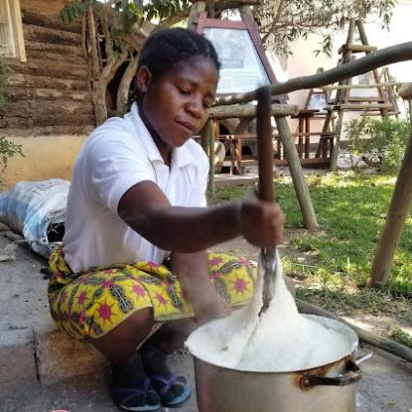


What does the future look like?
Our role in facilitating this transition
  Coordinate resource mobilisation to facilitate the growth of Kenya's emerging eCooking sector
  Develop shared spaces to facilitate the convergence of Kenya's electricity access and clean cooking sector
  Responding to invited contributions for policy development
  Document Kenya's transition & facilitate South-South collaboration to support other countries following similar pathways
Clean cooking
eCooking
Electricity access

Slide 21
Open discussion
How can we effectively facilitate South-South learning around eCooking?

