Slide 1
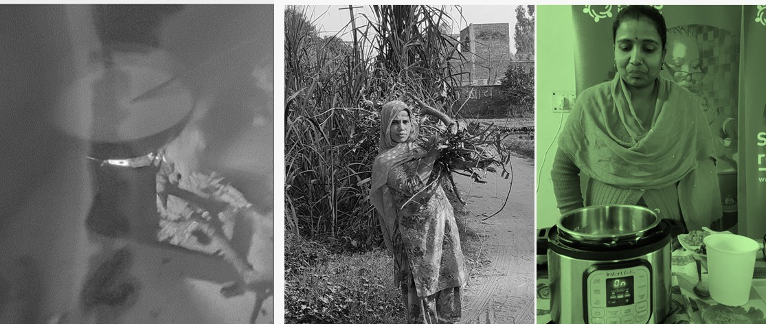
MECS Programme in India
In Country Partner -India

Slide 2
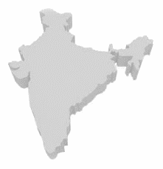
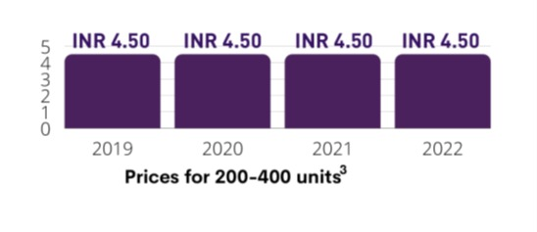
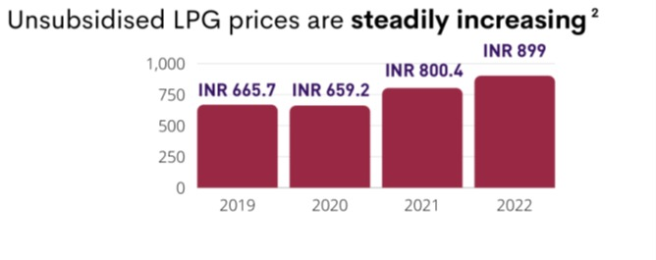
India’s transition towards clean cooking
Cooking with Traditional Fuels
India’s Shift to Clean Cooking
Switch to Modern Fuels for Cooking
Under the PMUY Scheme 99% LPG coverage in April 2021 from only 62% in 2016² & Phase II launched
Installed power capacity in India – 416 GW (43% is from RES)
GO ELECTRIC Campaign
ETAC’s Report – 25% of HHs to use electricity for cooking by 2030
BEE’s Star Labelling Prog for Induction Cookstoves
5% penetration of e-cooking devices in Indian households
Leads to poor air quality and 4% of India’s greenhouse gas emissions
Increased respiratory infections and premature deaths
Causing 0.48 M premature deaths
Issues of cylinder refills
India imports over 55% of its LPG requirement²
Notes:
Transition to clean cooking has been the priority of governments globally and India is no exception
India’s biggest push came through LPG however, we all are aware about the issues of the same
Cost of LPG has shown a consistent upward trend
However electricity prices have been very stable across years
Cost of Solar, Battery especially with PLI will be reduced
India has achieved remarkable improvement in recent years in the provisioning of electricity access through the GoI Flagship scheme such as
Rajeev Gandhi Grameen Vidyutkaran Yojana (RGGVY)
Deendayal Upadhya Gram Jyoti Yojana (DDUGJY)
Integrated Power Development Scheme (IPDS)
Ujwal DISCOM Assurance Yojana (UDAY) and
Sahaj Bijli Hra Ghar Yojana (SAUBHAGYA)

Slide 3
Improvement in Access to Electricity in India through Government Initiatives
India has achieved tremendous improvement in recent years in the provisioning of electricity access through the central Govt’s Flagship schemes, such as:
Ujwal DISCOM Assurance Yojna (UDAY): A Central scheme by Ministry of Power (MoP), Govt of India, launched in November 2015, with a vision to provide affordable and accessible 24×7 power to all.
Sahaj Bijli Har Ghar Yojna (SAUBHAGYA): A Central scheme by Ministry of Power (MoP), Govt of India to provide energy access to all by last mile connectivity and electricity connections to all remaining un-electrified households in rural as well as urban areas to achieve universal household electrification in the country.
Revamped Distribution Sector Scheme (RDSS): A Central scheme by Ministry of Power (MoP), Govt of India to help Utilities/DISCOMs improve their operational efficiencies and financial sustainability by providing result-linked financial assistance to Utilities to strengthen supply infrastructure based on meeting pre-qualifying criteria and achieving basic minimum benchmarks. The scheme has a budget of GBP 300 bn for 5 years i.e. FY 2021-26.
GO Electric: A Central scheme by Ministry of Power (MoP), Govt of India and Ministry of New and Renewable Energy (MNRE) Govt of India launched in February 2021. The objective of this campaign is to create awareness among masses about benefits of switching over to Electric Cooking (eCooking) and EVs, including various initiatives taken by Centre & State Governments to enhance acceptability of Electric Vehicles, and Electrical Cooking. This is implemented by Bureau of Energy Efficiency (BEE)
Govt initiatives to ensure 24x7 Power Supply: Ministry of Power (MoP), Govt of India is working on primary responsibility of providing 24x7 power supply to all consumers lies with the concerned Power Distribution Companies (DISCOMs) even in rural areas
This provides a good opportunity to integrate e-transition in the Indian household for cooking purposes.
Notes:
-India has achieved tremendous improvement in recent years in the provisioning of electricity access through the central Govt’s Flagship schemes comprising of UDAY, SAUBHAGYA, RDSS, GoElectric, etc.
-These schemes have major objective of providing uninterrupted power access to urban as well as rural India.
-With the launch of Go electric campaign awareness among masses about benefits of switching over to Electric Cooking (eCooking) the transition to cleaner fuels is initiated at a larger pace.

Slide 4
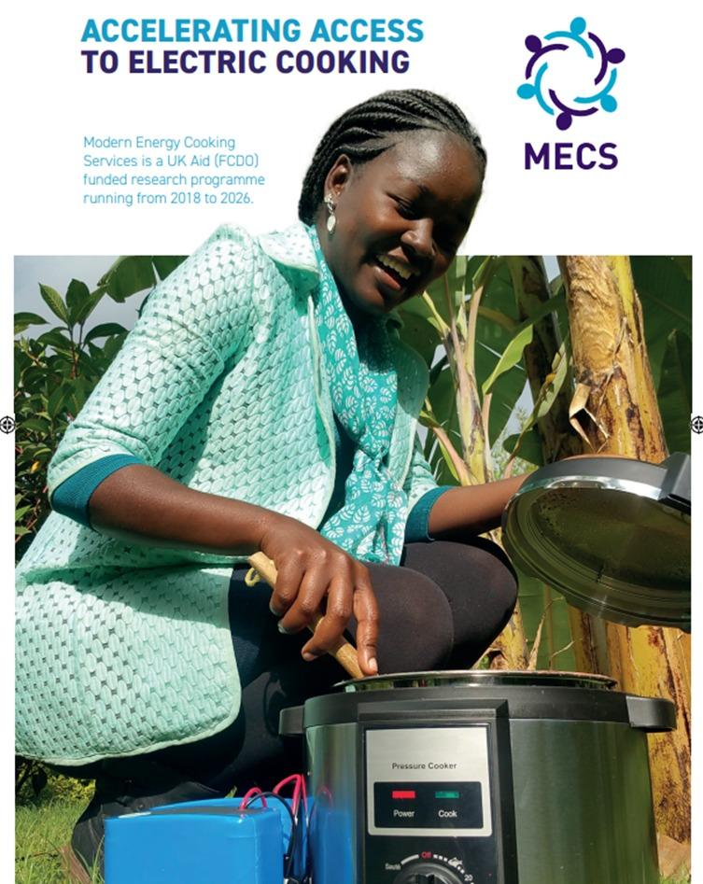
Modern Energy Cooking Services (MECS) Programme
In seeking to spark a new approach to clean cooking, the programme researches the socio-economic realities of a transition from polluting fuels to a range of modern fuels.
Whilst the research covers several clean fuels, the evidence is pointing to the viability, cost-effectiveness, and user satisfaction that energy-efficient electric cooking devices provide
Finovista is In Country Partner for the MECS Programme in India. It is an Indian consulting firm working in areas of
In-Country Representation, Project Management Consulting, Technology Transfer and Capacity Building

Slide 5
MECS Research globally shows…..
Significant progress has been made in access to electricity in the last decade
There has been significant investment in infrastructure for electricity access.
There is an urgent need to decarbonise
There have been significant gains in the energy efficiencies of cooking devices
Cooking with electricity is cost effective in many contexts and saves the household money
Cooking with electricity is also cost effective for small business food processing, institutions, and humanitarian contexts
Match between electric cooking and tasty food
Open to other research and approaches that include other fuels
Notes:
We all know that there is considerable efforts and money spent globally to ensure access to electricity
Despite the access there is very less reliance on electric cooking
There are several reasons for the same:-
Lack of evidence
Efficient devices
Consumer awareness
MECS Research across multiple countries shows that households and even small businesses can make substantial savings and gains, when cooking with electricity
Food cooked with electricity is tasty
A range of dishes can be cooked with electricity

Slide 6
Supply Chain
Consumer
Enabling Policy
Building Evidence
Market Development
Capacity Development
India eCookbook
Finance
Investor Pitching & Connect
EESL revolving fund
Entrepreneurship Development Programme
Innovation Challenge
Large Scale Deployment
Device Standards & Labelling
Talk Series –Phase 1 & 2
Modern Energy Cooking Forum 2022
Consumer Behaviour & Demonstration
Electric Cooking Promotion
Policy
Major Initiatives - MECS In India
100% Cooking with Electricity
Clean energy access for cooking for street food vendors
Evidence based Research in Clean cooking with NIAS
Market Access Support to Domestic Manufacturers
Exhibition on Modern Energy based Clean Cooking Technologies

Slide 7
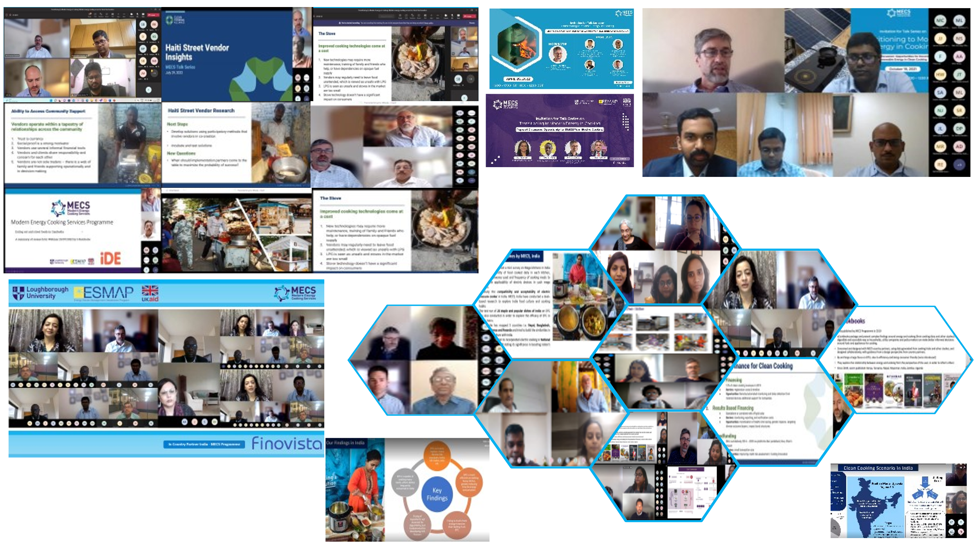
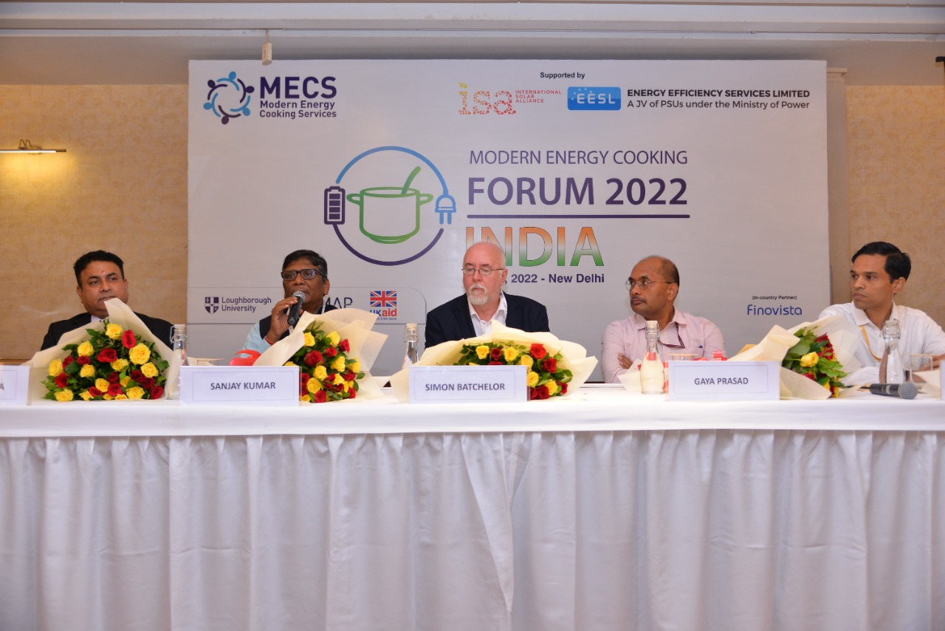
Electric cooking Platforms
TALK SERIES - A global virtual platform that brings together the key stakeholders to initiate discussions on aspects that are critical to enabling the Shift to Modern Energy based solutions for clean cooking
1400+ Attended
Also, MECS in India has made efforts and build up a WhatsApp community comprising over 150 participants belonging to various domains of the clean cooking sector.
1700+ Registrations
12 Sessions Phase 1 & 8 Sessions Phase 2
Modern Energy Cooking Forum-2022
After success of Forum 2022, MECS programme In-country partnership with Finovista bring the Modern Energy Cooking Forum 2023 on 27th October 2023 with more discussion, new ideas and approach towards clean cooking.
1’st of it’s kind globally
Discussion on future of clean cooking energy
Discussion on how to enable modern energy based clean cooking
Exhibition on modern energy cooking technology/solutions
Notes:
Talk series is an important tool of the MECS programme in India which establishes a platform for promoting modern energy and clean cooking services by bringing together stakeholders from modern energy cooking and allied sectors and discuss the most pertinent issues critical to transitioning to the clean cooking sector.

Slide 8
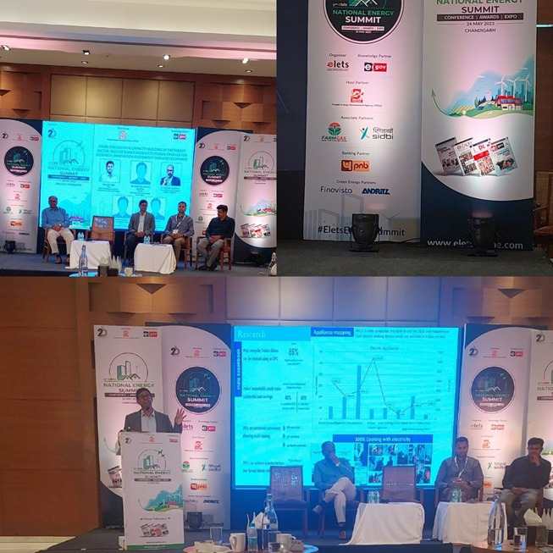
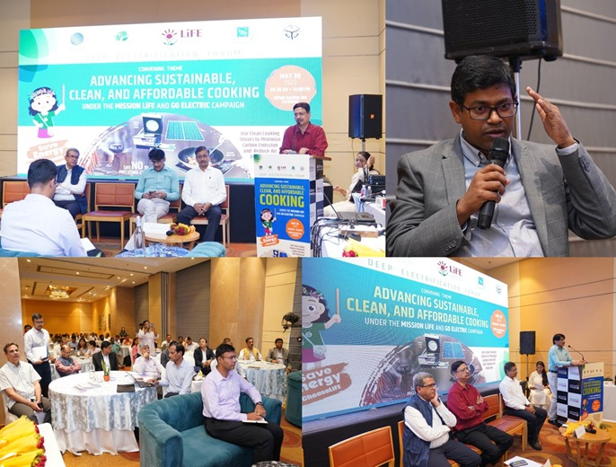
Work with States:
Department of Environment, Forest & Climate Change (DoEFCC)
Punjab Energy Development Agency
MECS in India participated in the forum organised by the Department of Environment, Forest & Climate Change (DoEFCC), Government of Uttar Pradesh (GoUP), in collaboration with Vasudha Foundation on 30 May 2023 in Lucknow, India under the Mission LiFE (Lifestyle for Environment) initiative. MECS participated as a speaker.
The 5th National Energy Summit, organised by Punjab Energy Development Agency (PEDA) in collaboration with the Elets Technomedia , was held on May 24, 2023 in Chandigarh, Punjab, India. MECS participated as Partner; Exhibition with Live Demo and a speaking slot.
Notes:
The Summit provided a forum for stakeholders to exchange ideas, explore partnerships, and collaborate on innovative solutions to address the challenges facing India's energy sector.
New business opportunity from the clean cooking sector has been proposed by PEDA, UP and Kerala.

Slide 9
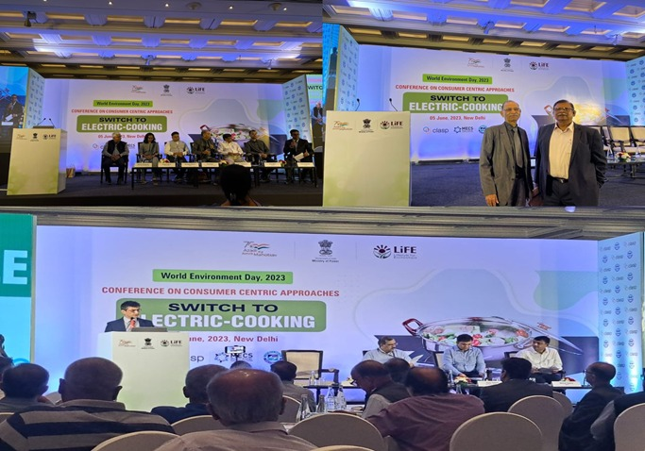
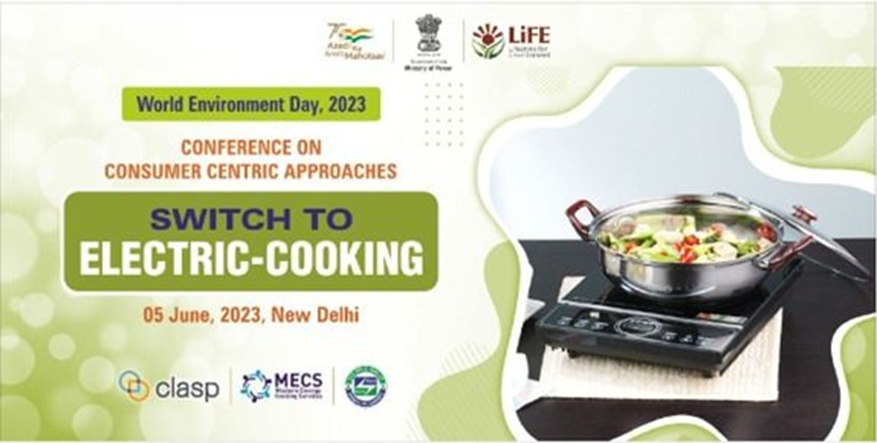
Work with BEE
On World Environment Day on June 5, 2023, Finovista participated in a conference titled "Consumer-Centric Approaches for E-cooking Transition, at New Delhi by the Bureau of Energy Efficiency (BEE), in collaboration with CLASP.
The event brought together institutional consumers, consumer research groups, policy makers, think tanks and manufacturers in a discussion on strategy for accelerating transition to electric cooking.
The transition towards energy-efficient and affordable eCooking solutions is a necessary due to concerns of environmental impact of traditional cooking methods and the rising price of LPG.
The participants engaged in dialogue and explained ideas on strategies for the transition to electric cooking. We suggested speaker Mr Anil Desai, Proprietor, Flame O Nil presented innovative solutions to make eCooking accessible to all, and emphasized that e-cooking is the need of the hour.
2.6th Talk Series was organized by the Modern Energy Cooking Services (MECS) Programme, in partnership with CLASP through its In-country partner - India, Finovista.
Notes:
During this workshop Ad. Sec Power stated that, E-cooking is going to be the future of the Indian kitchen, need Affordable Business Models
Also Finovista had organised their 6th Talk on Start labeling programme for induction cook stove with collab CLASP
Soon to organise a National level roundtable over the standard star labeling of Induction cook stove with BEE And CLASP

Slide 10
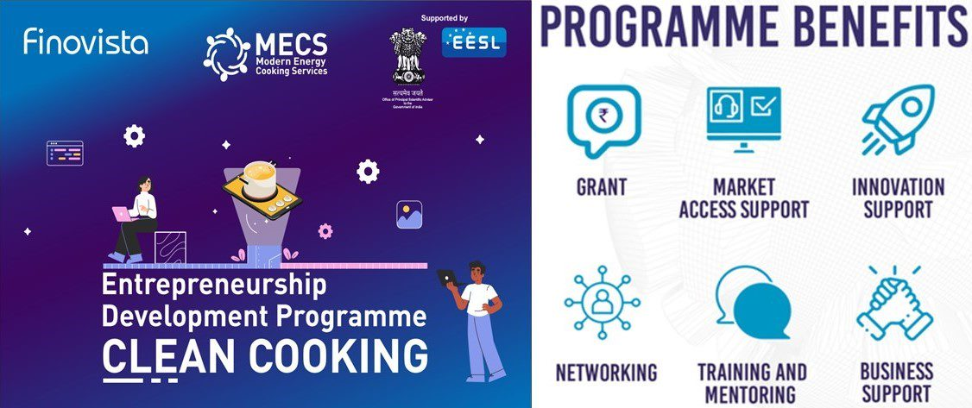
Work with Manufacturers
India's 1st Entrepreneurship Development Program In Clean Cooking. Supported by Office of Principal Scientific Advisor to Government of India(PSA) and Energy Efficiency Services Ltd (EESL)
The programme Supported Electric, Solar PV, Battery, Hybrid Solutions for Clean cooking
Exhibition on Modern Energy based Cooking Technologies/Solutions
6 Weeks of Multi-Disciplinary Training
Certificate
Coffee Table Book
29 Applications
Top 13 Entrepreneurs
Top 3 Entrepreneurs
INR 2.5 Lakhs Grant each
1-to-1 Mentoring
Workshop for Business Pitching
Applications were shortlisted through Expert Committee Group
Notes:
shortlisted 13 potential entrepreneurs at Stage I ---- provided training sessions (6 weeks) ---developed skills and capacity.
selected top three entrepreneurs at Stage II ----- gave a financial grant of up to INR 2.50 lakhs and one-on-one mentorship.
Outcomes: Aarti Kanodia – Real Flame has been connected widely within India and with global opportunities for supply of EPCs and Induction Cookstove
Rudra Solar – Was able to generate commercial loan for INR 25 Lakhs with our mentoring support

Slide 11
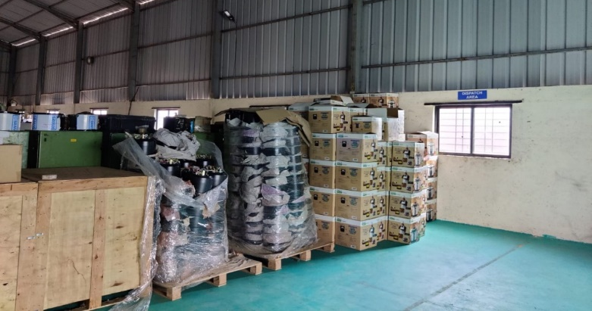
Work with Manufacturers …….Contd
MECS in India, has been closely working with Device manufacturers on capability building. In 2020, Indian Start-up brand “AUFLA” received the “Global Leap Award”
MECS in India, has worked closely with Aufla, under capacity building efforts and also helped them with required statuary
compliances and certifications.
Through the programm’s intervention, Aufla has been successful in setting and scaling it’s manufacturing capabilities and is ready to service large-scale domestic and international orders. Can service an order capacity of 5000 EPCs/Per Month
Recently, the brand has built up it’s capacity as an OEM and is in discussion with leading India Brands for their white labelling.

Slide 12
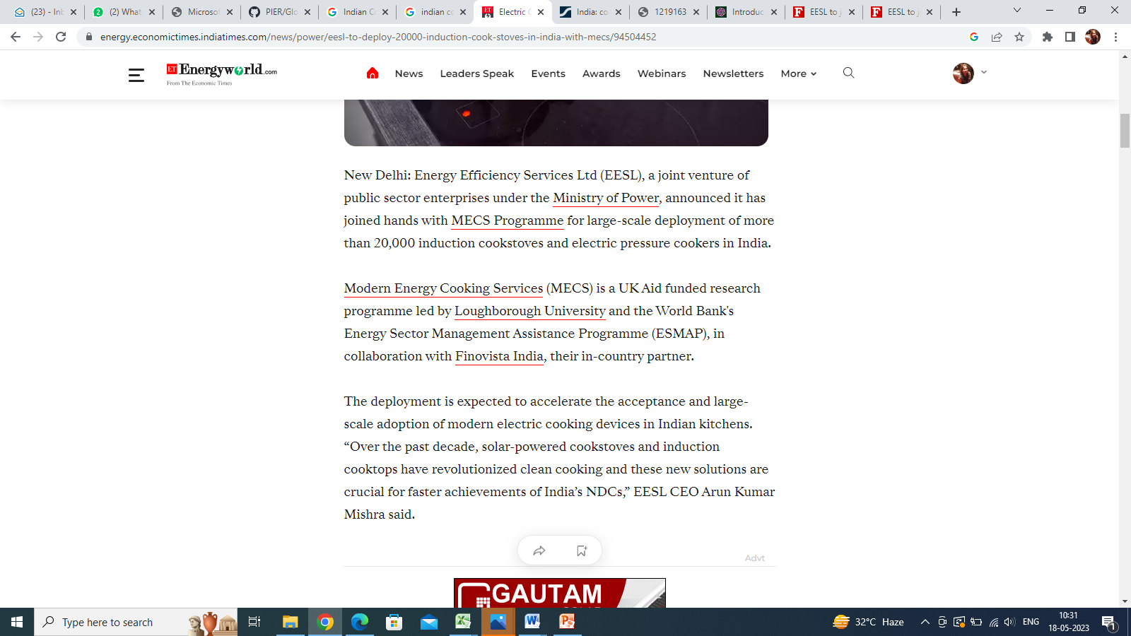
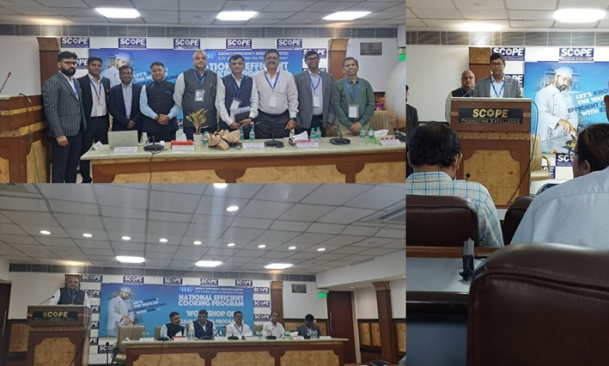
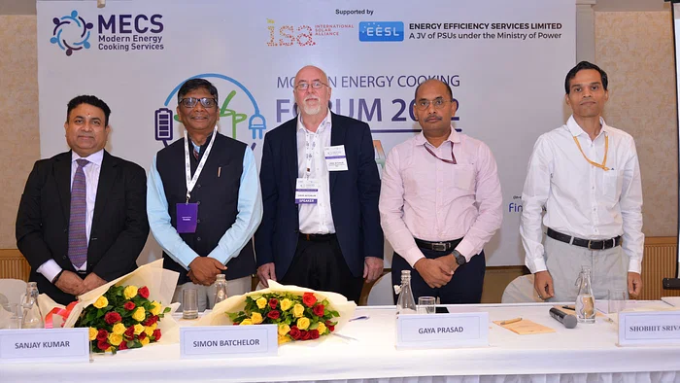
Collaboration with EESL – Demand Creation & Market Development
MECS In- Country Partner Finovista participated in Energy Efficiency Services Limited (EESL) Pre-launch of National Efficient Cooking Programme (NEEP), EESL recently hosted a stakeholder-consultation workshop with leading manufacturers and solution providers in the clean cooking space in India on 19 May 2023 in New Delhi, India.
The workshop aimed at facilitating knowledge exchange and discussions on state-of-the-art technologies in the clean cooking space, and also to explore the pathways to enable widespread adoption of energy efficient cooking appliances like induction cookstoves and induction-based pressure cookers, while also making them affordable and accessible to all.
Notes:
Mr Vimal Kumar, In Country Lead, MECS Programme India attended the workshop and gave a Presentation entitled “Sparking a cooking revolution: Catalyzing India’s transition to Clean electric cooking”.
Soon EESL and MECS are going for deployment of 20k Inductions and 5k EPC on Pan India basis
Jointly EESL and MECS is organizing a manufactures’ stakeholder meeting for generalisation of technical specs. Of EPC and Induction.

Slide 13
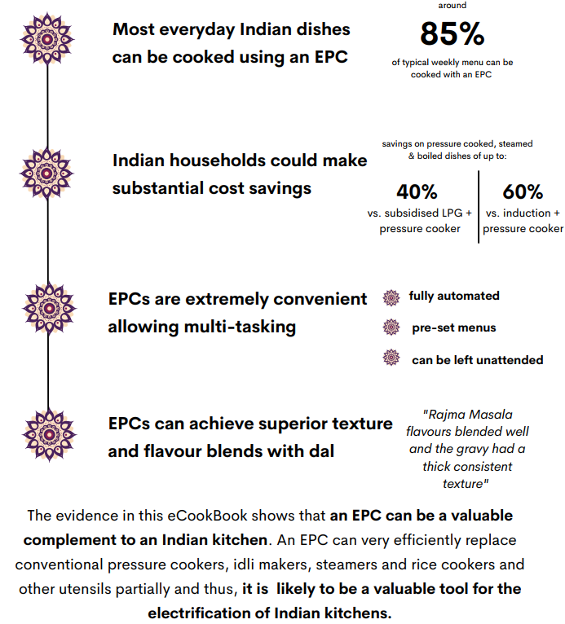
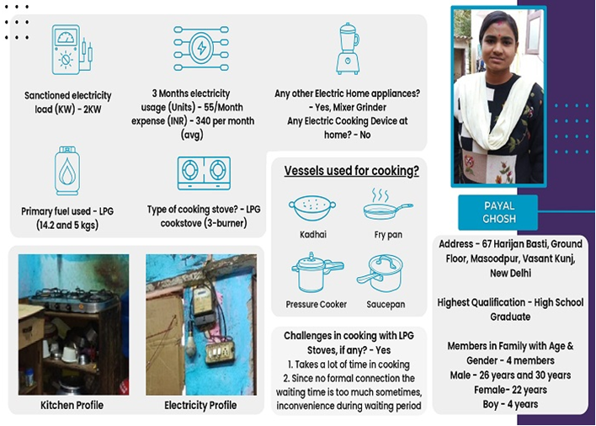
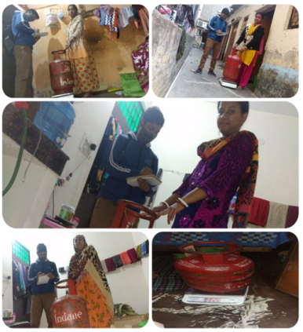
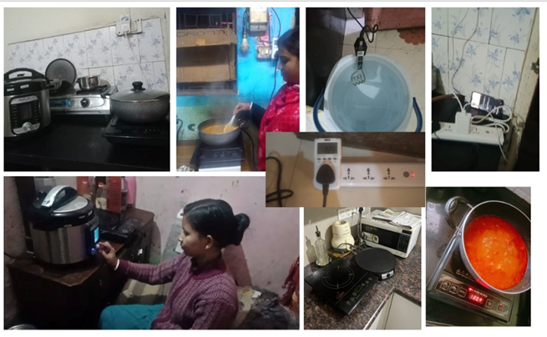
Research
Appliance mapping
MECS in India conducted this study in Oct-Dec 2022 and mapped over 650+ electric cooking devices which are available in Indian markets
India ecookbook
100% Cooking with electricity
Notes:
This is the overall impact in India, in some direct and some may be indirect
We started to talk about electric cooking in December 2019 with
Zero acceptance towards electric cooking
Handful of electric cooking devices available
Devices companies did not use to focus on electric cooking segment
Go electric campaign launched in 2021
A wide range of variety of electric cooking devices
Start-ups and new brands emerging
Built a strong evidence that a range of Indian dishes can be cooked on EPC device

Slide 14
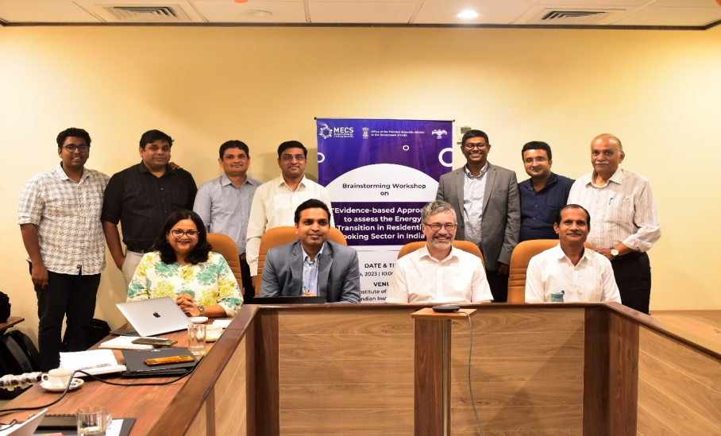
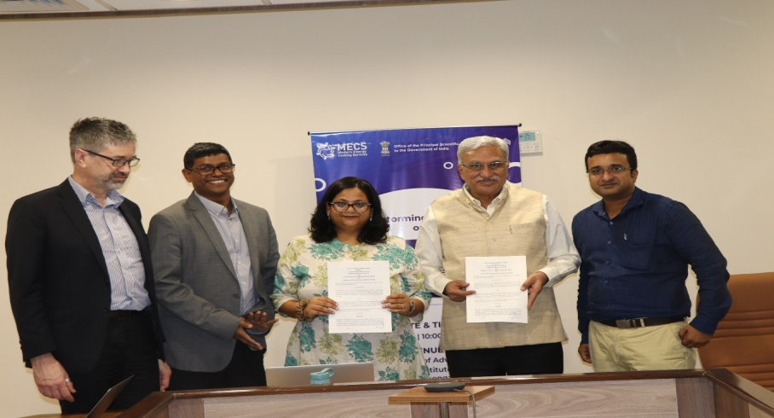
Work with NIAS- Baseline assessment and perception study for Electric cooking
The aim is to identify the feasibility of transitioning from traditional cooking practices to electric cooking in selected areas to further help in developing policies related to the same.
An interactive brainstorming workshop on the theme “Evidence-based Approach to Assess the Energy Transition in the Residential Cooking Sector in India” was conducted at (NIAS), IISc campus, Bengaluru on 14 March 2023.
Formal Release of NIAS-Finovista MoU during Brainstorming Workshop
Salient points based on the workshop’s recommendations were drafted in a easy to understand form. The research methods for the baseline survey is revamped.
Notes:
Considering field survey and the time needed for data analysis, a project can be taken up for a period of 18-24 months. About 1800-2000 low-to-medium income households across the two areas identified (in West Bengal and in Karnataka) would form the sample pool
Contract with NIAS is secured with Finovista
Pilot surveys are planned to be conducted in the NIAS neighborhood

Slide 15
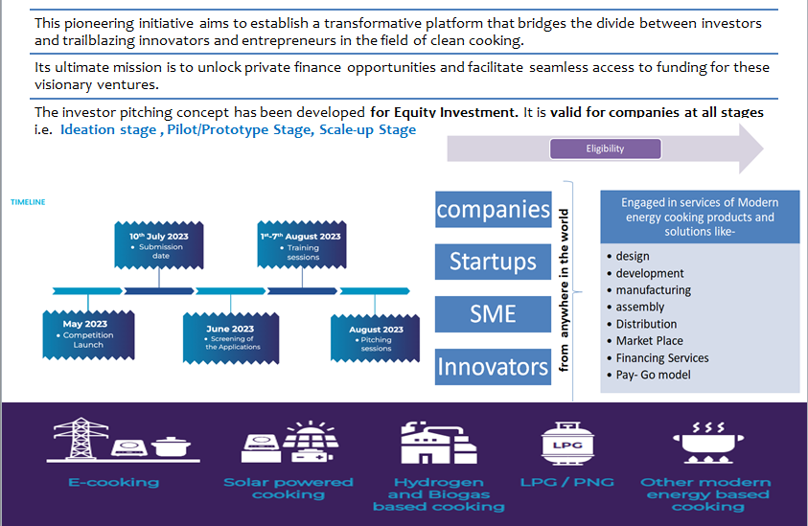
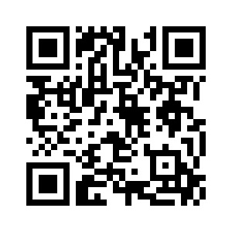
Access to Funds for Clean Cooking – Cook Clean | Pitch Green
An initiative for linking Investors and Businesses to facilitate capital raising in Clean Cooking
Access to Funds for Clean Cooking
Apply Now

Slide 16
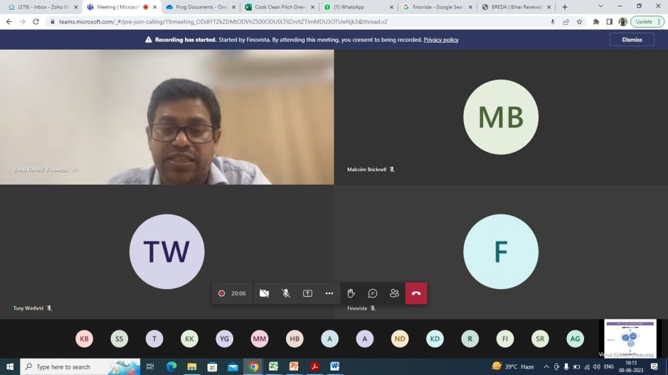
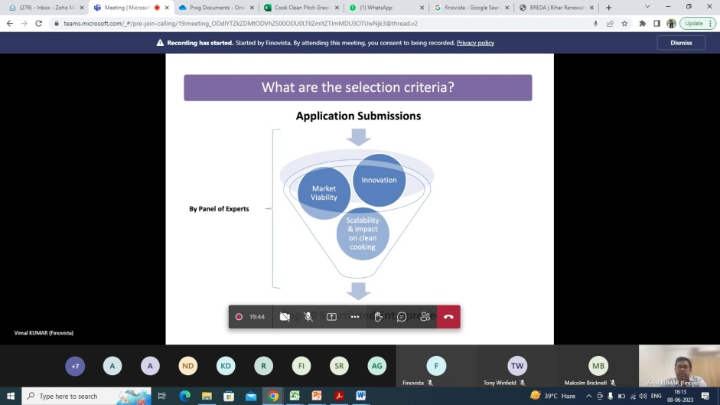
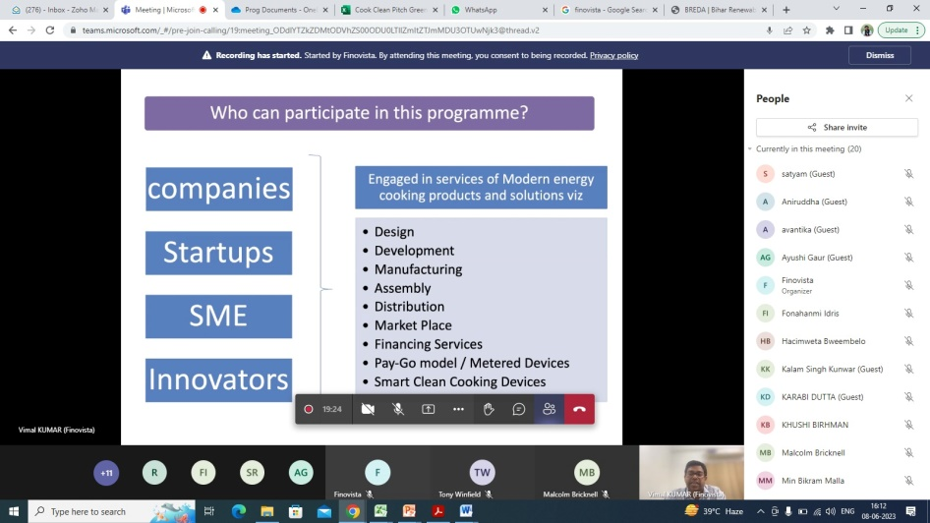
Access to Funds for Clean Cooking – Awareness Webinar
Finovista conducted an awareness webinar on 8th June 2023 at 11am IST Virtually. The webinar explained comprehensively the key facets of the Investor Pitch and Connect programme in clean cooking 2023 and addressed the queries and concerns of the participants.
Timelines associated with project submission and commencement
Eligibility criteria
Training processes
Networking opportunities with investors and innovators
The key facets of the programme include:-

Slide 17
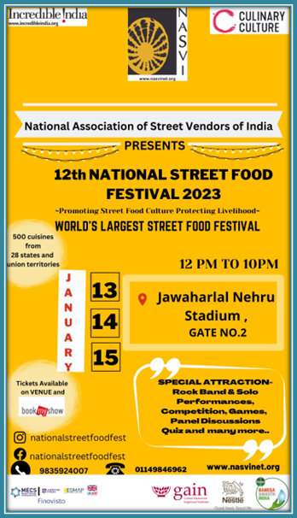
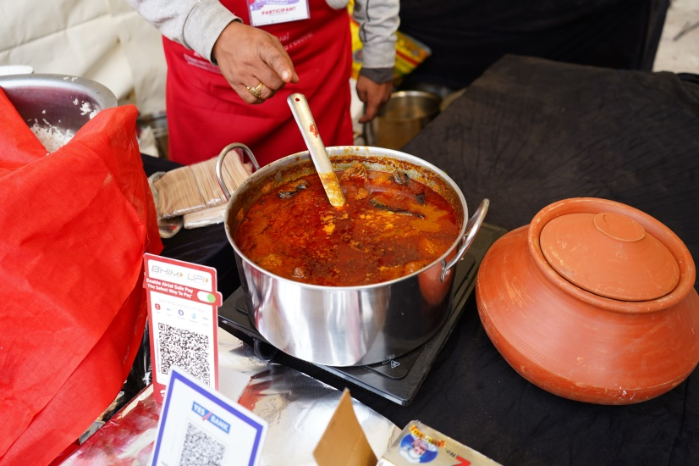
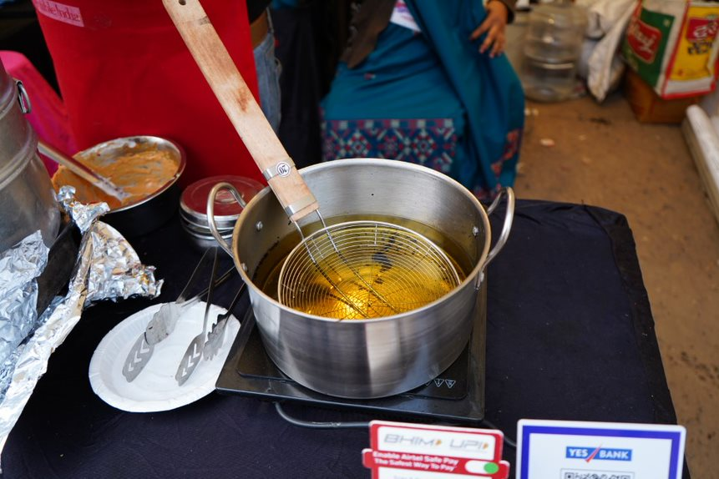
Work with focused communities - Street Food Vendors
MECS Programme in India, partnered with National Association of Street Vendors of India (NASVI) and sponsored for its 12th National Street Food Festival held in New Delhi between 13 – 15 January 2023
Electric-based cooking was deployed in 20 selected food stalls at the festival.
Food stalls were selected on the basis of the feasibility of using electric induction cooktops-
An introductory training was given to 60 selected vendors (20 stalls x 3 vendors each) to make them understand the usage of electric cooking, its benefits
Supported in providing induction-based utensils for these vendors
Notes:
-Finovista also partnered with NASVI to create to do a small -scale pilot study for 20 Street food vendors in the National Street Food Festival 2023 to test the feasibility of cooking with electricity.
-An introductory training was given to 60 selected vendors (20 stalls x 3 vendors each) to make them understand the usage of electric cooking, its benefits

Slide 18
Other Initiatives
Promoted the concepts of ISECooking (Insulated Solar Electric cooker), developed by Prof Pete Schwartz to over 100 companies in India
Contributed to EESL for finalisation of tech specification / EoI for business model on Solar based cooking with Carbon Finance . Wide Promotion of EESL’s EoI through our portal, newsletter, mass-mail etc. Connected EESL and CCA’s Shrikant Avi for discussion for EESL’s Solar Cooking EoI
The EOI by IIT Bombay on the procurement of Induction Cookstoves was promoted widely and a listing of the same was created on the Manthan Platform. Also, mass emails were sent by the Manthan Platform for the same.
Connected Mondragón Componentes / Aufla / Real Flame / Centro Stirling on eCooking components

Slide 19
Future Initiatives
Electric Cooking Demonstrations and Awareness Creation
To raise awareness about the benefits of electric cooking, including its convenience, safety, and environmental benefits. To demonstrate the ease of use and efficiency of electric cook stoves and induction cooktops. To encourage consumers to adopt electric cooking as a clean and sustainable alternative to traditional cooking methods. The activities will include live demonstrations, product displays and interactive session with the audience.
Tasting Festival- For Food cooked using modern energy cooking devices
To bust the myth that food cooked on modern energy based appliances does not taste as good, MECS in India is planning to organise a Food Tasting event where general public and renowned chefs will be tasting food cooked on modern energy devices and their responses will be recorded.
Modern Energy Cooking Forum 2023
The forum aims to consolidate and scale up the activities in India through co-creation and partnerships and as a prominent platform to facilitate networking and collaboration in clean cooking. The upcoming forum 2023 is being to be held on 27th October 2023.

Slide 20
Future Initiatives as a Country
Total formal LPG / PNG connections: 310 mn
Considering 30 mn (in next three years)
Induction: GBP 6 bn (20) [BEE/MoP]
Overall eCooking: GBP 22.5 bn (EPC + Induction + Utensils - 75) [BEE/MoP/State Govt]
Solar / Saur Nutan: GBP 120 bn (450) [IOCL / MNRE]

Slide 21
Key Discussion Points
How to help the Indian players to raise finances without Govt subsidy to make it affordable and Can Carbon Finance can play a role in reduction of device and energy prices
2024 is General Election Year may see mega surge
India is vast country and challenging to track multiple players
What would be right set of devices/single device for eCooking
How to balance ICS and ME Cooking for Carbon funded projects

