Slide 1
Country presentation: Uganda
Will Clements, Anna Clements
Tuesday 20th June 2023

Slide 2
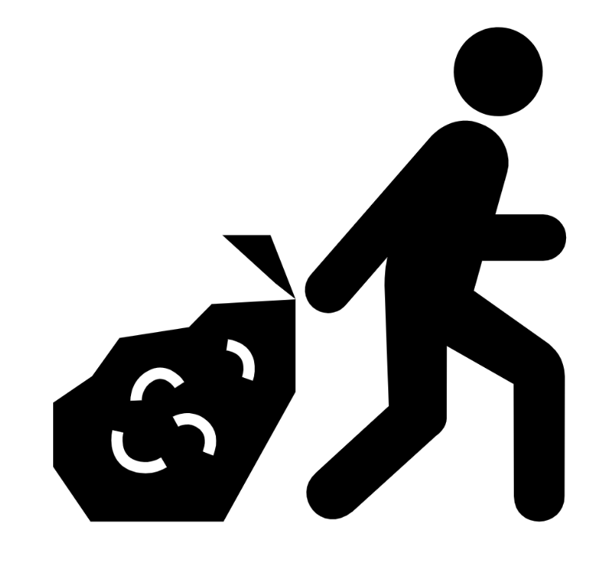
MECS Country Jigsaw to Scale Up - Uganda
Policy Enabling Environment
Supply Chain
Consumer Awareness

Slide 3
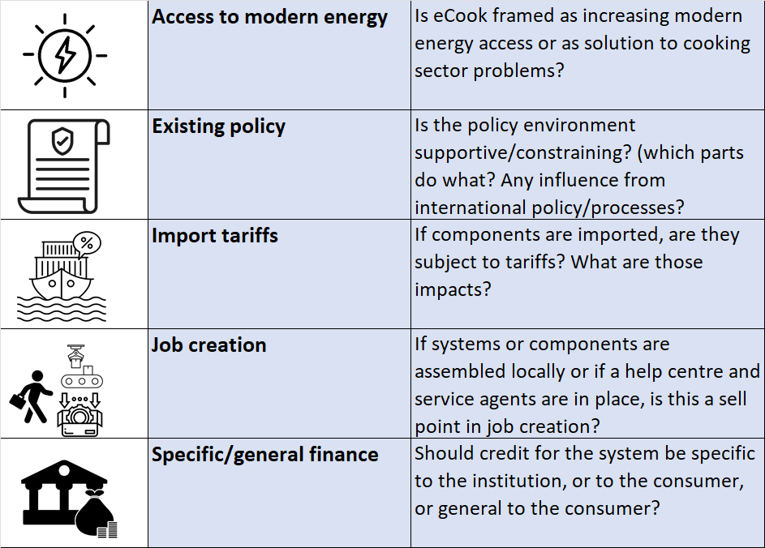
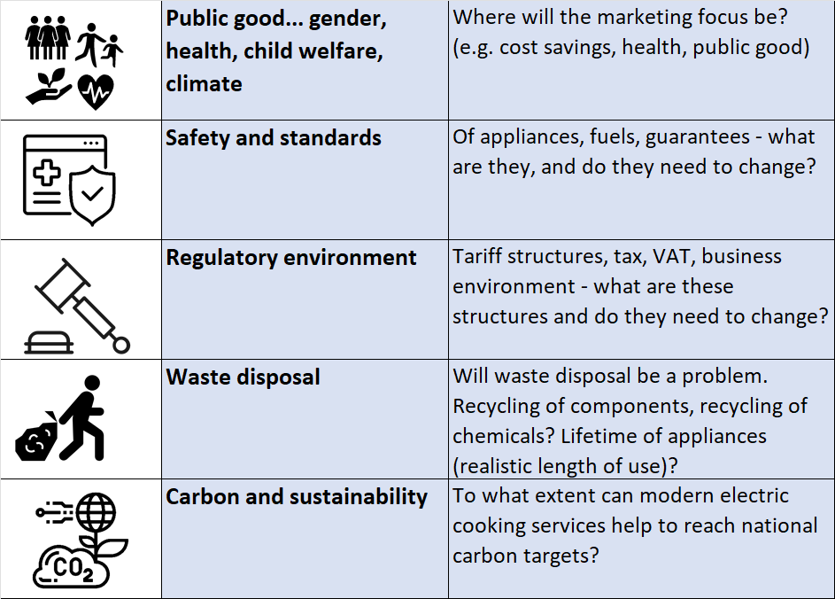
Policy Enabling Environment

Slide 4
Enabling environment - Uganda
Kampala – 93% elec access, 80% charcoal, 500 MW surplus
EPC cooking 50% cheaper than charcoal, most of menu compatible
eCooking tariff – 80 kWh threshold
eCooking strategy
Standard for EPC
Import tax waiver… and VAT?
Carbon

Slide 5
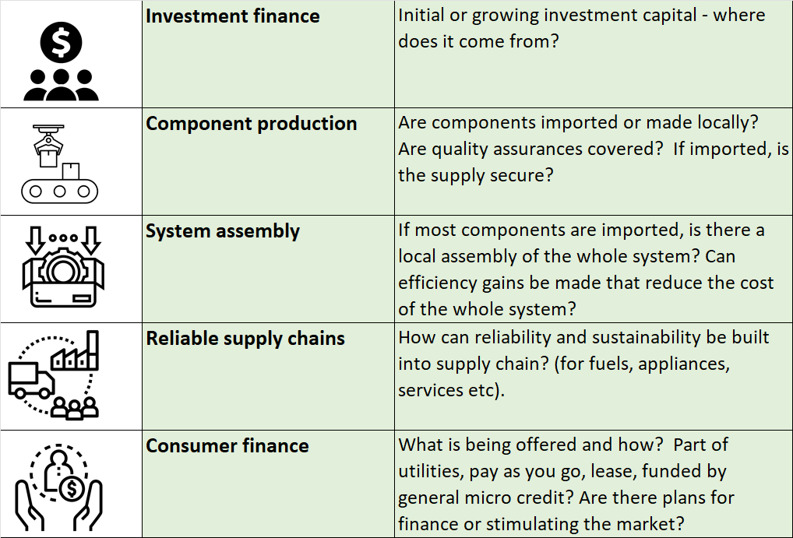
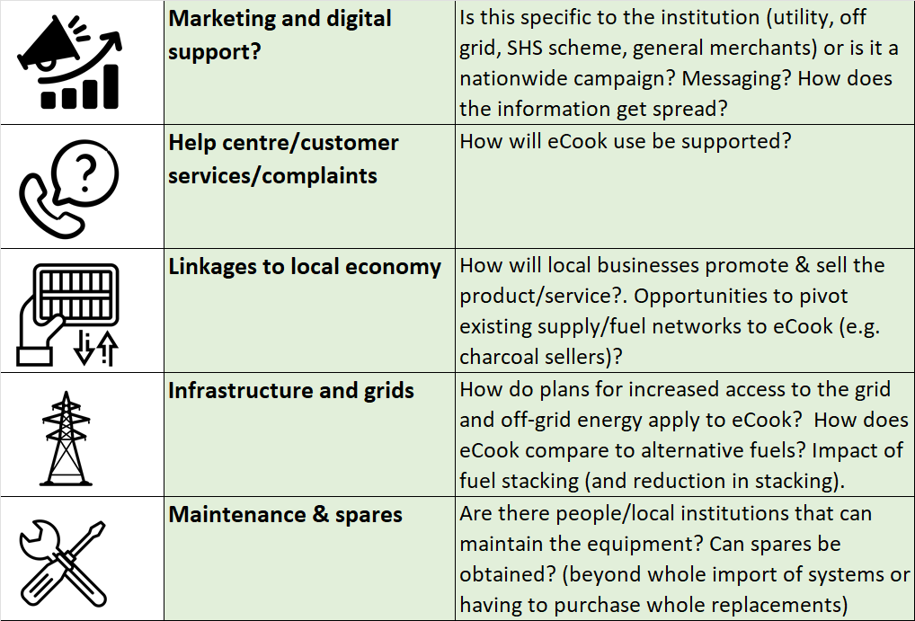
Supply Chains

Slide 6
Supply Chain - Uganda
Bottleneck
SC2, COSMO
EPC pilot led by Umeme – champions, create demand, get data on eCooking tariff, unlock sector for suppliers…
Scaling up through EASP – EPCs alongside new connections, and…
Repair
Power quality

Slide 7
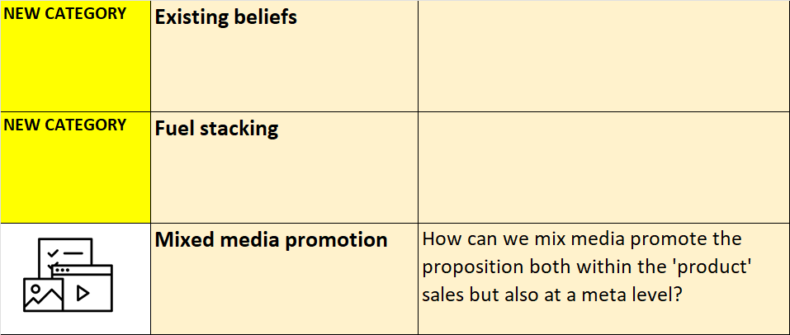
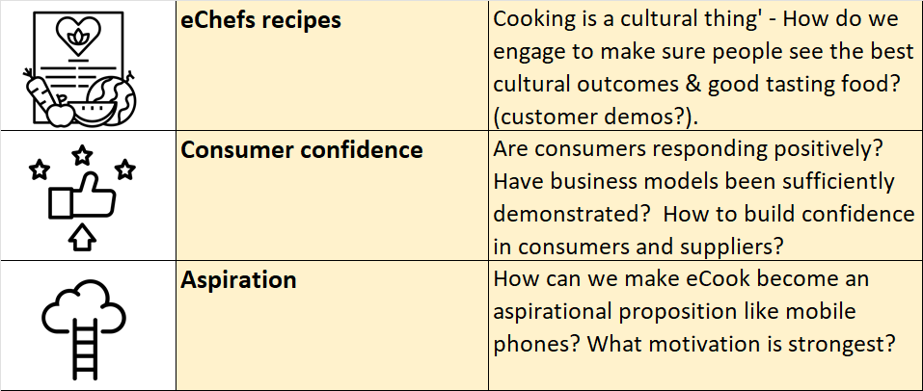
Consumer Awareness
What existing beliefs, factual or otherwise, hold back the transition for a significant group of people?
Is fuel stacking an opportunity or an issue? - e.g. gradual transition vs continued poor health from partial HAP

Slide 8
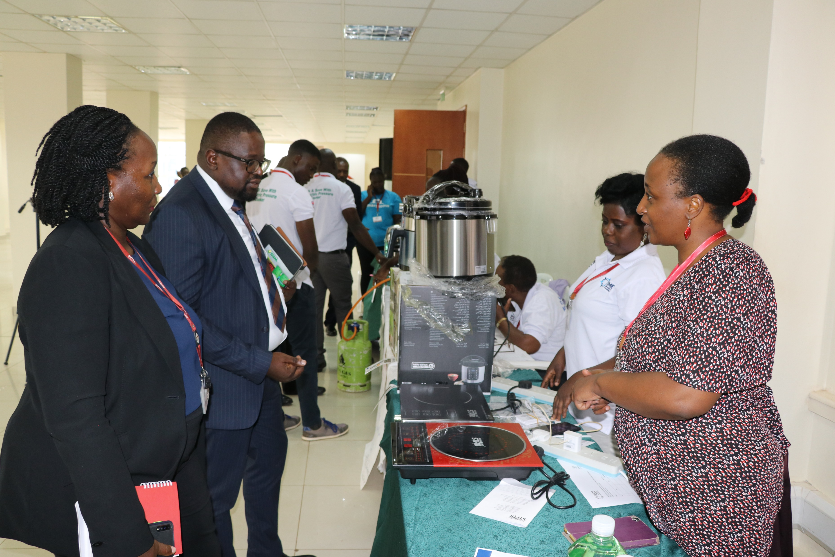
Consumer Awareness - Uganda
6 UNACC exhibitions including EPC demonstrations
Market centres, Equity Bank, KCCA, All Saints Church… spillover into hotels, hospitals, shops, markets
281 EPC sales, awareness raised among thousands
TV news items, radio features, short documentary on eCooking
Awareness low, demand high

Slide 9
Consumer Awareness - Uganda

Slide 10
Consumer Awareness - Uganda

Slide 11
Consumer Awareness - Uganda

Slide 12
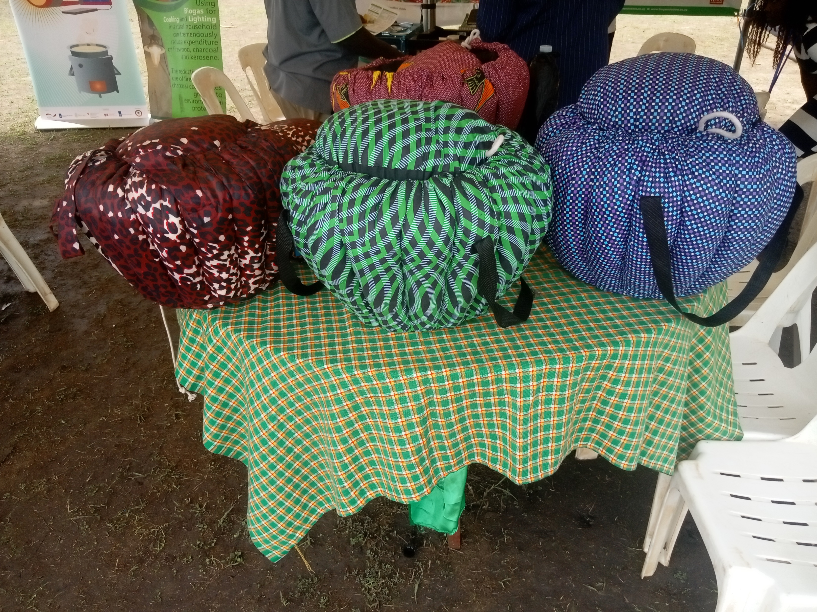
Consumer Awareness/Perceptions - Uganda
EPC pilot
UNACC exhibition
More ideas – champions, women’s groups, TV, radio,
Shamba shape up
Disseminating results to cooks?
Cooking baskets, extra pots, double dish cooking

Slide 13
The Jigsaw in Uganda
Great progress on enabling environment
Research and activity on consumer awareness
The supply chain is the bottleneck – how can we work together to scale electric cooking?
What can we learn from other countries?
Discuss? – Carbon, Repair, Awareness, Dissemination, Power quality, EPC usage

