Slide 1
Overview of MECS in Nepal
MECS Internal Workshop
Loughborough University, 19th – 21st June 2023
Richard Sieff, MECS Research Associate, richard@gamos.org Samir Thapa, MECS Research Associate, s.thapa@lboro.ac.uk

Slide 2
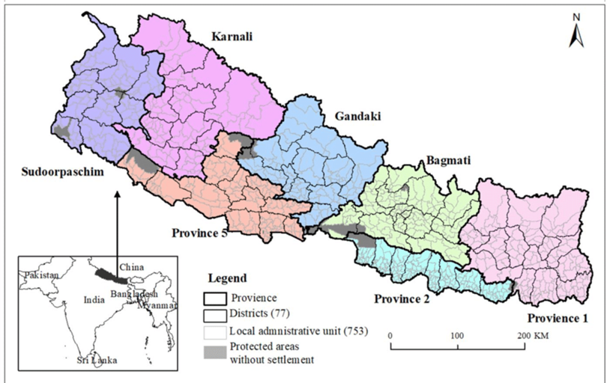
Overview
Story of MECS in Nepal
2023 MECS Field Visit Update
Where are we now with the jigsaw?
Key projects
Discussion
Feedback and wrap up

Slide 3
MECS in Nepal - Timeline

Slide 4
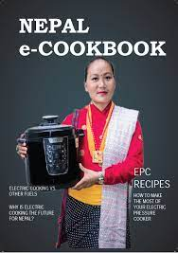
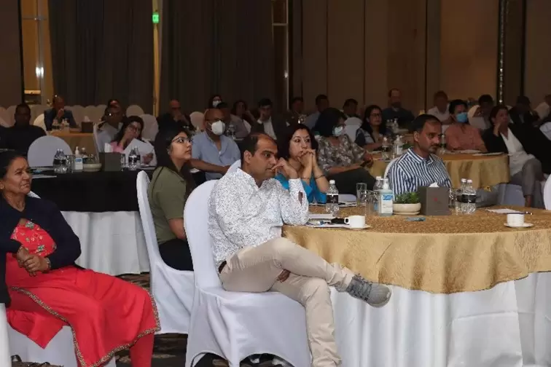
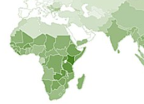
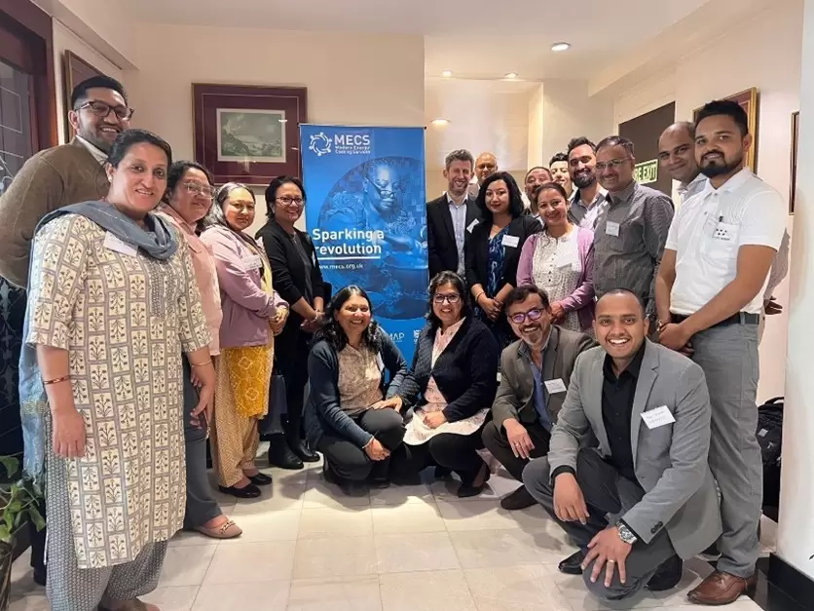
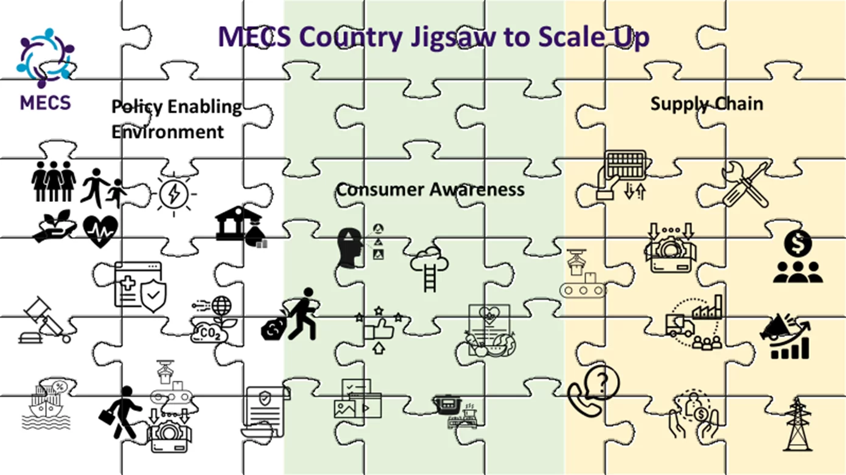
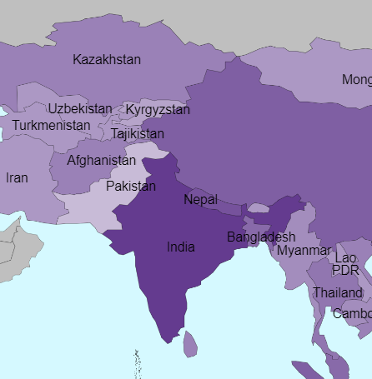
MECS activities in Nepal
4 ECO Follow up studies + 1 SC2 challenge fund
5 ECO challenge funds begin:
Best practice sharing
ECO 2022 Workshop. eCookbook launch
18 Nepal research consultancies start
1st challenge fund & Sthn partner projects begin
GMA update ranks Nepal 2nd for potential
Nepal jigsaw research:
New evidence highlights cost-effectiveness of modern EE appliances
GMA highlights potential in Nepal
Dr. Long Seng To starts 5yr RAEng Lboro fellowship. Nepal/Malawi focus
2023 MECS Nepal workshop
2016
2017
2018
2019
2020
2021
2022
2023
MECS launched
India to import 10GW over next 10 years
NEPAL: KEY EVENTS TIMELINE
49.2m USD GCF pipeline announced
2nd NDC Plan: 25% eCooking target (primary use)
Start of seasonal electricity surplus
CCA Country Action Plan
Load shedding ends
MoEWRI White Paper

Slide 5
2023 MECS Nepal Field Visit

Slide 6
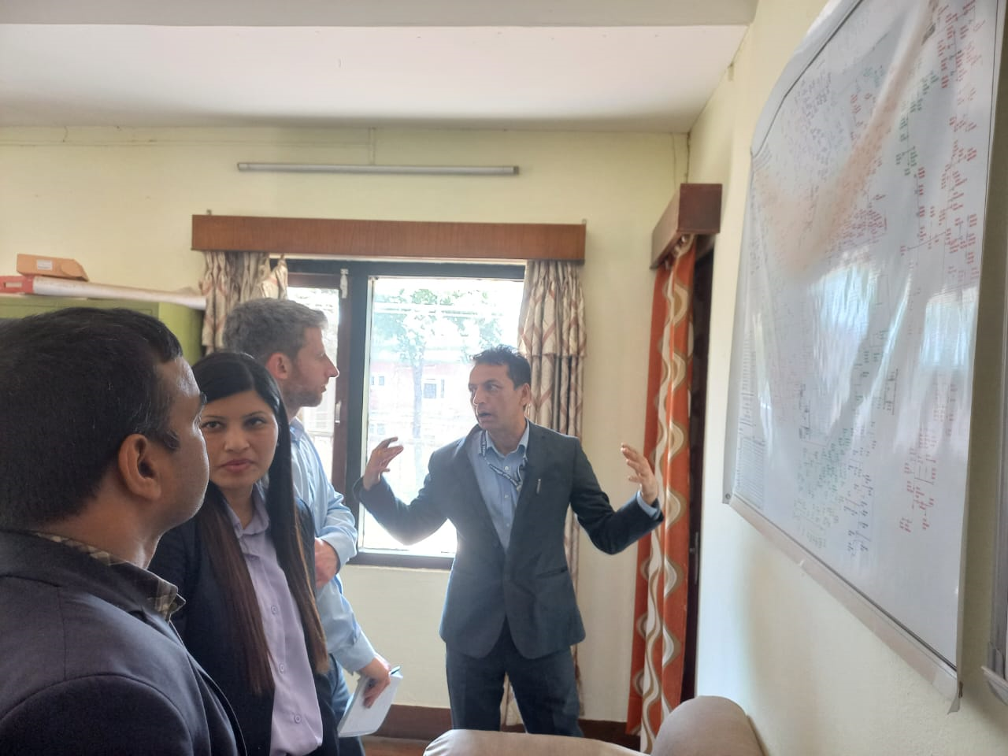
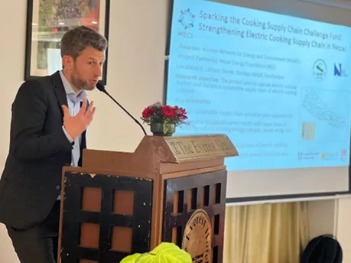
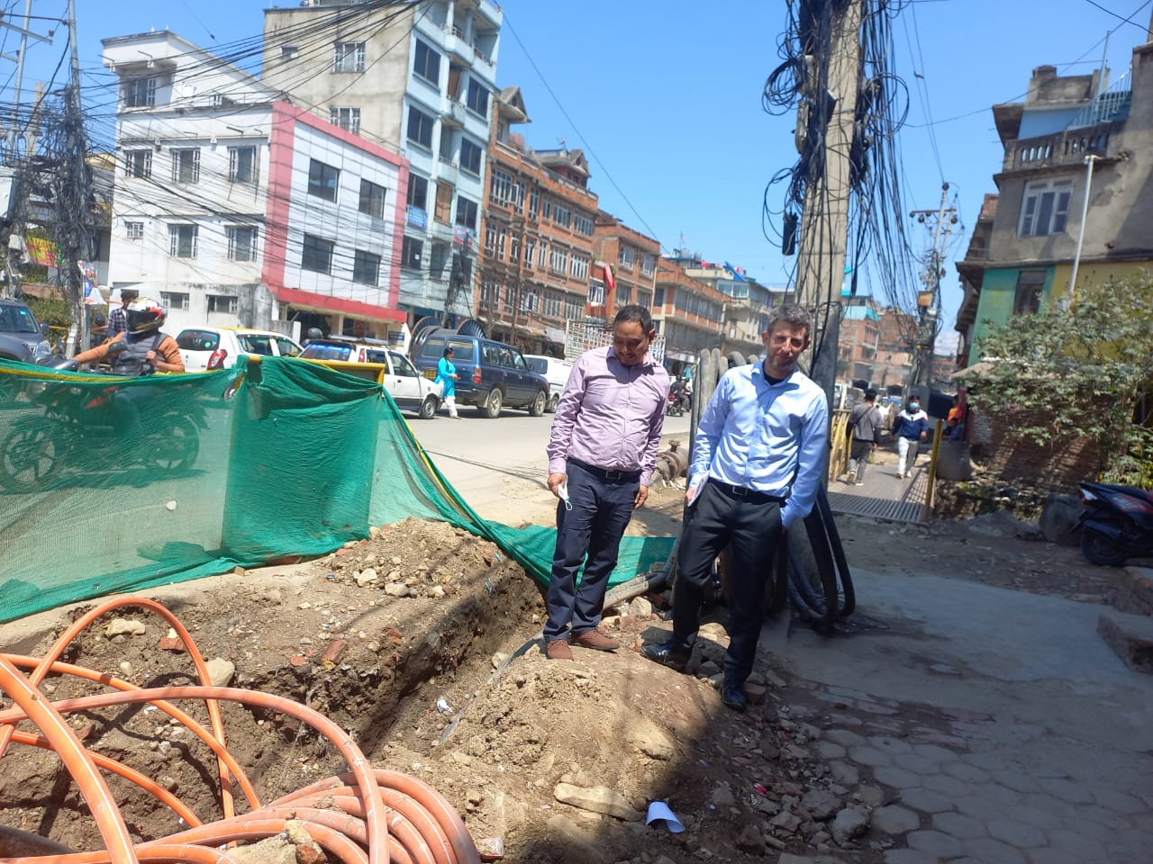
2023 MECS Nepal Field visit
Aims
MECS Workshop: Inform stakeholders of findings from the 18 research consultancies MECS commissioned in Nepal over the last year.
Develop new and further existing working relationships with key Nepali stakeholders.
Notes:
projects focused on 8 key areas targeting scale up.

Slide 7
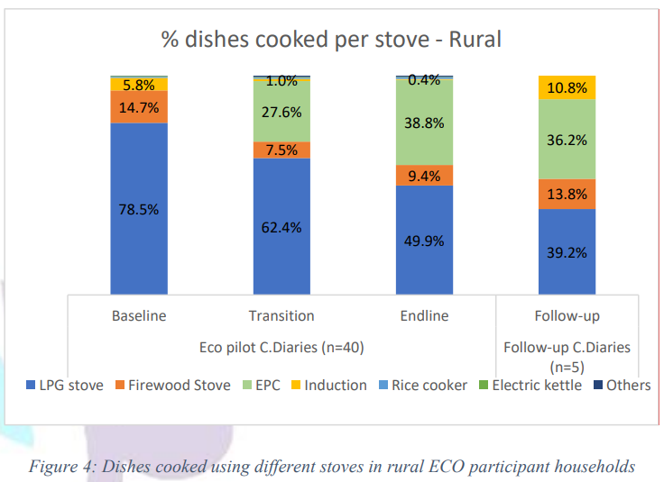
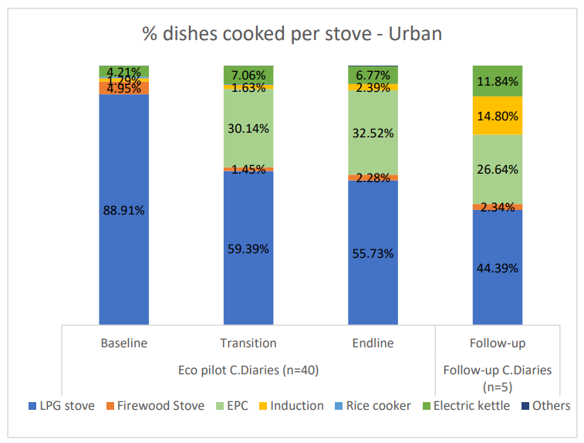
MECS 2023 Workshop
Electric Cooking Outreach (ECO) Challenge Fund: Follow up studies – showed long-term stories of impact from three ECO pilot studies
Vast majority of ECO participants continue to eCook regularly
eCooking increased in 2 of 3 projects to 40-50% of dishes - aided by purchases of a 2nd eStove
‘Out-scaling’ - wider community awareness and adoption of eCooking beyond ECO participants.
MECS ECO pilots had a significant impact in introducing the EPC to the Nepali market.
Proportion of dishes cooked on different fuels by phase in rural Timal and urban Banepa communities (WACN, 2022)

Slide 8
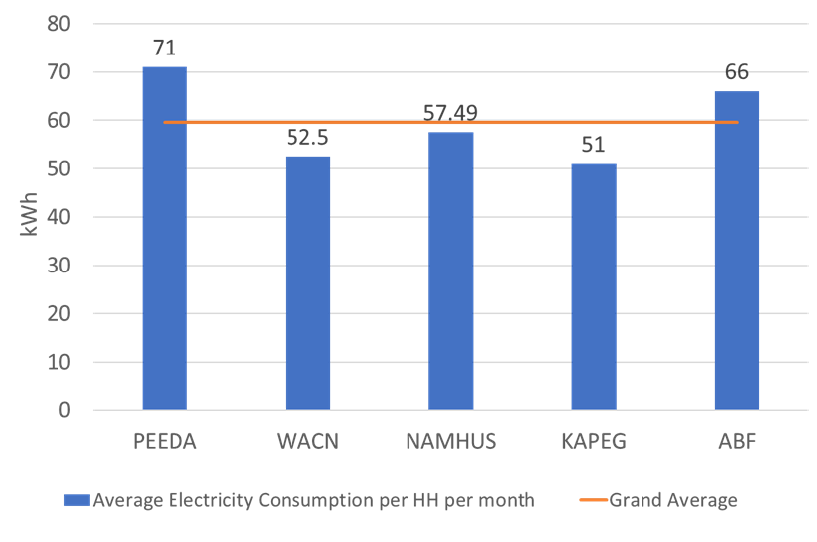
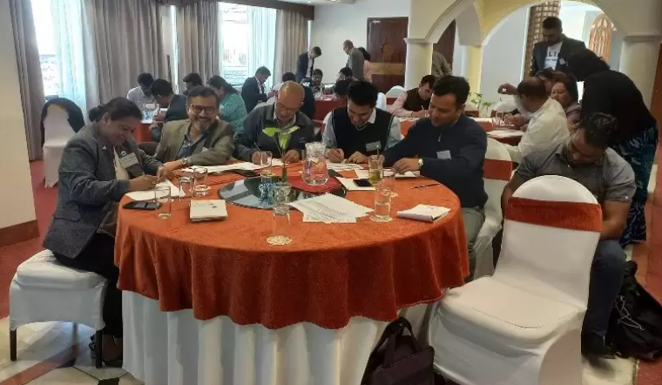
MECS 2023 Workshop
Electricity required to cook entirely with electricity (kWh/HH/month)
Five Nepal projects exploring the implications of HHs cooking entirely with electricity
Collated data. Multiple sources and averages increase confidence
Highlighted eCooking (using a choice of efficient electric cooking appliances) is already viable as a primary mode of cooking for households in urban centres.
Other workshop activities
Summary of initial findings from the ten ongoing MECS projects
MECS global experiences presentation including examples of recent MECS national policy and carbon finance initiatives facilitating scale up in FCDO priority countries.
Group discussions on how to improve information sharing and coordination in the eCooking sector.

Slide 9
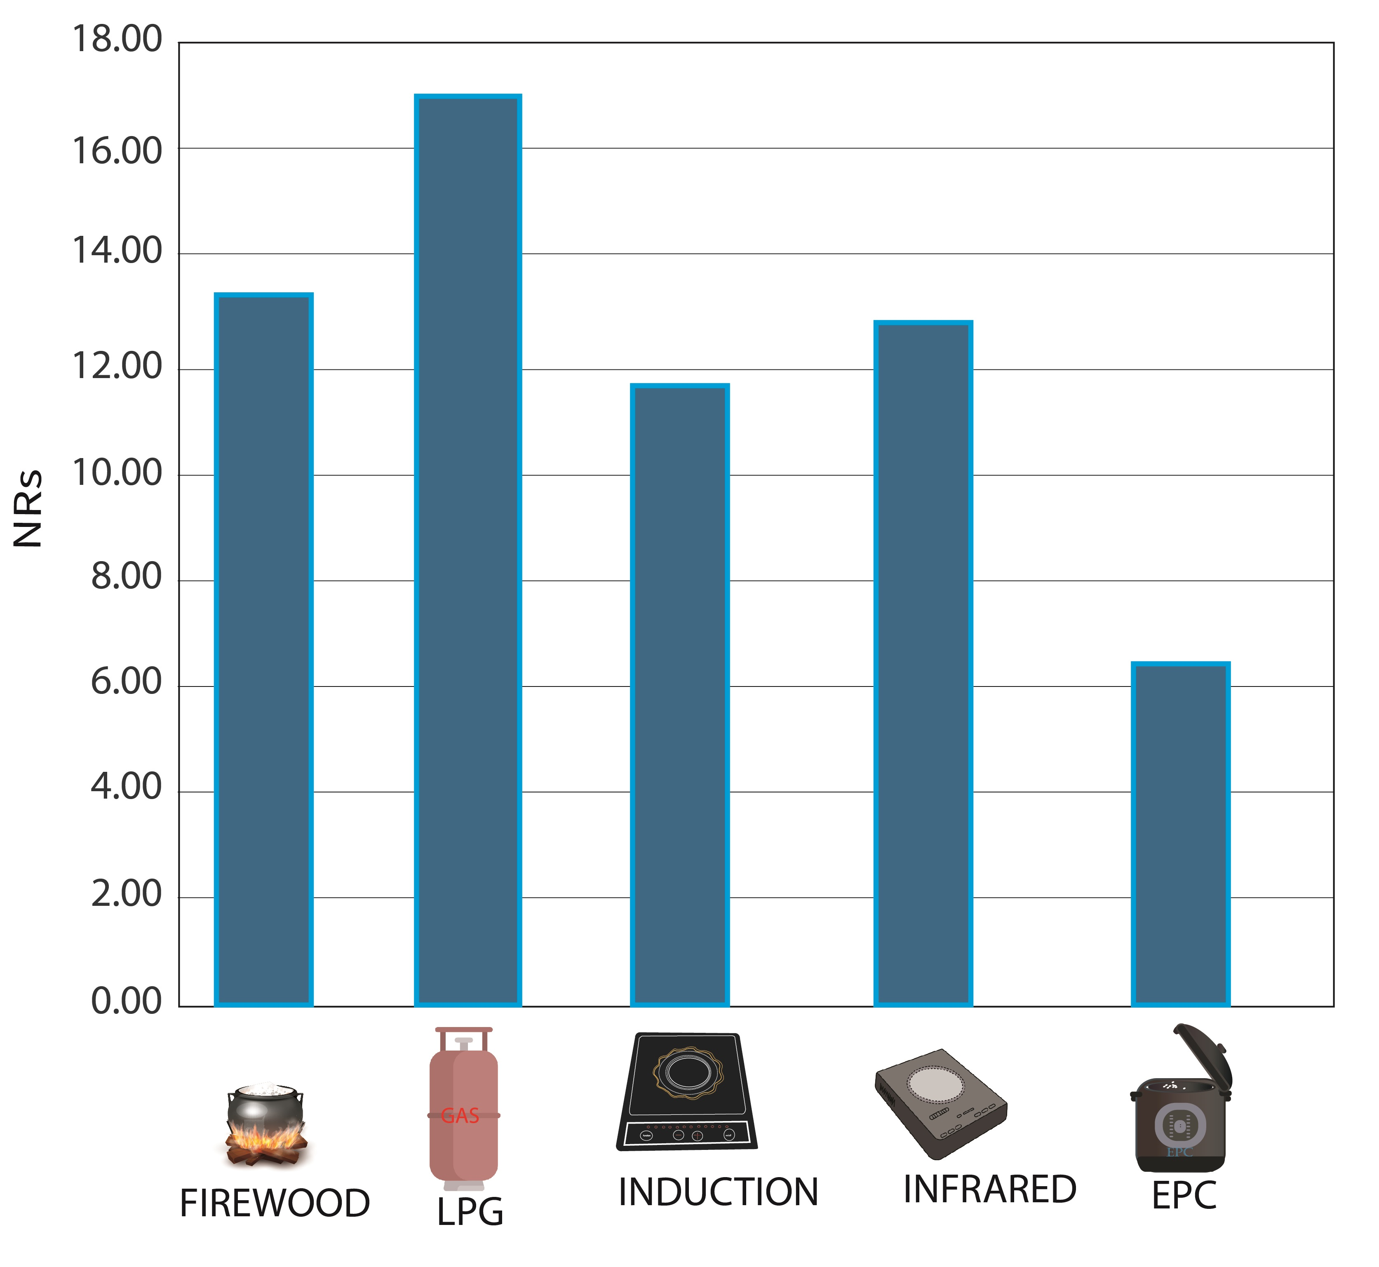
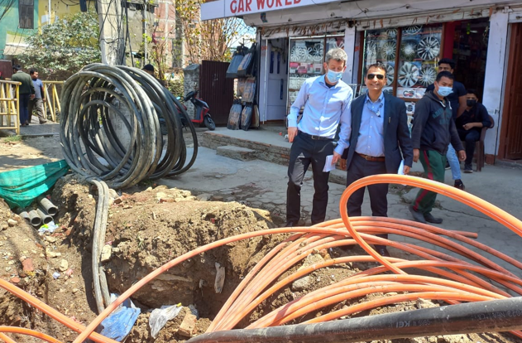
Develop new working relationships
Dinesh Kumar Ghimire, Secretary of Ministry of Energy, Water Resources and Irrigation
Interested to take up recommendations from MECS research
Kul Man Ghising, Managing Director of Nepal Electricity Authority (NEA).
Interested in MECS ECO data on efficiency and cost savings of EPC, and MECS All Electric Cooking data showing 60kWh/HH/month as the average for 100% eCooking.
Nepal Electricity Authority (NEA)
Distribution Centre Chief in Kathmandu – interest to use MECS data in a promotion campaign to inform NEA customers of benefits of shifting to eCooking.
Nepal cost of cooking graph taken from the MECS Nepal eCookbook
by People, Energy & Environment Development Association (PEEDA)

Slide 10
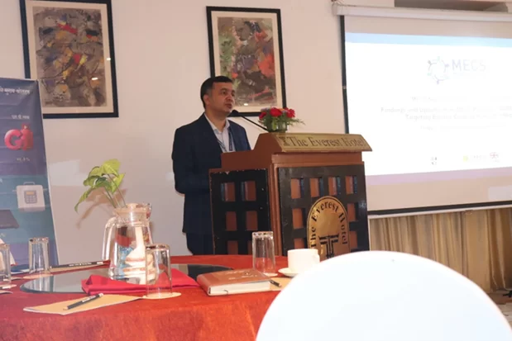
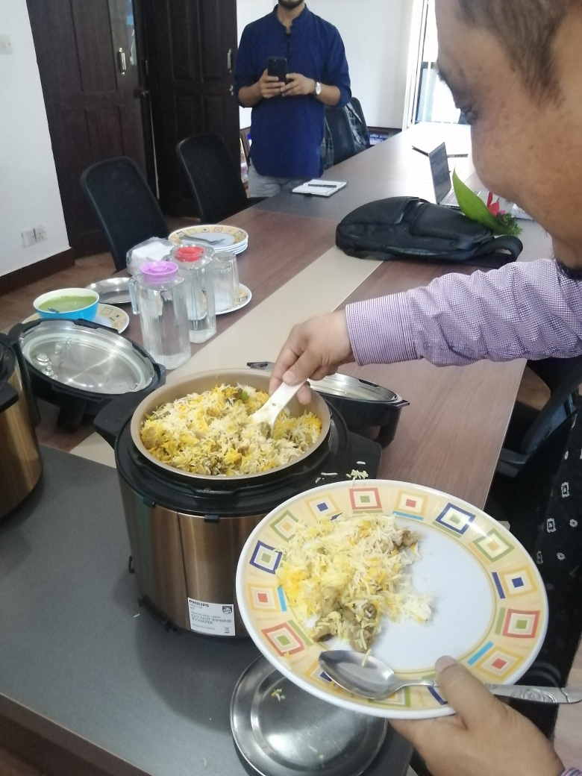
Further existing relationships
Alternative Energy Promotion Centre (AEPC) – The National Government agency with responsibility for clean cooking.
Discussed opportunities to collaborate on:
off-grid integrated planning, tariff design,
capacity building for appliance testing,
awareness raising on the no. of electricity units for 100% eCooking.
FCDO Nepal
Met with NEA and keen to collaborate on an NEA eCooking promotion
Collaboration on MECS/FCDO institutional and commercial level Cooking
Finance (Several organisations - e.g., ABF)
Highlight opportunities for carbon finance and the metered methodology
Practical guidance on the steps to carry out a carbon finance project

Slide 11
Field Visit Outputs
MECS Nepal eCooking Policy Brief – Link
Provides recommendations to help unlock the clear potential for scaling eCooking in Nepal.
Takes into consideration the gap which often exists between national policy objectives/targets and practical implementation considerations.
Recommendations developed from MECS project findings and through consulting key stakeholders on their views of the MECS research and scaling eCooking in Nepal.
Sieff, R., Thapa, S., (2023). Nepal eCooking Policy Brief. MECS Report.

Slide 12
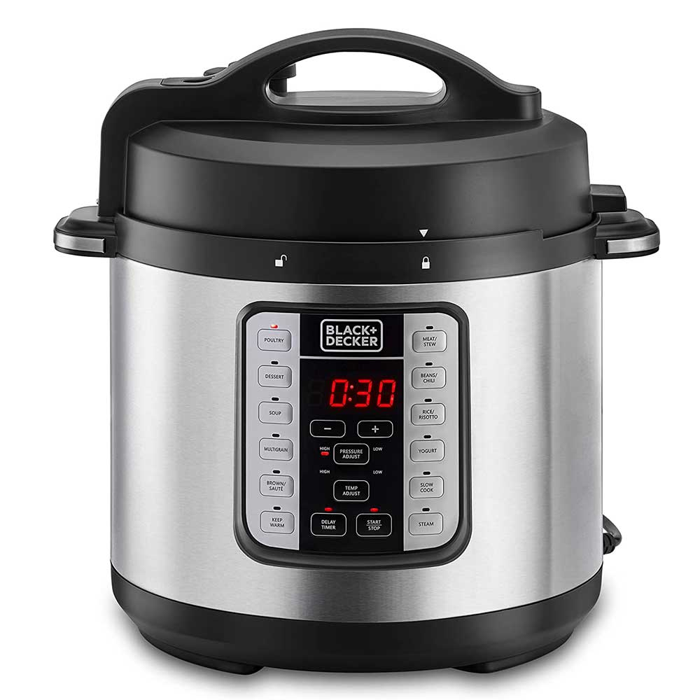
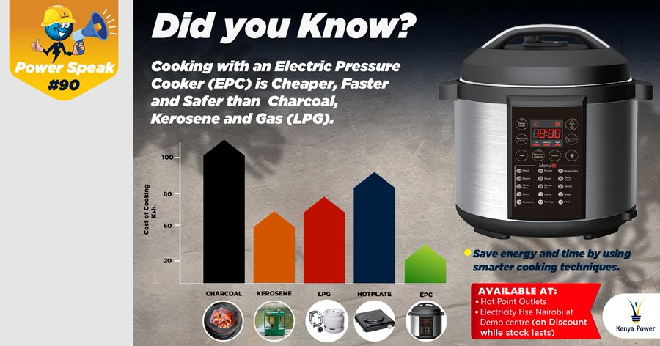
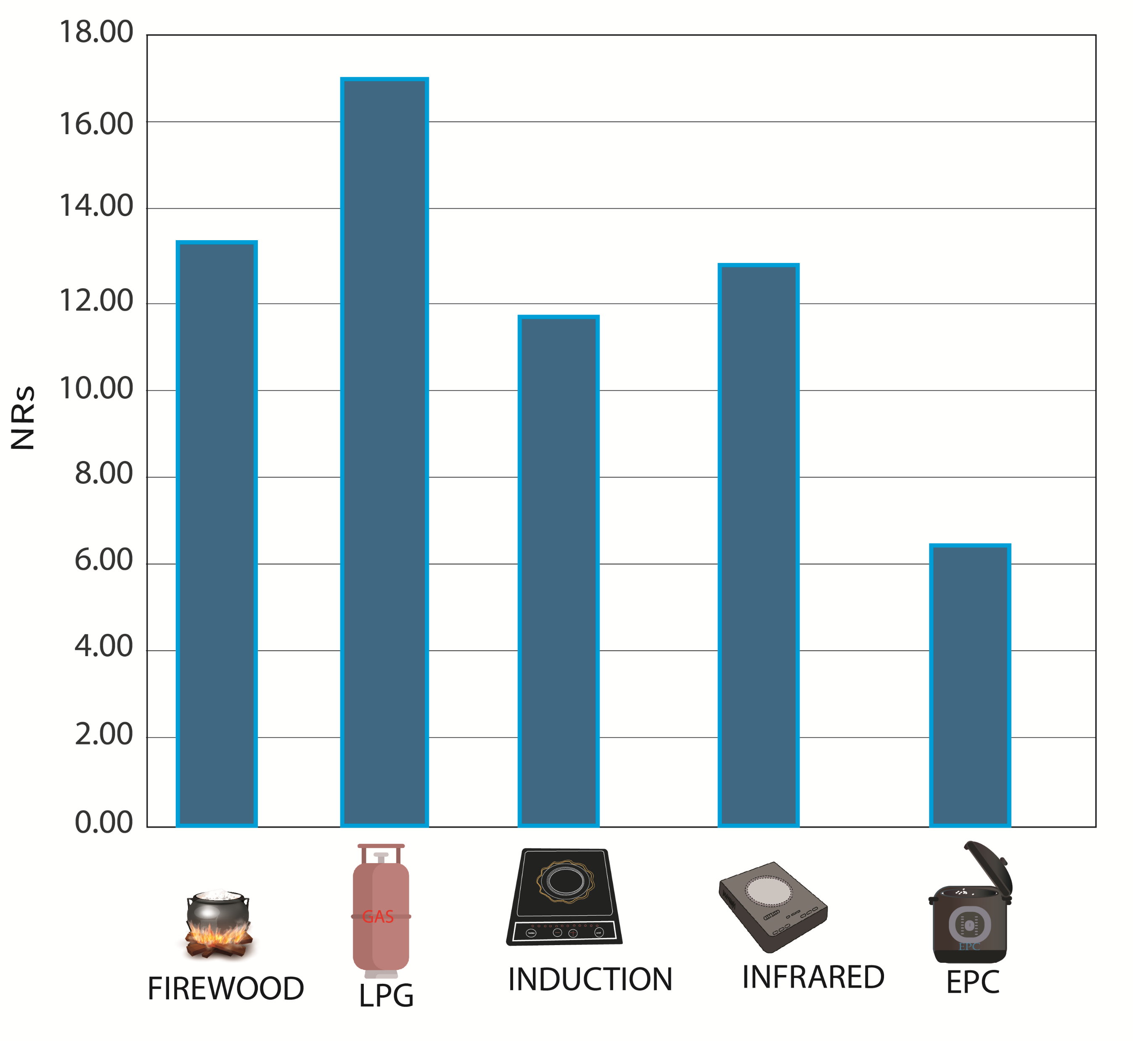
Field Visit Follow ups: NEA eCooking promotion
Did you know?
Cooking with Electricity is Cheaper and Safer than Gas (LPG) and Firewood.
Cost of cooking
Cook Dal Bhat Tarkari and Save Money, Energy and Time.
Widely available from:
Department stores
Home appliance stores
Online stores
Existing eCooking promotion by Kenya Power & Lighting Company Plc.
Possible Nepal Electricity Authority eCooking promotion?
Nepal cost of cooking graph taken from the MECS Nepal eCookbook
by People, Energy & Environment Development Association (PEEDA) https://peeda.net/

Slide 13
2023 Nepal Country Jigsaw to Scale Up

Slide 14
Where are we now?

Slide 15
Nepal: current energy use
Electricity
95% access (23% off-grid)
~2,000MW installed capacity (almost all hydro)
1,700MW peak demand
Primary cooking fuel used (% of HHs)
51% wood
44% LPG
0.5% electricity
Source: CBS, 2022
Notes:
Large seasonal variations in available capacity

Slide 16
Nepal Integrated Planning
Macroeconomic objective
Reduce LPG imports (100% imported via India) and trade deficit
Modern Energy
Biomass
Electricity policy targets
100% access by 2023
5GW installed capacity by 2024 and 15GW by 2030 (almost all hydro)
Clean cooking targets
One eStove in every HH by 2024
2030 NDC targets
25% of HHs using electricity as primary mode of cooking
No more than 39% HHs using LPG
30% of HHs using solid fuels
Modern Energy
Electricity access
eCooking
Clean Cooking
Notes:
Reduce

Slide 17
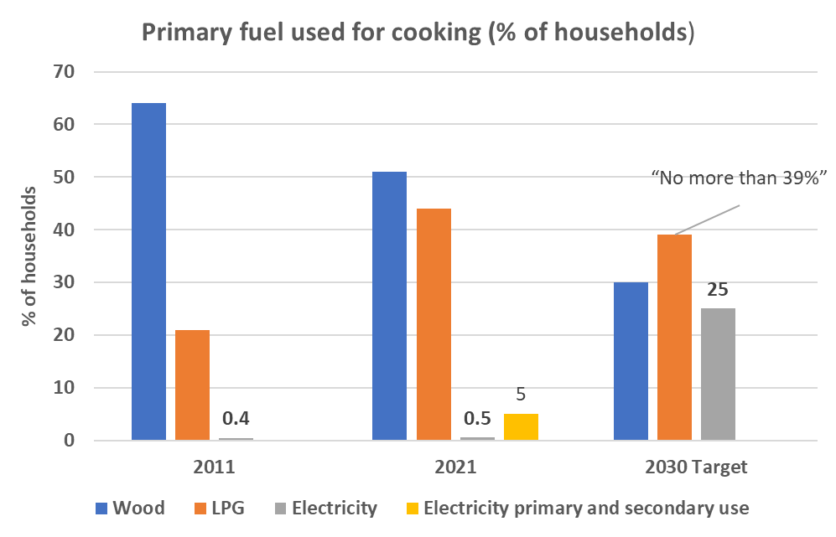
Integrated targets and
Improve macroeconomic outlook
Reduce LPG imports and trade deficit
Increase hydropower generation and
electricity access
Increase eCooking
Reduce LPG use
Provide demand for expected surplus hydro power

Slide 18
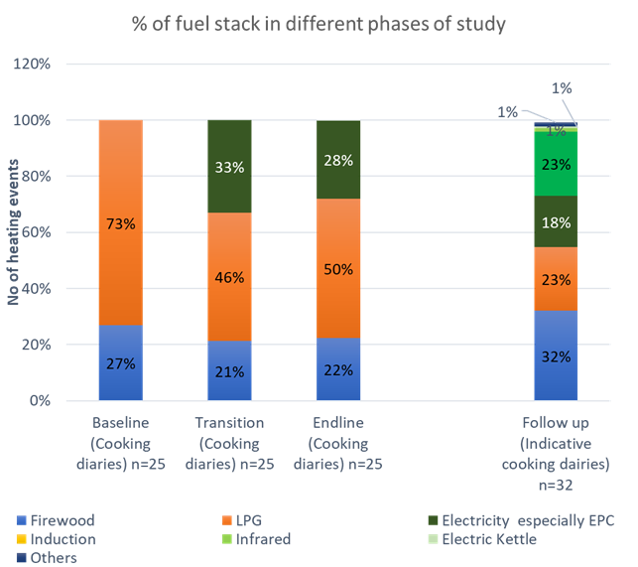
Jigsaw update: Enabling Environment challenges
Integrated planning of targets, but shortcomings in terms of the implementation process.
CCA Country Action Plan for Clean Cooking
Publication was delayed.
Not yet endorsed/processed by GoN.
Clean cooking decentralised to municipality level but capacity and coordination challenges - 753 municipalities.
Development sector very active but information sharing & stakeholder coordination could be improved
Biomass users at risk of being forgotten?
Proportion of dishes cooked on different fuels by phase in S.Lalitpur community over a 2-year period (PEEDA, 2022)

Slide 19
Key takeaway from jigsaw updates
Enabling Environment
eCooking a firm Government priority
Elements of integrated planning
Development sector very active
Emerging GoN interest in hydrogen
Challenges
Country Action Plan for Clean Cooking & implementation roadmap not yet endorsed/processed by GoN.
No of local governments & capacity
Risk of biomass being forgotten
Stakeholder coordination
Supply Chain
Growing range of eStove appliances on the market, including commercial scale.
CREEs and other local groups can address many elements of last mile supply chains
Large surplus on many micro-hydro sites
Challenges
Electricity supply reliability issues – seen as main barrier
Improving access to finance (SACCOs preferable to MFIs?).
Local repair and maintenance
Enforcing eStove product standards
Unknown durability of eStoves
Lifeline tariff jump disincentivises eCooking
Consumer demand
Clear uptake when made aware.
Staples, rice and daal, ideal for EPC
People want simultaneous cooking
Challenges
Lack of large-scale promotions
Narratives around 100% transitions can hold back viable and beneficial part transitions
Possible over-emphasis on induction cookstoves in GoN and development sector interventions. Need to offer greater choice of eStoves
Concerns that 49.2m USD Green Climate Fund Project could undermine the Nepali ecooking market.

Slide 20
Green Climate Fund (GCF): FP172: 'Mitigating GHG emission through modern, efficient and climate friendly clean cooking solutions. Project updates & MECS work to support and inform design and implementation

Slide 21
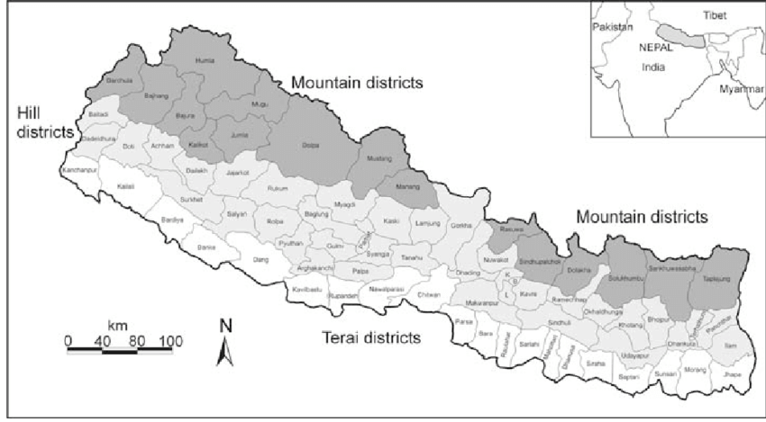
Green Climate Fund (GCF): FP172: 'Mitigating GHG emission through modern, efficient and climate friendly clean cooking solutions.
Project Partners and Funding: 49.2m USD:
GCF 21.1m (43%)
GoN 28.1m (57%): APEC 21m (43%), 150 local Governments 7m (14%).
Aims to install over 5 years:
500,000 Induction Stoves, 490,000 Tier 3+ ICS, 10,000 biogas plants
Location: 150 municipalities in the Terai region
Rationale: “higher electricity access rate, but eCooking use relatively low”

Slide 22
Green Climate Fund (GCF): FP172: 'Mitigating GHG emission through modern, efficient and climate friendly clean cooking solutions (CCS)'.
Project design
Expectation is that the 0.5m Induction cookstoves will be provided for free and beneficiaries will co-finance by buying compatible induction stove cookware.
Concerns
Least cost procurement policy – potential appliance quality implications
Local government partners: some capacity issues, impact of election cycles.
Widely held development sector concerns that the GCF project design could undermine work to develop an eCooking market in Nepal.

Slide 23
GCF Project Status
Dec 2019: Pipeline
Oct 2021: Approved
Dec 2022: Under implementation
Dec 2023: Procurement of stoves expected to begin
Some delays have occurred
Expected to be carried out in phases

Slide 24
Ongoing MECS study: Assessing the impact of electric cooking interventions in Mahankal Rural Municipality
Awardee: People, Energy & Environment Development Association (PEEDA)
Aim: Assess the impact of eCooking appliance subsidies and after-sales services on a sustainable eCooking ecosystem.
Location: Mahankal Rural Municipality
Sample:
32 HHs (from a total of 110) who were participants in the MECS ECO Challenge Fund
Each HH paid 30-40% of the cost of an EPC
200 HHs (from a total of ~2000) beneficiaries of an eCooking subsidy provided via Municipal Government & AEPC support.
Each HH received an induction stove for free
Research methods: surveys, indicative cooking diaries
Key Finding: A much greater proportion of the HHs which part-paid for an EPC are using their appliances compared to the HHs which received an Induction cooker for free.

Slide 25
MECS study: Assessing the impact of electric cooking interventions in Mahankal Rural Municipality
Key Finding: A lack of compatible induction ready cookware was the main reason for households not using the inductions stoves provided for free.

Slide 26
Next steps
Explore scope to support the AEPC/GCF project by using data from the MECS Mahankal Rural Municipality study and the broader MECS database to inform on areas relevant to the GCF project such as:
Subsidy design
Findings from the MECS Mahankal Rural Municipality study indicate subsidy schemes which require beneficiaries to buy compatible cookware for induction stoves provided for free result in lower usage rates of the stoves.
Appliance procurement
After sales services such as local repair and maintenance

Slide 27
Discussion: Supporting Municipal Governments in Nepal to deliver energy roles effectively.

Slide 28
Nepal Federalism + Municipal (local) Government energy roles
Level | Number | Governance | 2015 Constitution: Energy Roles
Federal | 1 | Elected lower & upper house | international + inter-provincial transmission lines, electricity mega projects, nuclear energy
Province | 7 | Elected assemblies for each province | Provincial level electricity
District | 77 | Formed of heads and deputy heads from municipalities. FG appointed Chief District Officer: highest administrative officer | No specific roles Idea to coordinate municipalities within a district. Appear not to be prominent
Municipality | 753 | Elected assemblies | Small electricity projects and alternative energy – includes clean cooking
Ward | 6,743 | Elected 5 members per ward | None stated

Slide 29
Capacity challenges for Municipal Governments
Common capacity issues
Limited budgets and not linked to external funding sources (overseas aid dispersed via Federal Government)
Understanding the cross over benefits of energy to other sectors and the importance of energy among the Municipal Government’s various responsibilities
Limited technical expertise to manage energy portfolios, understand and supervise energy projects
Can often lack knowledge of the capacity of local electrification infrastructure to support eCooking and other electricity services
Lack of experts to assess the pros and cons of various energy technologies to make informed procurement decisions
Lack of experts to assess the pros and cons of donor/investor projects
Lack knowledge on how to access relevant information sources
Coordination
Roles mandated by constitution might be better fulfilled by several municipalities coordinating: e.g., bulk procurements, energy infrastructure overlapping municipality boundaries.
5-year election cycles can lead to policy direction changes and lack of continuity between the outgoing and incoming governments.

Slide 30
Discussion
Building Municipal Government (MG) capacity to deliver energy roles effectively remains a challenge. What would you suggest to help support MGs? Bearing in mind.
The very large number of municipalities – 753
The significant energy roles of MGs: small electricity projects and alternative energy – including clean cooking.
The capacity issues previously outlined
Please consider:
Relevant MECS research which might support interventions, advocacy, etc.
Examples from other country contexts that could be drawn on
How relevant research and data could be effectively provided to key stakeholders?

