Slide 1
Energy Transfer in Kitchen Appliances
An overview
Dr Simon Batchelor
May 2023

Slide 2
Introduction
In the Water Boiling Test WBT (and in many other assessments of thermal efficiencies), the protocol prescribes 3 test phases –
i) raising a specified amount of water or food to a given temperature from a cold start,
ii) raising a specified amount of water or food from a hot start, and
iii) simmering said water for a given time (generally 45 minutes, but in some protocols 30mins). ‘Simmering’ while generally applied to a stew or water-based food, can be interpreted as ‘holding the water or food at a prescribed temperature’.
Cooking is more complex than boiling water, and so some devices such as air fryers, ovens, grills cannot be tested by the conventional WBT.
However, in the following we have taken our cue from the WBT and considered the 2 key phases to energy efficiency in cooking:
Heating of the pot of food
Slides 3 to 6 consider how a device raises the temperature of the food
Losses during cooking of the food
Slides 8 onwards consider how the food is maintained at temperature

Slide 3
Phase 1 – Heating of the pot

Slide 4
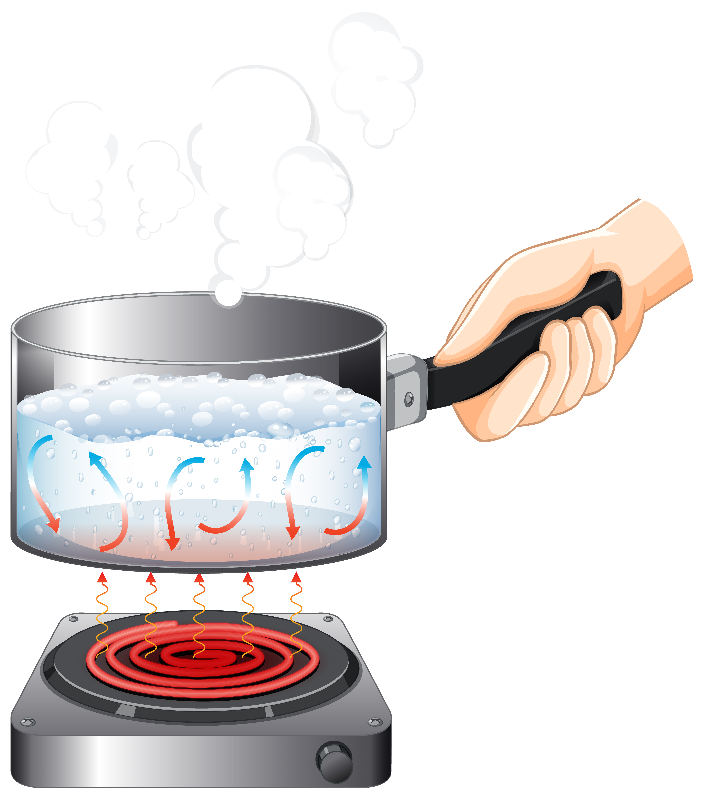
Resistive heating element (hotplate)
Heat generated in plate by passing current through a resistive element.
Relies on contact to transfer heat by conduction (and a little radiant)
Can be AC or DC, depends on current and voltage and resistance.
Easy to make and easy to adapt – operation is on and off controlled by thermostat.
Can use any material for the pot
Cooking pot
Heat transfer to pot dependent on fit of pot to top of heating element.
Resistive heating element
Image credit - freepik
Badly made heating elements lose heat downwards as the base is open.
If pot significantly smaller than heating element then there are losses at the edges
If pot significantly smaller then loss at edges
If pot has dents, some bits don’t touch

Slide 5
Infra-red heating element.
Heat generated in plate by passing current through a resistive element such that heat transfer is through infrared.
Relies on radiant transfer of heat
Can be AC or DC, depends on current and voltage and resistance.
Easy to make and easy to adapt – operation is on and off controlled by thermostat.
Can use any material for the pot
Cooking pot
Heat transfer to pot possible even with an air gap.
Infrared heating element
Most constructed with reflective base, so few losses downward.
Image credit - freepik
If pot significantly smaller than heating element then there are losses at the edges
Less concern about pot dents, heat transfer across small air gaps

Slide 6
Induction heating of a pot
Heat generated in the pot by fluctuating magnetic field
Low frequency AC is converted to DC and back to high frequency AC. DC input is also possible.
Operation relies on the electronics.
Pot has to be iron based.
Cooking pot
Heat generated in the pot, energy transfer very slightly sensitive to distance to pot.
Induction coil
Image credit - freepik
NO heat loss downwards
If pot significantly smaller then NO loss at edges
If pot has dents, induction sensitive to distance to metal of pot.

Slide 7
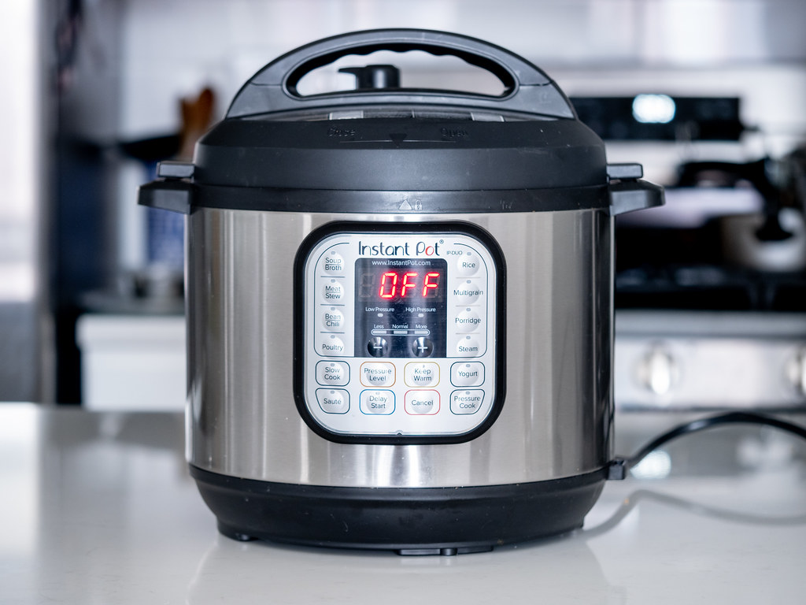
Most electric pressure cookers use resistive heating elements because heat transfer assured by design:-
Cooking pot
Has a bespoke pot, that is correct size for heating element and…
Heat generated in plate by passing current through a resistive element.
Can be AC or DC, depends on current and voltage and resistance.
Easy to make and easy to adapt - operation is on and off controlled by thermostat.
Reistive heating element
Image credit ajay_suresh
Pot base slightly concave as required for pressure cookers ISO, and therefore heating element slightly convex to fit pot – contact between the two is excellent. (Also heating element slightly smaller than pot, so no side leakage)
Pot is fit to heating element diameter (often fractionally bigger)
Pot has no dents
Heating element is enclosed so downward losses minimal.

Slide 8
Phase 2 – losses during cooking
Transferring heat into the pot is only half the issue when it comes to considering energy efficiency.
As said slide 2, WBT iii) considers energy required to hold the water at just below 100 degrees for a given time (i.e. ‘simmering’).
If you simmer a food (like beans in water) for 30 minutes or more, then the losses from your cooking device mount up.
Energy efficient devices for long cooking (e.g. over 20 mins) include insulation to mitigate those losses.
Cooking variously includes frying, baking and simmering (among other processes), and some task specific appliances cannot ‘simmer’. We have interpreted the simmering phase as ‘holding the food at a specified temperature for a given period of time’.

Slide 9
Losses during cooking – no insulation True for either induction, resistive hotplates, infra-red
Lid is important.
Radiant heat emitted from pot sides (can be about 400W)
So once at temperature (100deg) 30 min simmer is 0.2kWh
While simmering, the resistive heating element or infrared or induction tries to compensate for losses, judging when to come on by a thermostat.
Control becomes important
If thermostat is analogue, based on a dial, then off and on could boil the water rapidly, and losses greater due to evaporation. Control is down to preferences and skill of the cook - they decide where to put the dial
If thermostat is more precise (generally but not exclusively digital), then simmering can be held at a precise temperature just below boiling point – evaporation losses minimal.
Cooking pot
Cooking pot
For short stir fry or quick cooking in a frying pan, then losses during the cooking phase are minimal – heat in the pot doesn’t have the time to go out from the pot, and the surface area of the sides is small.

Slide 10
Electric pressure cookers minimize losses by
Needs less energy to cook than uninsulated devices.
Lid is tight to form the pressure seal. But even without pressure, the lid is a good fit minimizing losses.
Cooking pot
Air gap between pot and outside world. Air is low conduction, and inside of outer wrap reflects back the radiant heat.
Temperature control is based on a switch triggered by the pressure – so very precise temperature control.
Image credit ajay_suresh
Once at pressure, heating element barely comes on, losses are minimal so cooking continues with minimal new heating energy coming into the system.
Utilises good stage 1 heat transfer to pot as pot sized to fit resistive heater.
Without pressure and at simmering temperature (100deg) 30 min simmer is about 0.02kWh (which was 0.2kWh uninsulated).
With pressure the food is at between 108 and 116 deg, and therefore cooks faster.
Also faster cooking due to pressure so 2 hour simmer of beans would only need less than 30 mins because of the pressure effects.

Slide 11
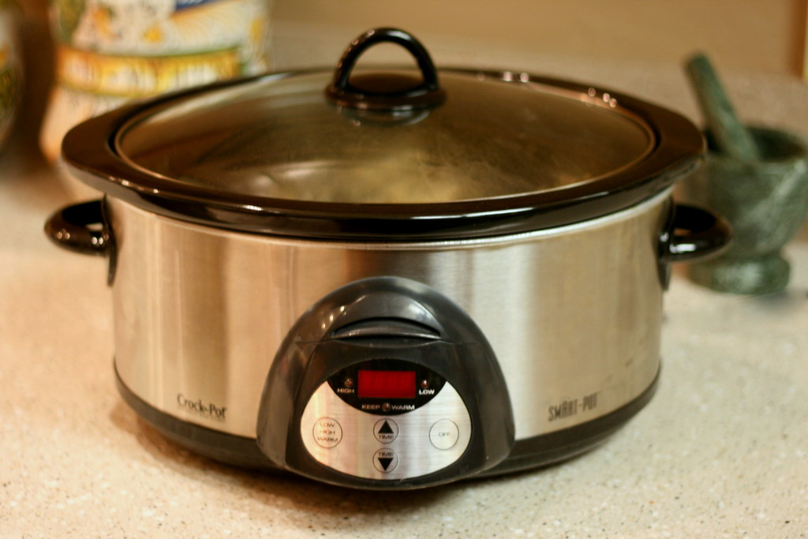
Slow cookers minimizes losses by
Lid is tight but not sealed. But even without pressure, the lid is a good fit minimizing losses.
Cooking pot
Depending on quality, there is insulation or an air gap between pot and outside world.
Image credit - Bunches and Bits {Karina}
Temperature control is based on a thermostat.
Resistive heating element
Not always the most energy efficient as insulation not always the best – so slow that losses for a cooked meal are almost as much as without insulation.
Utilises good stage 1 heat transfer to pot as pot sized to fit resistive heater.

Slide 12
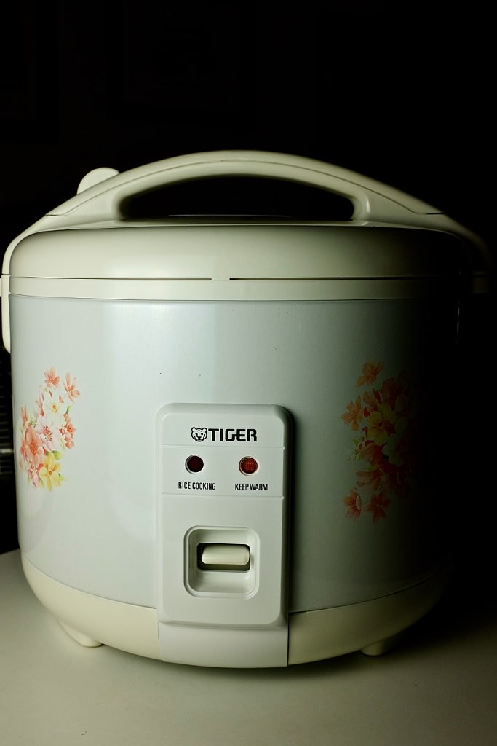
Rice cookers minimize losses by
Lid is tight, almost sealed. Without pressure but the lid is a good fit minimizing losses.
Cooking pot
Depending on quality, there is insulation or an air gap between pot and outside world.
Temperature control is based on a thermostat. Keeps it at or just below boiling. If the base gets dry then it switches off (rice must be done)
Image credit: The Marmot
Resistive heating element
Short duration of rice making makes this a very energy efficient but task specific product.
Utilises good stage 1 heat transfer to pot as pot sized to fit resistive heater.
Can be used for other cooking, but the thermostat prevents frying.

Slide 13
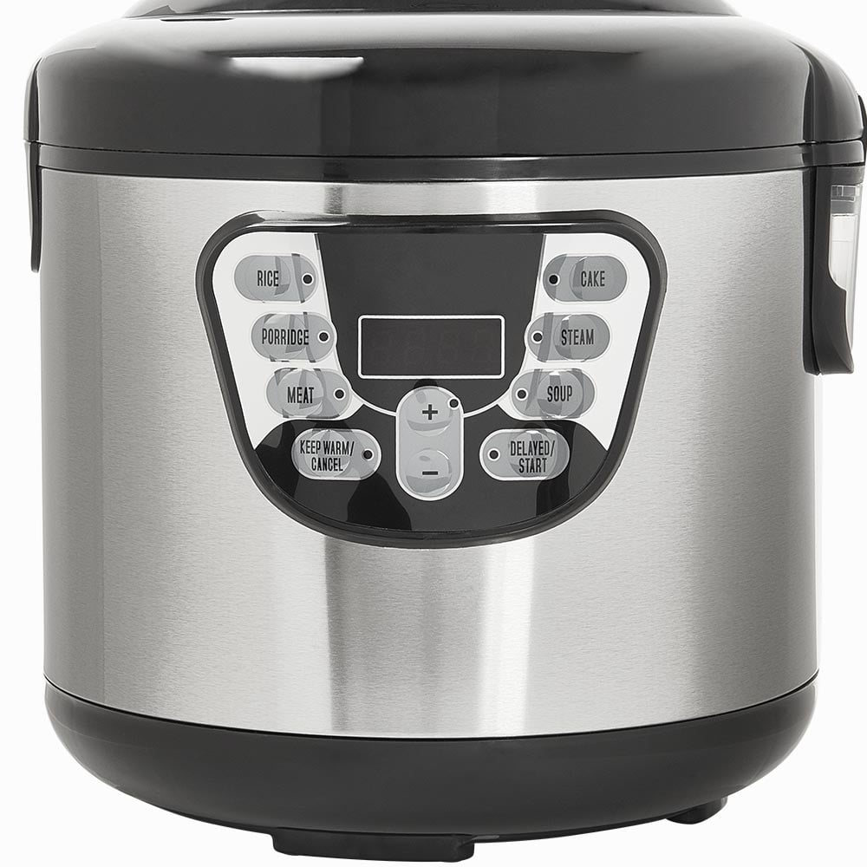
Multi cookers minimize losses by
Lid is tight, almost sealed. Without pressure but the lid is a good fit minimizing losses.
Cooking pot
Depending on quality, there is insulation or an air gap between pot and outside world.
Temperature control is based on a thermostat.
However, in contrast to a rice cooker, the thermostat will allow 140 degree frying.
Image credit :wilko.com
Resistive heating element
Utilises good stage 1 heat transfer to pot as pot sized to fit resistive heater.
Very variable overall efficiency – dependent on thermostat control and whether it has some insulation

Slide 14
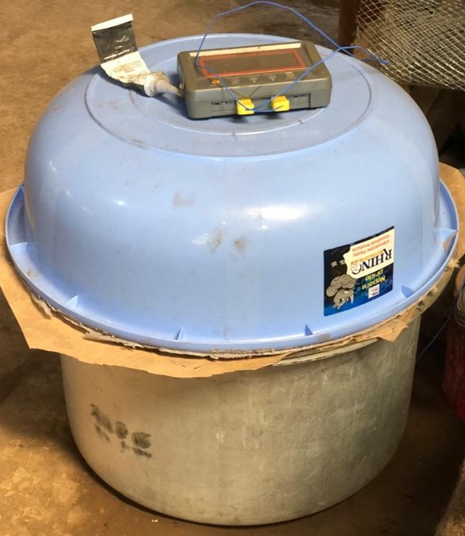
ISEC (insulated Solar Electric Cookers (origin California, now in 8 countries) minimize losses by
Lid can be tight, almost sealed. Without pressure but the lid is a good fit minimizing losses.
Cooking pot
Thick quality insulation between pot and outside world is a key point of the device. When using thermal storage the heater heats the mass or phase change material, and then the heating of the pot is ‘boosted’ by the thermal store.
Resistive heating element
Image credit – P Schwartz
Sometimes with Thermal storage
No temperature control on most – relies on being low power to not overheat (between 100 and 400W).
Utilises good stage 1 heat transfer to pot as pot sized to fit resistive heater.
Very variable overall efficiency dependent on quality of the insulation and its construct.

Slide 15
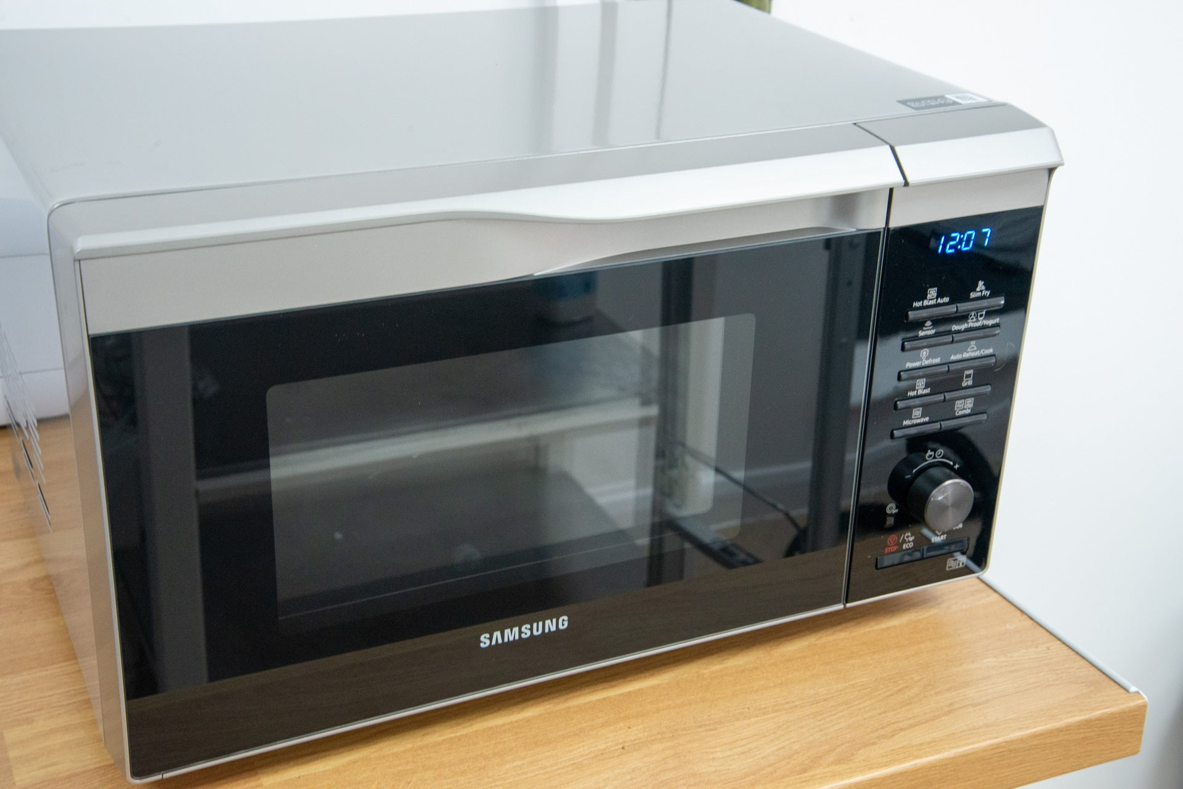
Fan assisted ovens minimize losses by
Door opens sideways. Most ovens are well sealed, but seals weaken over time. Most don’t have active insulation but rely on an air gap in the glass door, and the mass of the oven.
Cooking pot
Heating elements may be in base, sides or ceiling
The fan ensures even distribution of heat, while the pot (or baking tray) sits on a shelf – not touching the resistive heaters. (Can also be infra-red heaters)
Photo credit – Trusted reviews.
Resistive heating element
Temperature control is based on a thermostat.
Can get to 200 degrees+.
Flexible pot and pan sizing, baking tray etc, as the environment around it is heated.
Very variable overall efficiency – fan ovens are twice as efficient as same configuration of oven without a fan.

Slide 16
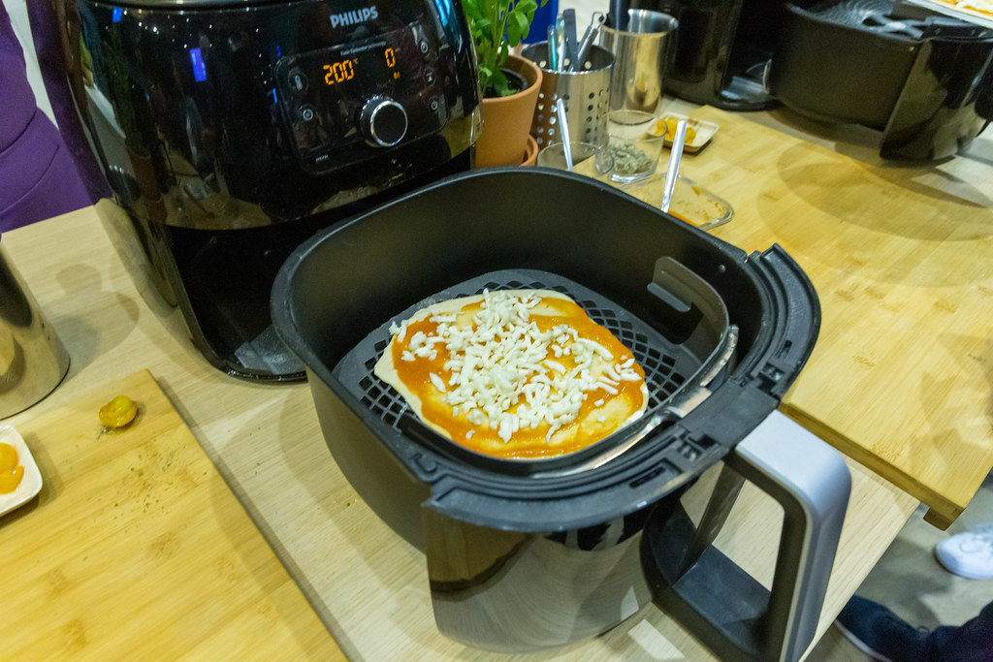
Air fryers minimize losses by
Accessed via a tray that pulls out sideways. Most air fryers relatively well sealed, but the inner pot itself has no ‘lid’ to keep air flow max. ‘Chips and Sausages’ added directly to air-fryer inner pot which has holes in base, dripping juices onto inner base.
Cooking pot
Heating elements generally at the top (ceiling). Can sometimes give a ‘grill’ effect depending on type.
Photo credit: Marco Verch
The fan ensures even distribution of heat, while the pot allows for air flow – not touching the resistive heaters. (Can also be infra-red heaters)
Pot comes with device, and environment around it is heated. Generally access is a tray that pulls the pot out.
Temperature control is based on a thermostat.
Can get to 200 degrees+.
Very efficient because basically a small fan oven without large thermal mass in the walls.

Slide 17
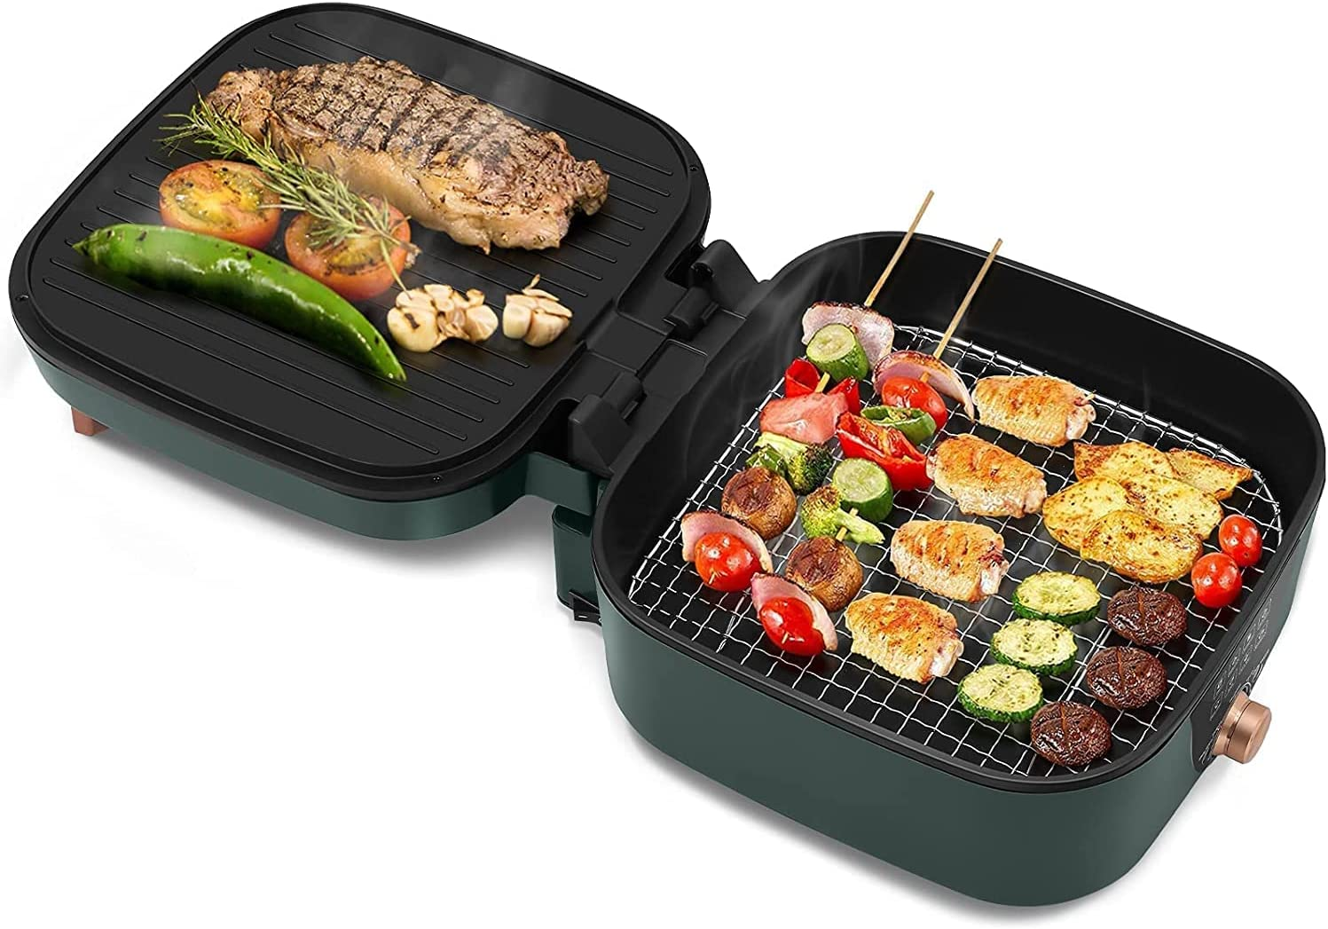
Final comment
There are other devices not covered in this slide deck, eg Kettles, toasters, grills, among others.
New configurations of multi cookers are appearing – e.g. Hotpot grills which combine hotplates and tight control of temperature during simmering (but don’t have insulation)
Induction is seen as the best for Phase 1 heat transfer, but this is only the case when compared to resistive heating and infra-red with a poorly matched pot.
The MECS programme has an ever growing body of test data on these devices both in lab settings and in real world use. For more information please consult our website www.mecs.org.uk (particularly the ecookbooks)
Please note this slide deck is based on the WBT, but MECS as a research programme believes every appliance should be tested with other protocols. At a minimum - Controlled Cooking Tests (CCT) (cooking a pre-determined local meal) to ensure a cultural fit to food, and piloted use in Kitchen performance test preferably over time (what we call cooking diaries).
Photo Credit Amazon

