Slide 1
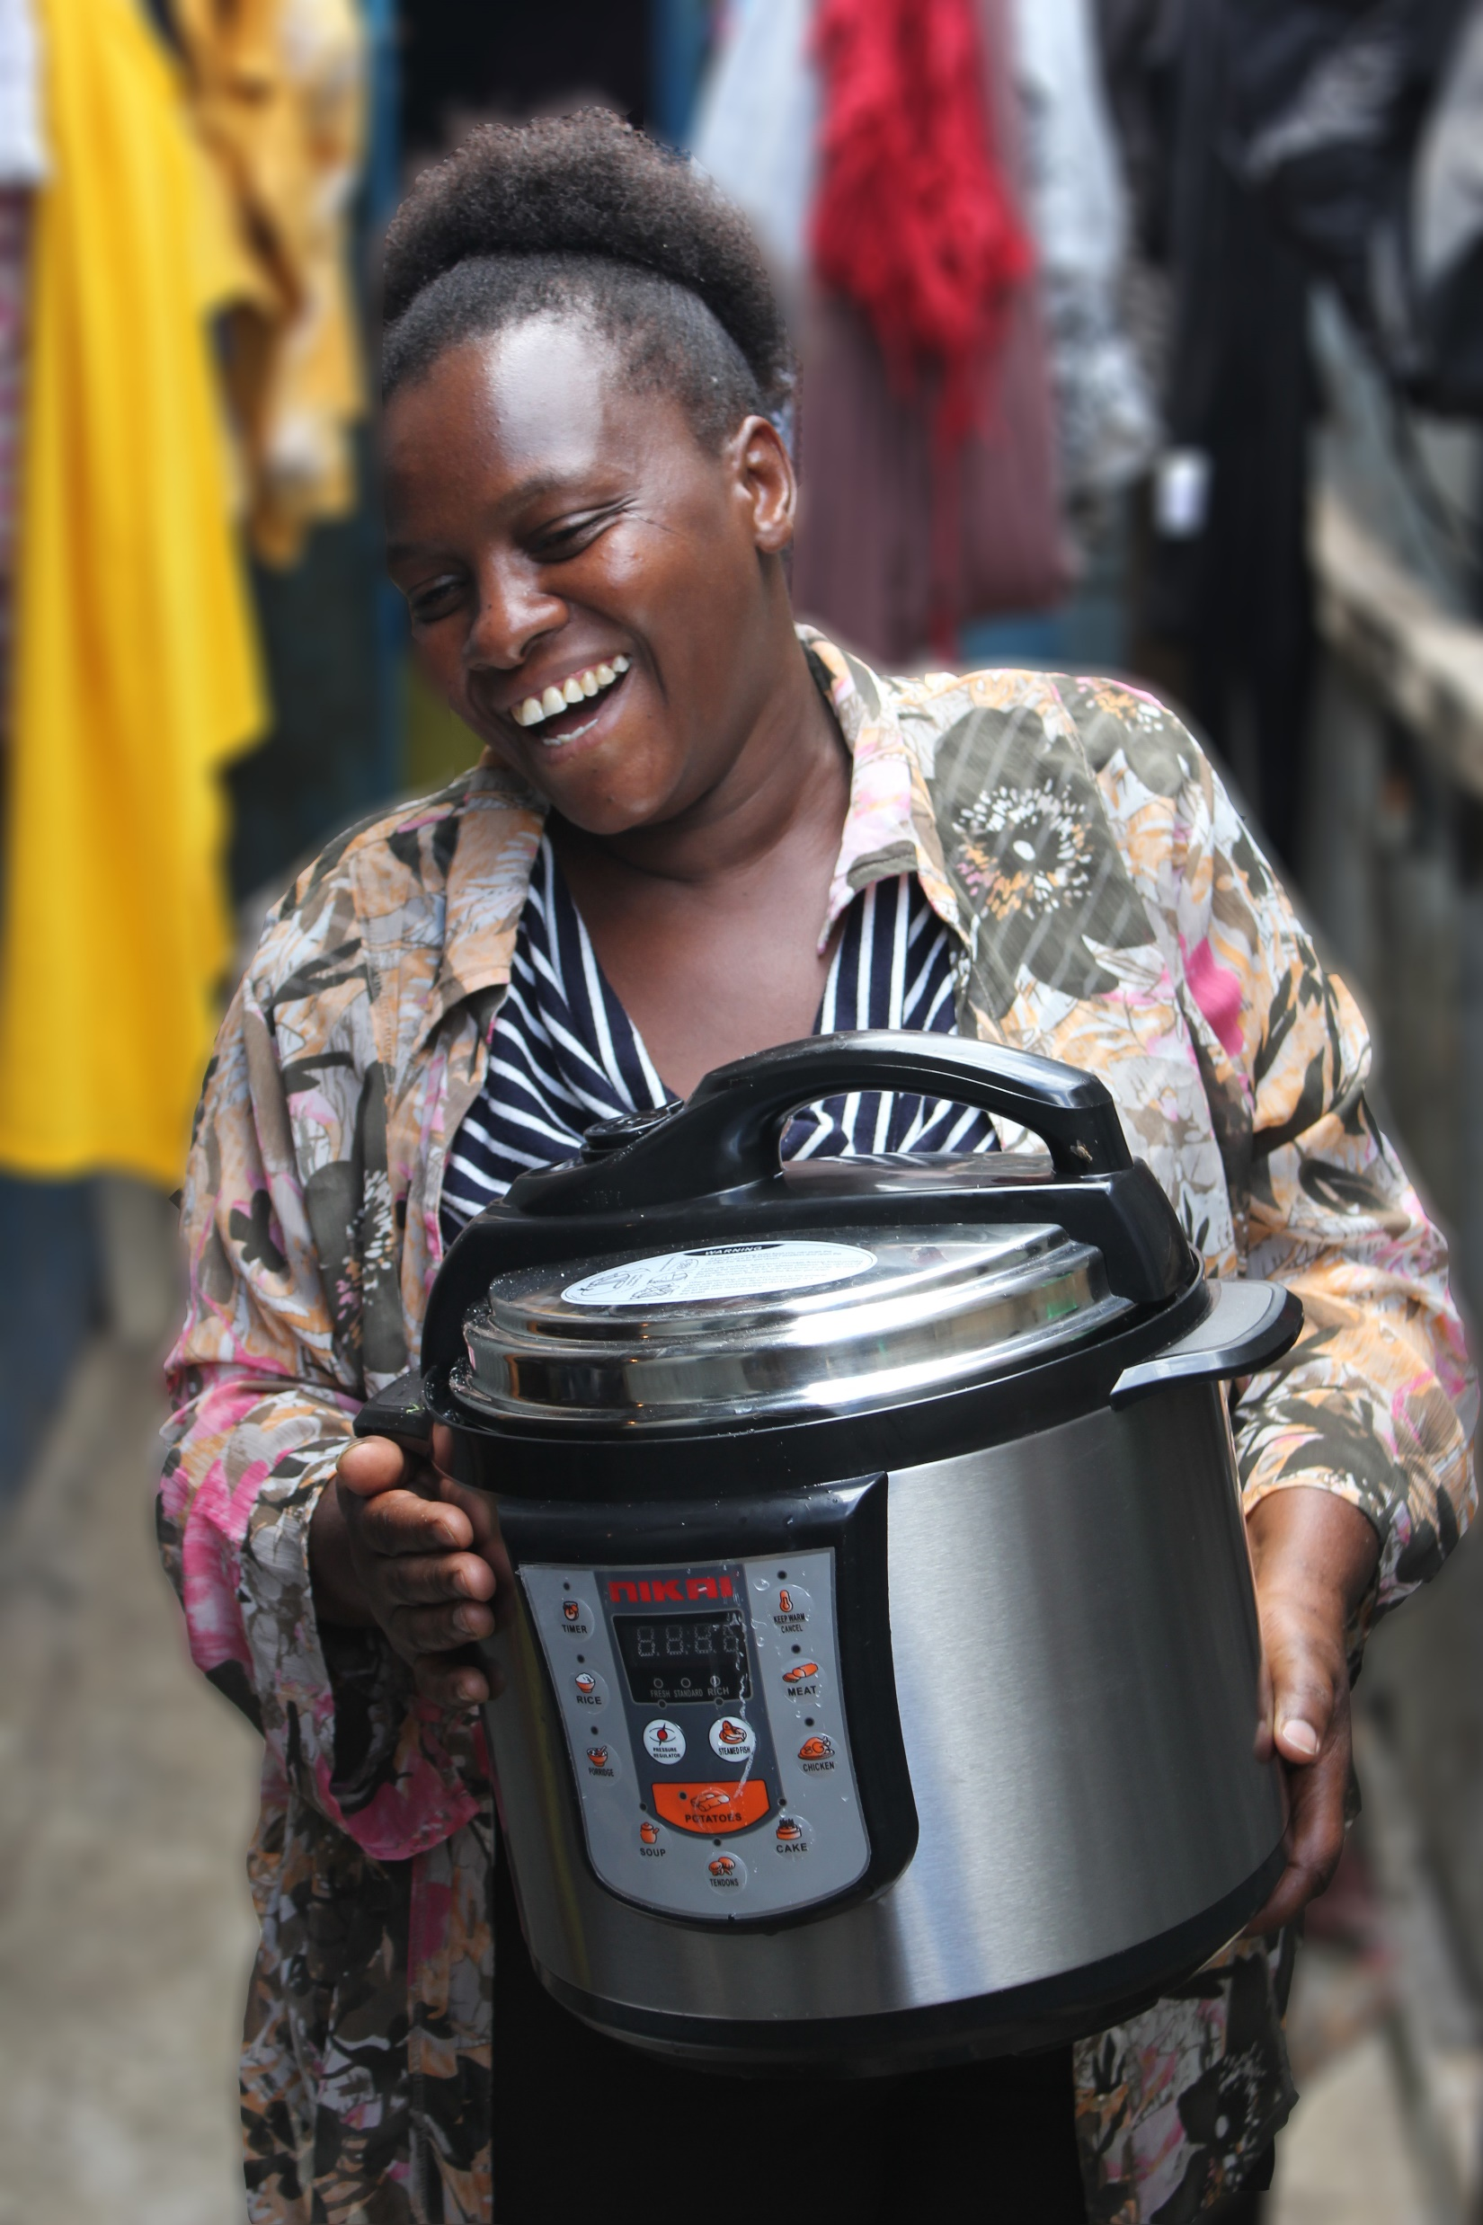
PARIS AGREEMENT ARTICLE 6 AND COOKING TRANSITIONS: Overview and Contexts - MECS Preliminary Findings
Dr Samir Thapa, Research Associate, MECS

Slide 2
Outline
Introduction to MECS and GeCCo
Article 6.2 Cooperative Approach
Status of Cooking Projects
Article 6.4 Paris Agreement Crediting Mechanism
Baseline setting approaches
Fees and contributions
Project Finance

Slide 3
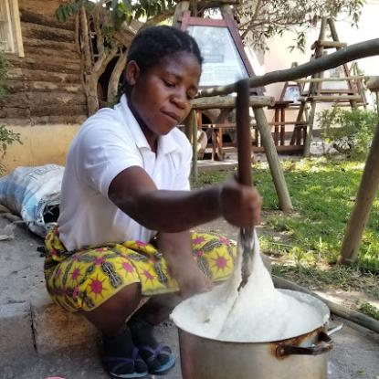
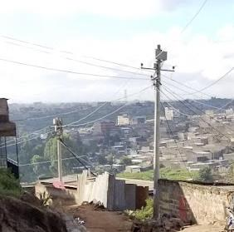
MECS (Modern Energy Cooking Services)
8yr FCDO-funded research & innovation programme
innovation challenge funds
country partnerships
thematic workstreams
WB partnership
Biomass
Modern Energy
Clean cooking
Electricity access
eCooking
Photo credits: Jacob Fodio Todd & Jon Leary @ MECS

Slide 4
GeCCo (The Global eCooking Coalition)
Anchor partners
30+ International Members
Opening commitment = >10% transition in >10 countries
Enable a mass transition to eCooking in at least 10 countries in SSA, Asia, & LAC by 2030, where electricity becomes the cooking fuel of choice for a significant (>10%) proportion of households and institutions.

Slide 5
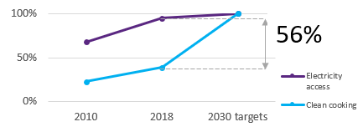
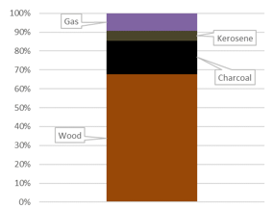
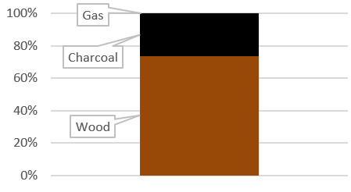
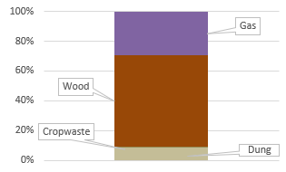
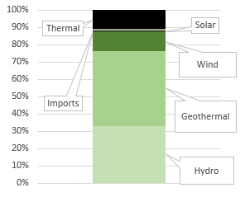
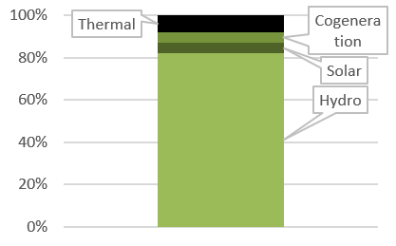
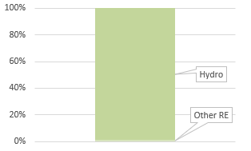
Comparing opportunities for carbon project
Large target market: All 3 countries have >50% connected to electricity, but primarily cooking with polluting fuels
Kenya
Uganda
Nepal
Existing expenditures on commercialized polluting fuels facilitate transition: Majority cook with polluting fuels, but in Kenya & Uganda, charcoal is common in urban areas
Diverse renewable generation is optimal: Electricity generation >90% renewable, but Kenya has the greatest diversity in power generation.
Kenya
Uganda
Nepal
Kenya
Uganda
Nepal

Slide 6
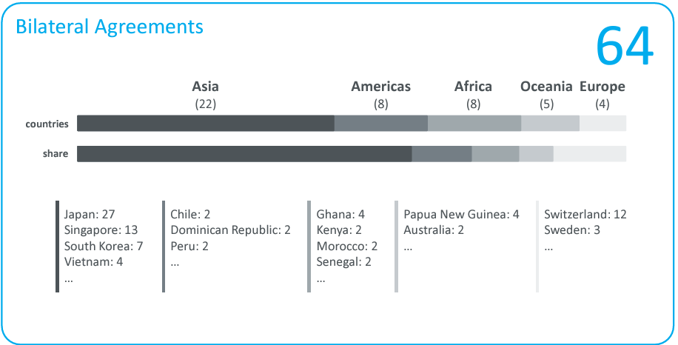
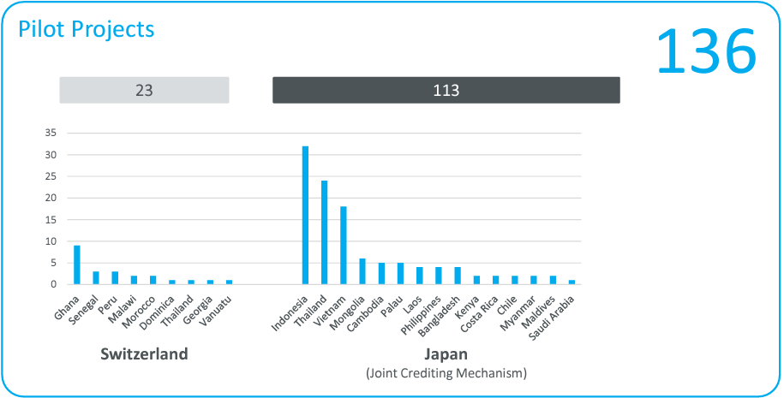
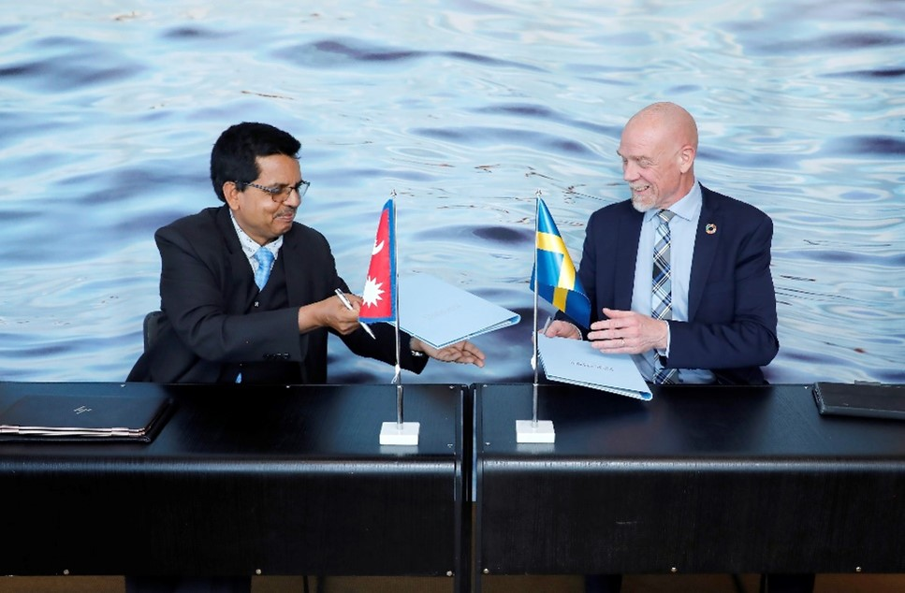
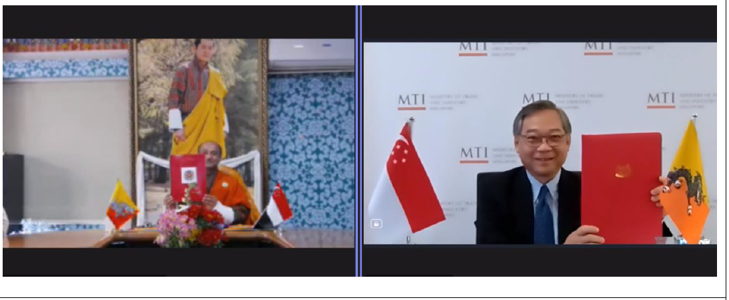
Article 6.2 Status
Memorandum of Agreement
Bilateral agreements and pilot projects
Stockholm, Sweden; 1 June 2022 – Swedish Energy Agency (SEA) and the Government of Nepal, signing a MOU to cooperate on the implementation of PA Article 6.
18 May 2023: Singapore and Bhutan signed MoU to work towards signing a legally binding bilateral agreement that sets out a framework for the international transfer of correspondingly adjusted carbon credits.

Slide 7
Article 6.2 Status
Cooking projects
Title | Host country | Receiving Party | Participating Entity | Expected Reduction (KtCO2e) | Status
Transformative Cookstove Activity in Rural Ghana | Ghana | Switzerland | ACT Commodities | 3,231 | Authorised – validation completed
Tuki Wasi ("Clean Homes"), Improved Cook Stoves | Peru | Switzerland | Klik Foundation and Ruru Tarpuy | 122 | Under Development
Biomass and electric pressure cookers | Ghana | Switzerland | Klik Foundation and UpEnergy | NA | MAIN Development
Ghana Example
Bilateral Agreement | Authorised Date | Crediting Period | Use of ITMOs
23/11/2020 | 31/01/2024 | 2023 - 2030 | Swiss NDC, OIMP, final use as specified by Swiss Confederation

Slide 8
Article 6.4 Related Developments
Standard for the development and assessment of Article 6.4 mechanism methodologies (v 1.0)
Setting the baseline in mechanism methodologies – Draft Standard
Article 6.4 Sustainable Development Tool (v1.0)
Mitigation benefits with host country regulations

Slide 9
Baseline Setting Approaches
I. Based on the Best available technologies (BAT) -
Baseline set based on economically feasible and environmentally sound (comparatively)
Contextual - geographic locations, market penetration, policy drivers
For example: LPG could be considered as the baseline in Bhutan and Nepal for eCooking given 1) the deficit due to LPG imports and 2) the electricity surplus.
II. An ambitious benchmark approach (AB) –
Baseline set at the average emission level of the best performing comparable activities
Already being used in the clean cooking activities because of stacking.
Data available due to existing project data for comparable activities e.g. ICS, LPG Stoves.
III. Based on historical or actual emissions, adjusted downwards (HA) -
Lack of adequate data - actual or historical emissions can be used.
For example – historical or actual emissions of firewood and charcoal use in remote/rural locations.
The value calculated must be adjusted downwards.

Slide 10
Steps – Setting the Crediting Baseline
Calculate difference with downward adjustment between BAU and crediting baseline
Comparison tCO₂e per stove - GS Methodology for Metered and Measured Energy Cooking Devices (MMECD)
Step I | Estimate Baseline – 3 Approaches | Downward Adjustment (DA) | For NDC, LT-LEDS, and Long-Term Temp Goal of PA
Step II | Estimate BAU | BAU - Step I
Step III | If Step II > Step I – No Adjustment
Context/Country | Baseline Approach | Step I – Crediting Baseline |  | Step II – Check |  | Step III
 |  | Baseline Estimate | Downward Adjustment (10%) | BAU | BAU – Step I | I vs II
Urban: Nepal | BAT – LPG | 0.73 | 0.073 | 0.73 | 0.073 (10%) | =
Rural: SSA | HA – Firewood/Charcoal/LPG | 2.01 | 0.201 | 2.23 | 0.424 (19%) | >

Slide 11
Fees and Contributions – Govt. Regulations
Country | Letter of No Objection (US $) | Letter of Authorisation (US $) | Issuance (US $ per tCO₂e) | CA Fee (US $ per tCO₂e) | Consolidated Fund | Benefit Share
Tanzania | 250 to 500¹ | 1% of revenue | 8% of revenue as fee |  | NA | NA
Kenya | 78 to 780¹ | 780 to 1560¹ | 0.1-0.2² | 4 | 25% | 25%^{3,#}
Ghana | 1400 to 2400² | 1000 | 0.01 to 0.2 ² | 3 to 5 ² | NA | NA
Nepal* | 150 to 370² | 370 to 900² | NA | 0.2 | NA | 80%³
¹ Between citizens and non-citizens |  |  |  | ³ of Profit
² Scale (e.g. <15,000) and type (e.g. VCM) dependent |  |  |  | * Draft regulation
 |  |  |  | # Community-owned

Slide 12
Analysis of Price – Leveraging Finance
Scenario/Countries (in US $ per tCO₂e) | Firewood, Charcoal, LPG |  |  | LPG
 | Tanzania | Ghana^{b} | Kenya | Nepal^{b} | Bhutan
Without DA | 2.87 | 10.66 | 10.31 | 7.25 | 6.98
With DA | 3.6 | 11.52 | 11.24 | 8.14 | 6.98
With Operational Costs | 34.6 | 46.12 | 50.55 | 70.02 | 69.76
Leverage Difference | 31.00 | 34.60 | 39.31 | 61.88 | 62.78
Project Features
Crediting Period (Yrs) | Stoves Sold (+10% delta) | ERs generated (tCO₂e) |  | Average Annual ERs (tCO₂e)
 |  | Charcoal, Firewood, LPG | LPG | Charcoal, Firewood, LPG | LPG
5 | 33,578 | 145,834 | 57,832 | 29,167 | 11,567

Slide 13
Way forward for A6 implementation
Data on Specific Energy Consumption - Controlled Cooking Tests –MMECD.
Suppressed Demand – threshold value/s e.g. 5 Liter/day in the case of water sector.
fNRB – Marginal fNRB.
MECS Carbon related resources
https://mecs.org.uk/resources/carbon-financing-for-clean-cooking-projects/

Slide 14
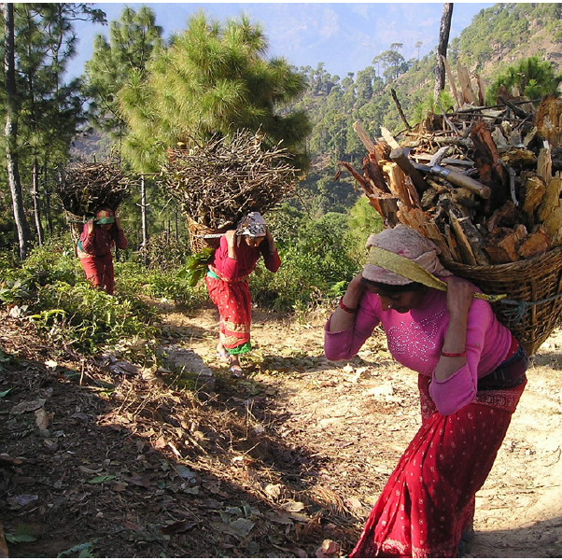
Thank you
Women collecting firewood in rural Nepal. Steinberger, Simon 2010. Open-sourced. Accessed 20 August 2024, < https://pixabay.com/photos/nepal-carrier-baskets-firewood-390/>

